Slide 1
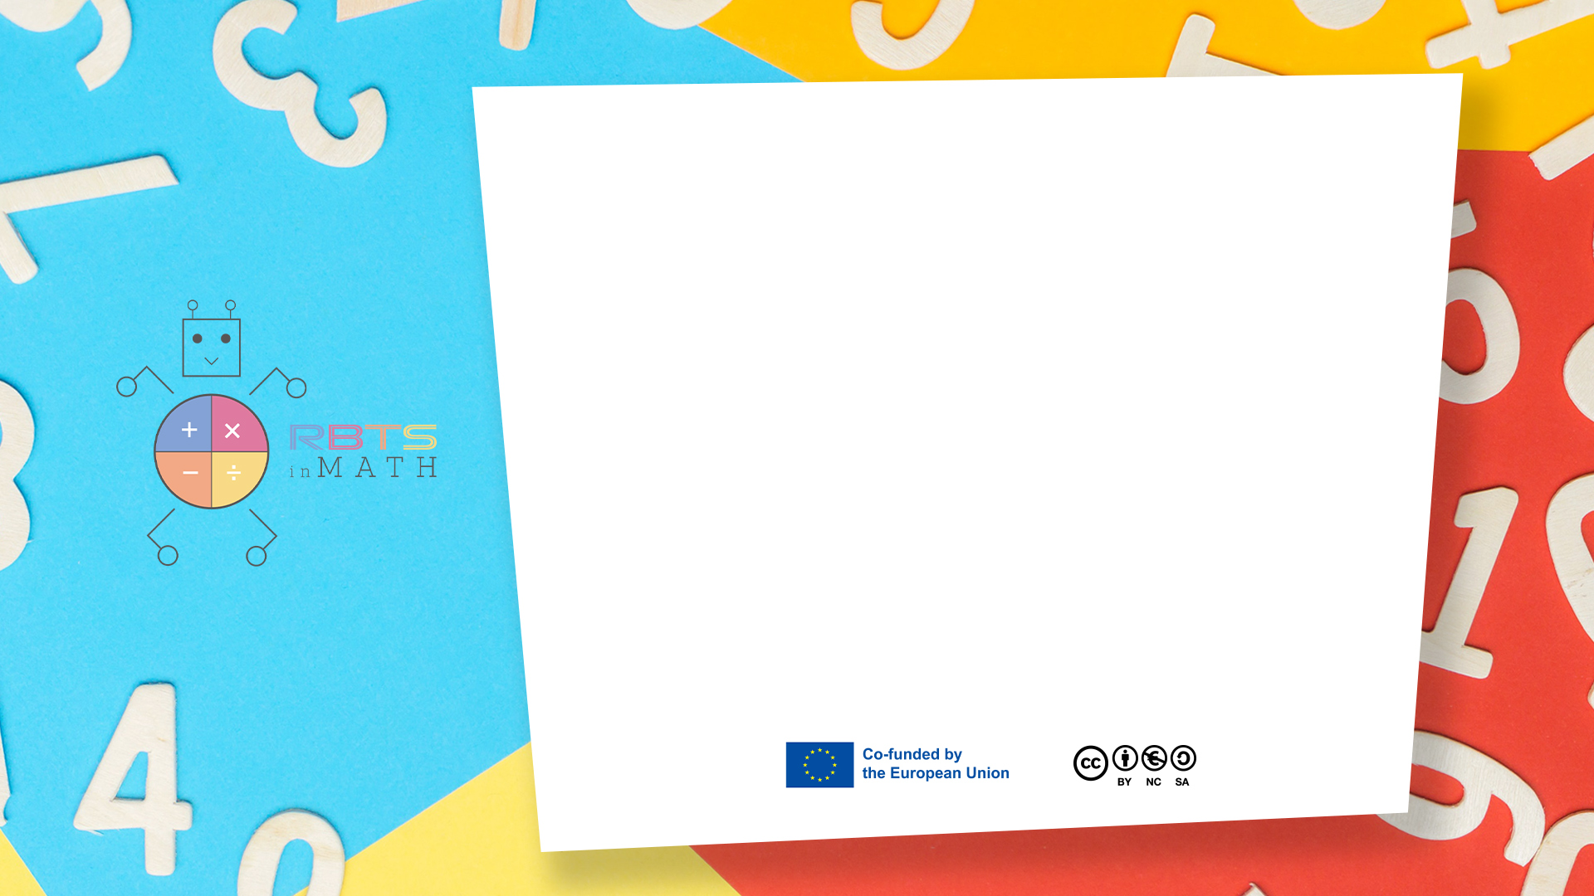
RbtsInMath: Developing Mathematics Achievement
through Using Robotics Applications in Flipped Learning
2022-1-PL01-KA220-HED-000089820
MODULE 10:
CODING AND ROBOTICS TO IMPROVE MATH LEARNING
Lesson 10.1: Cartesian grid with Scratch
Co-funded by the European Union. Views and opinions expressed are however those of the author(s) only and do not necessarily reflect those of the European Union or Fundacja Rozwoju Systemu Edukacji. Neither the European Union nor the granting authority can be held responsible for them.

Slide 2


MODULE 10:
CODING AND ROBOTICS TO IMPROVE MATH LEARNING
Lesson 10.1: Cartesian grid with Scratch
Prepared by:
All the pictures and photographs used in this publication are royalty-free, chosen from open sources.

Slide 3
Cartesian Grid with Scratch
Scratch, with its visual and interactive interface, is an excellent tool for teaching the Cartesian grid and its principles. Here's a step-by-step guide to create an engaging lesson
Co-funded by the European Union. Views and opinions expressed are however those of the author(s) only and do not necessarily reflect those of the European Union or Fundacja Rozwoju Systemu Edukacji. Neither the European Union nor the granting authority can be held responsible for them. Project no. 2022-1-PL01-KA220-HED-000086524

Slide 4
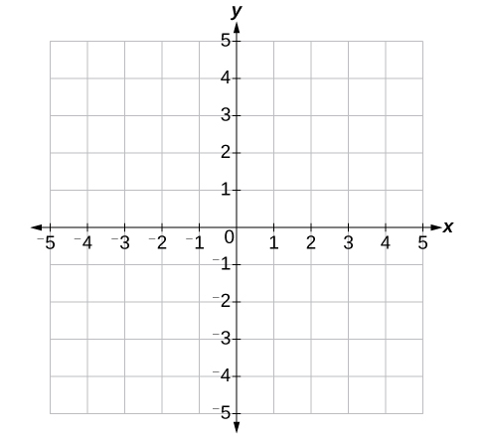
How to set the activity
Preparation
Scratch Interface Basics:
Open Scratch and introduce the stage as a coordinate plane.
Explain that the center of the stage is (0,0), the origin.
x-axis: Horizontal direction (left is negative, right is positive).
y-axis: Vertical direction (down is negative, up is positive).
Point out the edges of the stage:
Left: x = -240, Right: x = 240
Top: y = 180, Bottom: y = -180
Visual Aids:
Add a background with a visible Cartesian grid (available in Scratch or custom uploaded).
Use a sprite (e.g., a character or arrow) to navigate the grid.
Co-funded by the European Union. Views and opinions expressed are however those of the author(s) only and do not necessarily reflect those of the European Union or Fundacja Rozwoju Systemu Edukacji. Neither the European Union nor the granting authority can be held responsible for them. Project no. 2022-1-PL01-KA220-HED-000086524

Slide 5
How to set the activity
Objective: Teach students how to identify and use coordinates.
Initial Setup:
  Add a sprite to the stage.
  Create a simple script for sprite movement:
    go to x: [ ] y: [ ]
Demonstration:
  Enter various coordinates into the block to move the sprite (e.g., x: 100, y: 50).
  Ask students to predict the sprite's position before running the code.
Interactive Task:
  Provide a list of coordinates (e.g., (50, 50), (-100, -50)), and challenge students to move the sprite to each point.
  Discuss what happens when x or y values are negative.
Co-funded by the European Union. Views and opinions expressed are however those of the author(s) only and do not necessarily reflect those of the European Union or Fundacja Rozwoju Systemu Edukacji. Neither the European Union nor the granting authority can be held responsible for them. Project no. 2022-1-PL01-KA220-HED-000086524

Slide 6
How to set the activity
Objective: Teach students how to identify and use coordinates.
Initial Setup:
  Add a sprite to the stage.
  Create a simple script for sprite movement:
    go to x: [ ] y: [ ]
Demonstration:
  Enter various coordinates into the block to move the sprite (e.g., x: 100, y: 50).
  Ask students to predict the sprite's position before running the code.
Interactive Task:
  Provide a list of coordinates (e.g., (50, 50), (-100, -50)), and challenge students to move the sprite to each point.
  Discuss what happens when x or y values are negative.
Co-funded by the European Union. Views and opinions expressed are however those of the author(s) only and do not necessarily reflect those of the European Union or Fundacja Rozwoju Systemu Edukacji. Neither the European Union nor the granting authority can be held responsible for them. Project no. 2022-1-PL01-KA220-HED-000086524

Slide 7
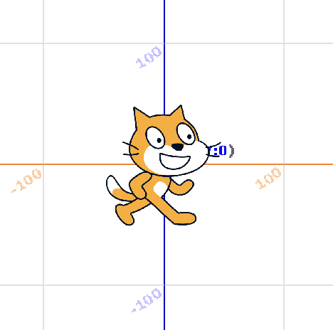
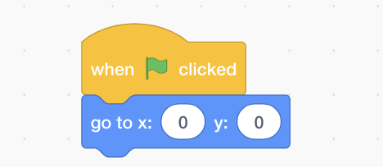

Slide 8
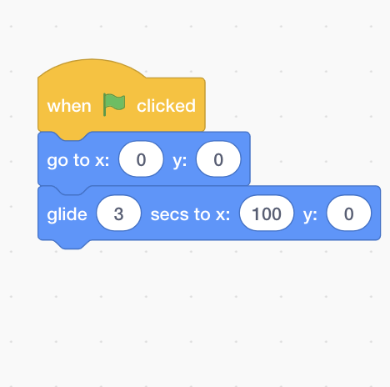

Slide 9
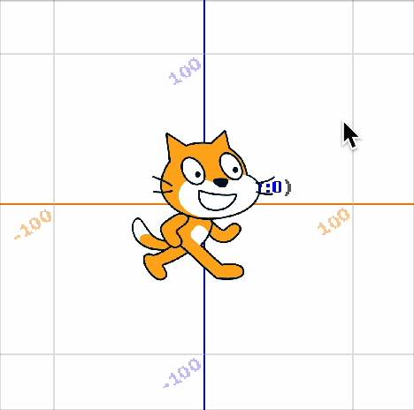

Slide 10

Activity Flow
Learning Outcome:
Understand the Cartesian coordinate system.
Navigate the grid using x and y coordinates.
Apply mathematical concepts in a visual and interactive environment.
Co-funded by the European Union. Views and opinions expressed are however those of the author(s) only and do not necessarily reflect those of the European Union or Fundacja Rozwoju Systemu Edukacji. Neither the European Union nor the granting authority can be held responsible for them. Project no. 2022-1-PL01-KA220-HED-000086524

Slide 11
Thank you for your attention!
Co-funded by the European Union. Views and opinions expressed are however those of the author(s) only and do not necessarily reflect those of the European Union or Fundacja Rozwoju Systemu Edukacji. Neither the European Union nor the granting authority can be held responsible for them. Project no. 2022-1-PL01-KA220-HED-000086524

Slide 12

This document may be copied, reproduced or modified according to the above rules.
In addition, an acknowledgement of the authors of the document and
all applicable portions of the copyright notice must be clearly referenced.
All rights reserved. © Copyright 2023 RbtsInMath

