Slide 1
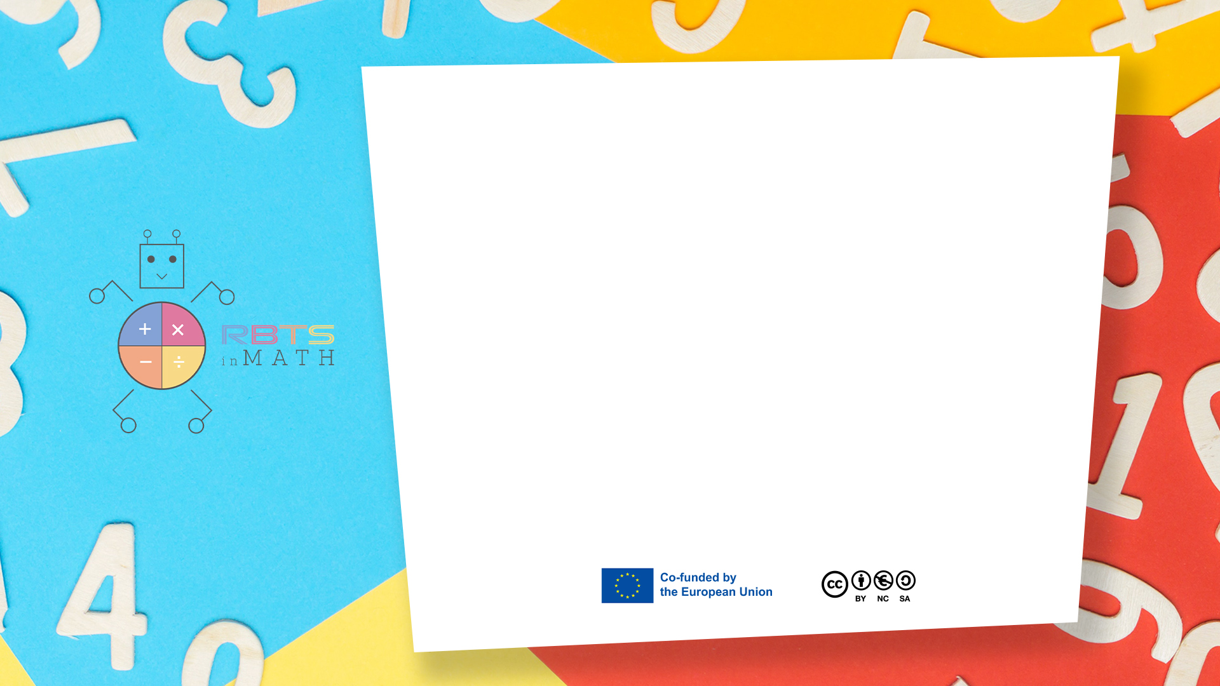
RbtsInMath: Developing Mathematics Achievement through Using Robotics Applications in Flipped Learning
2022-1-PL01-KA220-HED-000089820
MODULE 10: CODING AND ROBOTICS TO IMPROVE MATH LEARNING
Lesson 10.2: Time and Speed
Co-funded by the European Union. Views and opinions expressed are however those of the author(s) only and do not necessarily reflect those of the European Union or Fundacja Rozwoju Systemu Edukacji. Neither the European Union nor the granting authority can be held responsible for them.

Slide 2


MODULE 10: CODING AND ROBOTICS TO IMPROVE MATH LEARNING
Lesson 10.2:Time and Speed
Prepared by:
All the pictures and photographs used in this publication are royalty-free, chosen from open sources.

Slide 3
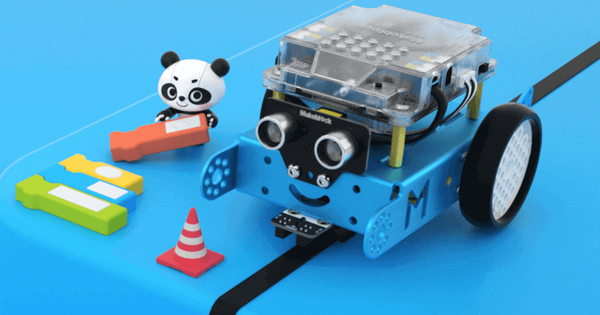
Time and Speed
Help students understand the relationship between distance, time, and speed through programming and experimentation with mBot.
Co-funded by the European Union. Views and opinions expressed are however those of the author(s) only and do not necessarily reflect those of the European Union or Fundacja Rozwoju Systemu Edukacji. Neither the European Union nor the granting authority can be held responsible for them. Project no. 2022-1-PL01-KA220-HED-000086524

Slide 4
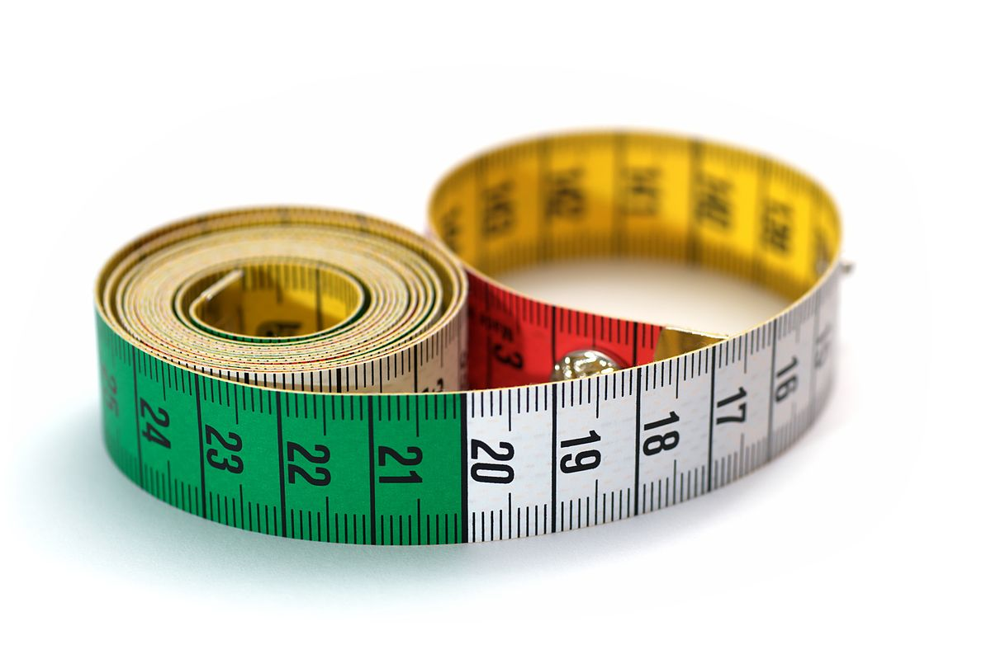
How to set the activity
Materials Needed:
mBot robot.
Measuring tape or ruler.
Stopwatch or a timing app.
A smooth surface (like a long table or floor).
Masking tape or markers to designate start and finish lines.
Questa foto di Autore sconosciuto è concesso in licenza da CC BY-SA
Co-funded by the European Union. Views and opinions expressed are however those of the author(s) only and do not necessarily reflect those of the European Union or Fundacja Rozwoju Systemu Edukacji. Neither the European Union nor the granting authority can be held responsible for them. Project no. 2022-1-PL01-KA220-HED-000086524

Slide 5
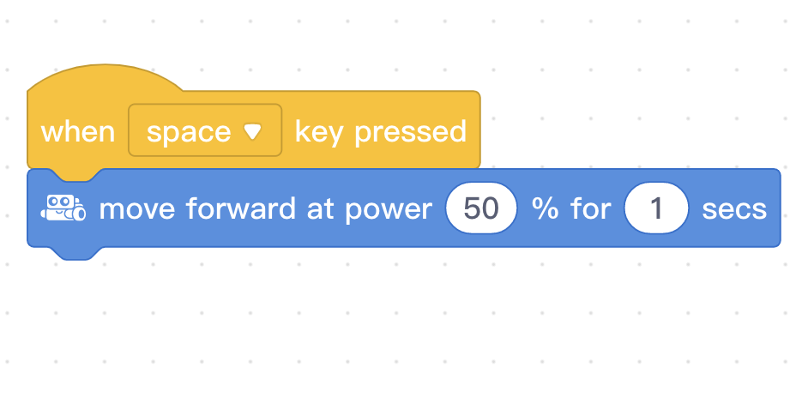
How to set the activity
Concepts Introduced:
Speed = Distance ÷ Time
Units of measurement (e.g., meters per second or centimeters per second).
Setup:
Mark a straight track for mBot (e.g., 1 meter or 100 cm).
Program mBot to move forward at a constant speed.
Steps:
Prediction:
Ask students to guess how long it will take mBot to travel the track.
Experiment:
Use a simple program to move mBot forward at a specific speed.
Start the stopwatch as mBot begins and stop it when it crosses the finish line.
Measurement:
Record the time taken and calculate speed using the formula.
Co-funded by the European Union. Views and opinions expressed are however those of the author(s) only and do not necessarily reflect those of the European Union or Fundacja Rozwoju Systemu Edukacji. Neither the European Union nor the granting authority can be held responsible for them. Project no. 2022-1-PL01-KA220-HED-000086524

Slide 6

Activity Flow
Learning Outcome:
Understand the relationship between speed, distance, and time.
Use mathematical formulas to solve real-world problems.
Develop programming and problem-solving skills through robotics.
Co-funded by the European Union. Views and opinions expressed are however those of the author(s) only and do not necessarily reflect those of the European Union or Fundacja Rozwoju Systemu Edukacji. Neither the European Union nor the granting authority can be held responsible for them. Project no. 2022-1-PL01-KA220-HED-000086524

Slide 7
Thank you for your attention!
Co-funded by the European Union. Views and opinions expressed are however those of the author(s) only and do not necessarily reflect those of the European Union or Fundacja Rozwoju Systemu Edukacji. Neither the European Union nor the granting authority can be held responsible for them. Project no. 2022-1-PL01-KA220-HED-000086524

Slide 8

This document may be copied, reproduced or modified according to the above rules. In addition, an acknowledgement of the authors of the document and all applicable portions of the copyright notice must be clearly referenced.
All rights reserved. © Copyright 2023 RbtsInMath

