Slide 1
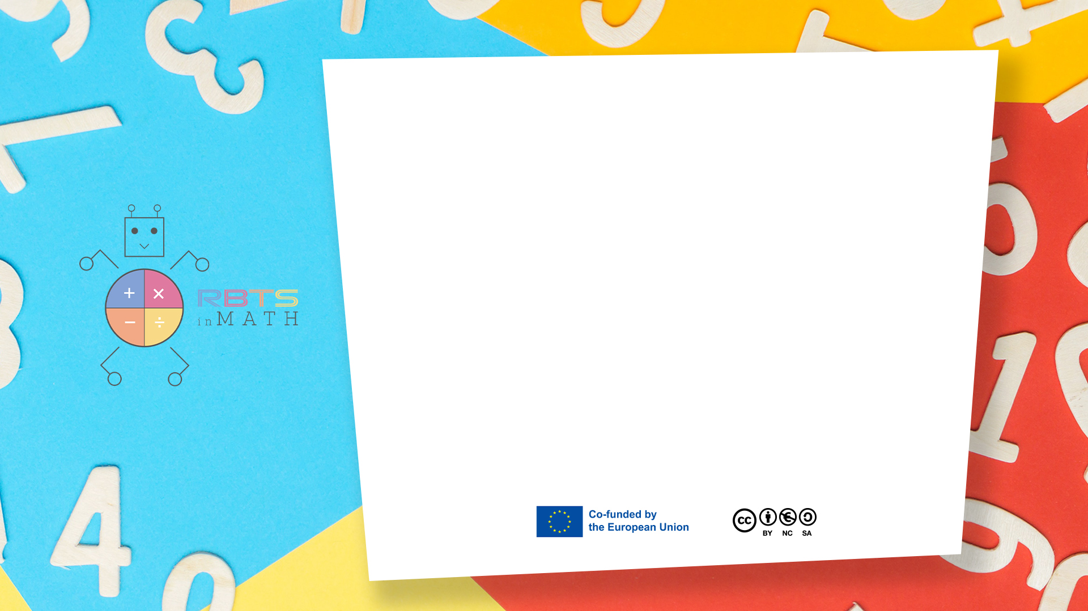
RbtsInMath: Developing Mathematics Achievement through Using Robotics Applications in Flipped Learning
2022-1-PL01-KA220-HED-000089820
MODULE 10: CODING AND ROBOTICS TO IMPROVE MATH LEARNING
Lesson 10.3: Numbers Mat
Co-funded by the European Union. Views and opinions expressed are however those of the author(s) only and do not necessarily reflect those of the European Union or Fundacja Rozwoju Systemu Edukacji. Neither the European Union nor the granting authority can be held responsible for them.

Slide 2


MODULE 10: CODING AND ROBOTICS TO IMPROVE MATH LEARNING
Lesson 10.3: Numbers Mat
Prepared by:
All the pictures and photographs used in this publication are royalty-free, chosen from open sources.

Slide 3
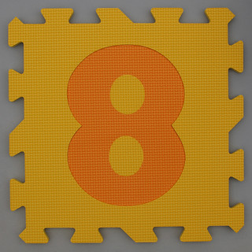
Numbers Mat
A teaching mat for screenless robots (like Bee-Bot, Blue-Bot, or similar) can effectively engage students in learning numbers through interactive and hands-on activities. Here's a step-by-step guide to design and use the mat.
Co-funded by the European Union. Views and opinions expressed are however those of the author(s) only and do not necessarily reflect those of the European Union or Fundacja Rozwoju Systemu Edukacji. Neither the European Union nor the granting authority can be held responsible for them. Project no. 2022-1-PL01-KA220-HED-000086524

Slide 4
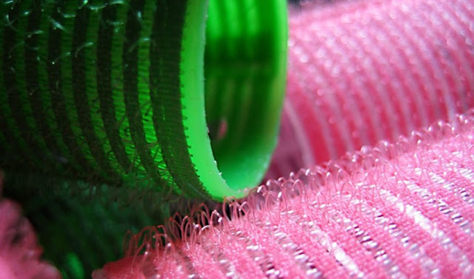
How to set the activity
Materials Needed:
Large sheet of durable material (e.g., laminated poster board, vinyl, or fabric).
A grid layout (10x10 grid works well).
Markers or printed stickers for numbers and decorations.
Optional: Velcro or pockets to attach task cards.
Questa foto di Autore sconosciuto è concesso in licenza da CC BY-NC-ND
Co-funded by the European Union. Views and opinions expressed are however those of the author(s) only and do not necessarily reflect those of the European Union or Fundacja Rozwoju Systemu Edukacji. Neither the European Union nor the granting authority can be held responsible for them. Project no. 2022-1-PL01-KA220-HED-000086524

Slide 5
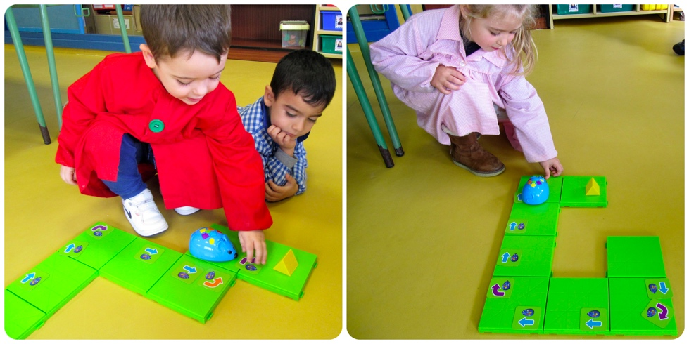
How to set the activity
Activity 1: Number Recognition
Objective: Help students identify and navigate to specific numbers.
Setup:
Call out a number (e.g., "Find 7").
Students program the robot to move to that number.
Extensions:
Use clues like "The number after 6" or "An odd number between 5 and 10."
Co-funded by the European Union. Views and opinions expressed are however those of the author(s) only and do not necessarily reflect those of the European Union or Fundacja Rozwoju Systemu Edukacji. Neither the European Union nor the granting authority can be held responsible for them. Project no. 2022-1-PL01-KA220-HED-000086524

Slide 6

Activity Flow
Asks Cards: Provide pre-designed challenges like “Start at 2, add 3, then subtract 1.”
Obstacle Course: Add barriers or "no-go zones" to increase difficulty.
Themes: Adapt the mat to seasonal or curricular themes (e.g., numbers in a garden with flowers or in space with planets).
Co-funded by the European Union. Views and opinions expressed are however those of the author(s) only and do not necessarily reflect those of the European Union or Fundacja Rozwoju Systemu Edukacji. Neither the European Union nor the granting authority can be held responsible for them. Project no. 2022-1-PL01-KA220-HED-000086524

Slide 7
Thank you for your attention!
Co-funded by the European Union. Views and opinions expressed are however those of the author(s) only and do not necessarily reflect those of the European Union or Fundacja Rozwoju Systemu Edukacji. Neither the European Union nor the granting authority can be held responsible for them. Project no. 2022-1-PL01-KA220-HED-000086524

Slide 8

This document may be copied, reproduced or modified according to the above rules. In addition, an acknowledgement of the authors of the document and all applicable portions of the copyright notice must be clearly referenced.
All rights reserved. © Copyright 2023 RbtsInMath

