Slide 1
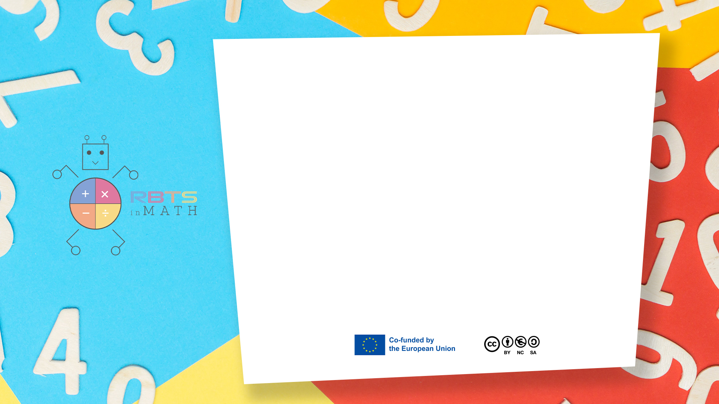
RbtsInMath: Developing Mathematics Achievement
through Using Robotics Applications in Flipped Learning
2022-1-PL01-KA220-HED-000089820
MODULE 10:
CODING AND ROBOTICS TO IMPROVE MATH LEARNING
Lesson 10.5: Exploring Mathematical Concepts Through Robotics
Co-funded by the European Union. Views and opinions expressed are however those of the author(s) only and do not necessarily reflect those of the European Union or Fundacja Rozwoju Systemu Edukacji. Neither the European Union nor the granting authority can be held responsible for them.

Slide 2


MODULE 10:
CODING AND ROBOTICS TO IMPROVE MATH LEARNING
Lesson 10.5: Exploring Mathematical Concepts Through Robotics
Prepared by:
All the pictures and photographs used in this publication are royalty-free, chosen from open sources.

Slide 3
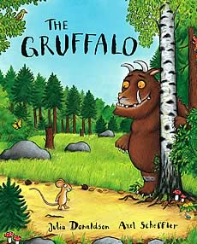
Exploring Mathematical Concepts Through Robotics
Use LEGO SPIKE ESSENTIAL to make math interactive and fun
Focus on geometry, numerical operations, and patterns
Integrate storytelling with mathematical concepts
Questa foto di Autore sconosciuto è concesso in licenza da CC BY-SA
Co-funded by the European Union. Views and opinions expressed are however those of the author(s) only and do not necessarily reflect those of the European Union or Fundacja Rozwoju Systemu Edukacji. Neither the European Union nor the granting authority can be held responsible for them. Project no. 2022-1-PL01-KA220-HED-000086524

Slide 4
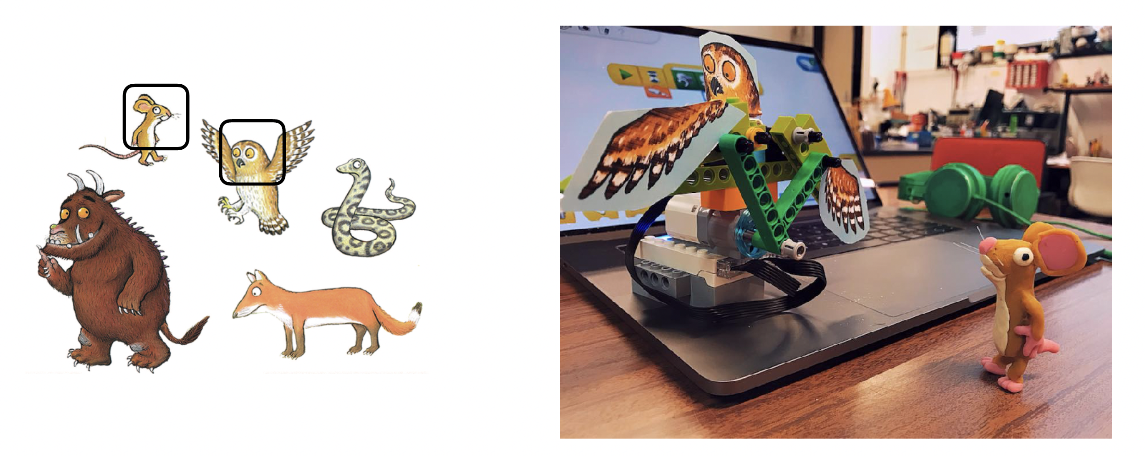
How to set the activity
Building the Owl and other puppets
Focus on geometric shapes and structures
Explore symmetry and measurements while building
Discuss mathematical patterns in the Gruffalo story
Co-funded by the European Union. Views and opinions expressed are however those of the author(s) only and do not necessarily reflect those of the European Union or Fundacja Rozwoju Systemu Edukacji. Neither the European Union nor the granting authority can be held responsible for them. Project no. 2022-1-PL01-KA220-HED-000086524

Slide 5
How to set the activity
Activity 1: Number Recognition
Use the IR sensor to detect distances
Understand sensor readings to numerical values
Create a program to calculate and display results dynamically
Co-funded by the European Union. Views and opinions expressed are however those of the author(s) only and do not necessarily reflect those of the European Union or Fundacja Rozwoju Systemu Edukacji. Neither the European Union nor the granting authority can be held responsible for them. Project no. 2022-1-PL01-KA220-HED-000086524

Slide 6

4C: Activity Flow
1. Connect: Relate math to storytelling (Gruffalo)
2. Construct: Build physical models using LEGO
3. Contemplate: Reflect on mathematical patterns and principles
4. Continue: Extend learning to new challenges
Co-funded by the European Union. Views and opinions expressed are however those of the author(s) only and do not necessarily reflect those of the European Union or Fundacja Rozwoju Systemu Edukacji. Neither the European Union nor the granting authority can be held responsible for them. Project no. 2022-1-PL01-KA220-HED-000086524

Slide 7
Thank you for your attention!
Co-funded by the European Union. Views and opinions expressed are however those of the author(s) only and do not necessarily reflect those of the European Union or Fundacja Rozwoju Systemu Edukacji. Neither the European Union nor the granting authority can be held responsible for them. Project no. 2022-1-PL01-KA220-HED-000086524

Slide 8
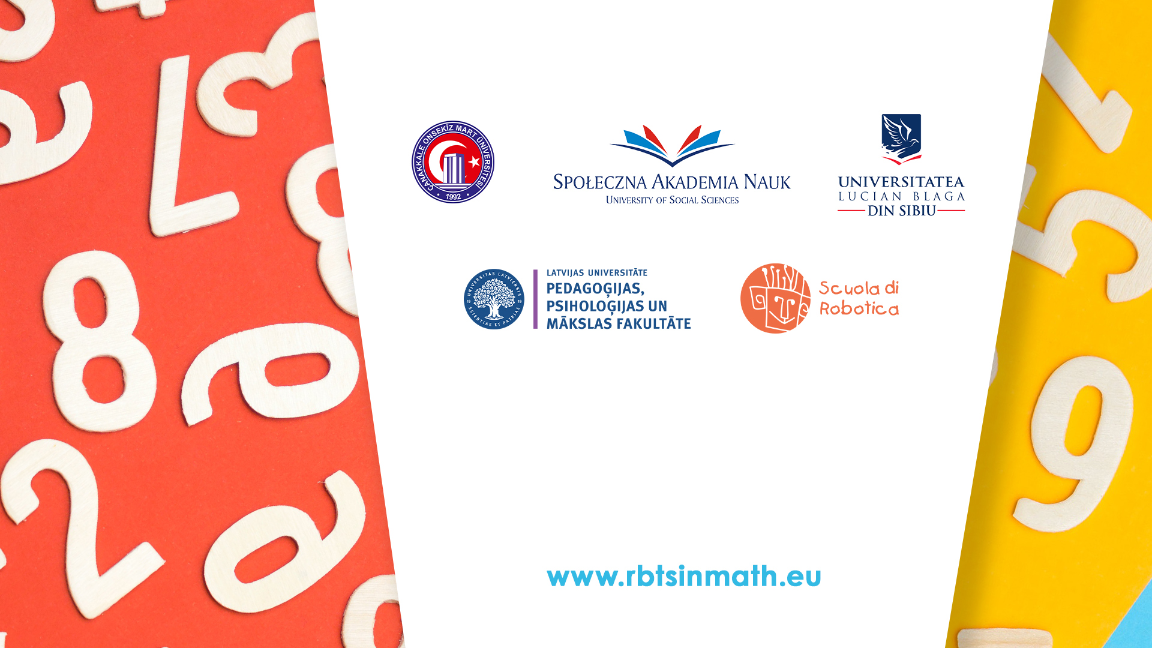
This document may be copied, reproduced or modified according to the above rules.
In addition, an acknowledgement of the authors of the document and
all applicable portions of the copyright notice must be clearly referenced.
All rights reserved. © Copyright 2023 RbtsInMath

