Slide 1

RbtsInMath: Developing Mathematics Achievement through Using Robotics Applications in Flipped Learning
2022-1-PL01-KA220-HED-000089820
MODULE 1: LEARNING THEORIES
Lesson 1.1.1: What is Learning?
Co-funded by the European Union. Views and opinions expressed are however those of the author(s) only and do not necessarily reflect those of the European Union or Fundacja Rozwoju Systemu Edukacji. Neither the European Union nor the granting authority can be held responsible for them.

Slide 2


MODULE 1: LEARNING THEORIES
Lesson 1.1.1: What is Learning?
Prepared by:
All the pictures and photographs used in this publication are royalty-free, chosen from open sources.

Slide 3
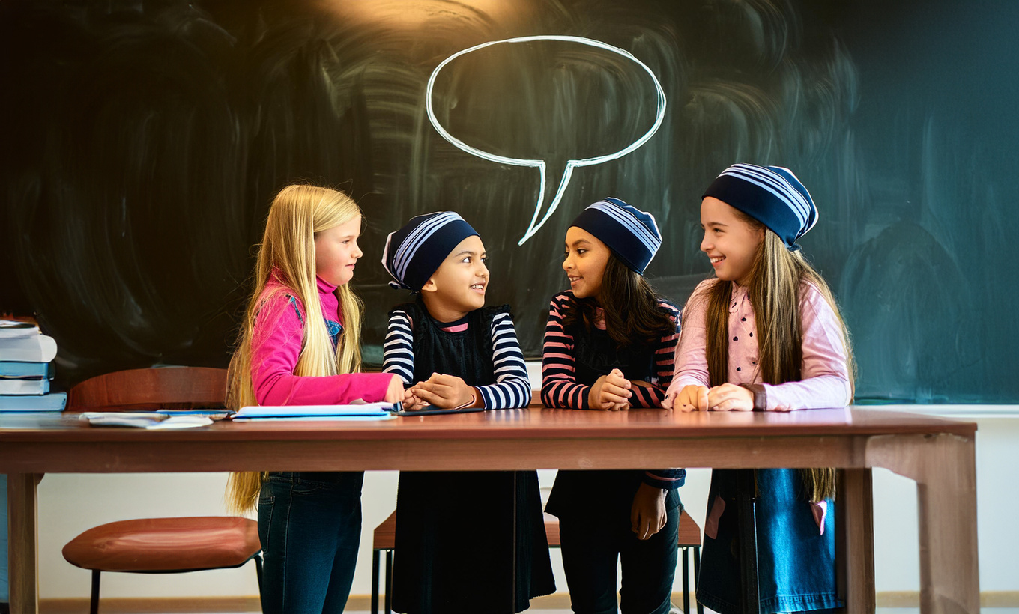
Lesson 1.1.1: What is Learning?
Hello friends, do you know how we learn?
Co-funded by the European Union. Views and opinions expressed are however those of the author(s) only and do not necessarily reflect those of the European Union or Fundacja Rozwoju Systemu Edukacji. Neither the European Union nor the granting authority can be held responsible for them. Project no. 2022-1-PL01-KA220-HED-000086524

Slide 4

Lesson 1.1.1: What is Learning?
All living things in the world show many behaviors and reactions in order to continue their lives. Each behavior sometimes appears as an adaptation process, sometimes as a struggle for survival, and sometimes as a reaction process. So how do living things carry out this process, how do they develop, how do they adapt, how do they know how to react?
Co-funded by the European Union. Views and opinions expressed are however those of the author(s) only and do not necessarily reflect those of the European Union or Fundacja Rozwoju Systemu Edukacji. Neither the European Union nor the granting authority can be held responsible for them. Project no. 2022-1-PL01-KA220-HED-000086524

Slide 5


Lesson 1.1.1: What is Learning?
If we want to base the answer to all these questions on an action whose subject is alive. What could this action be? Here, the most basic action and the concept of this action is "learning".
These learnings can be innate, like crying when hungry. These learnings can be in the form of reflexes, such as blinking when something comes to your eye. These learnings can be directed towards physical actions, such as crawling, walking, playing the guitar
Co-funded by the European Union. Views and opinions expressed are however those of the author(s) only and do not necessarily reflect those of the European Union or Fundacja Rozwoju Systemu Edukacji. Neither the European Union nor the granting authority can be held responsible for them. Project no. 2022-1-PL01-KA220-HED-000086524

Slide 6
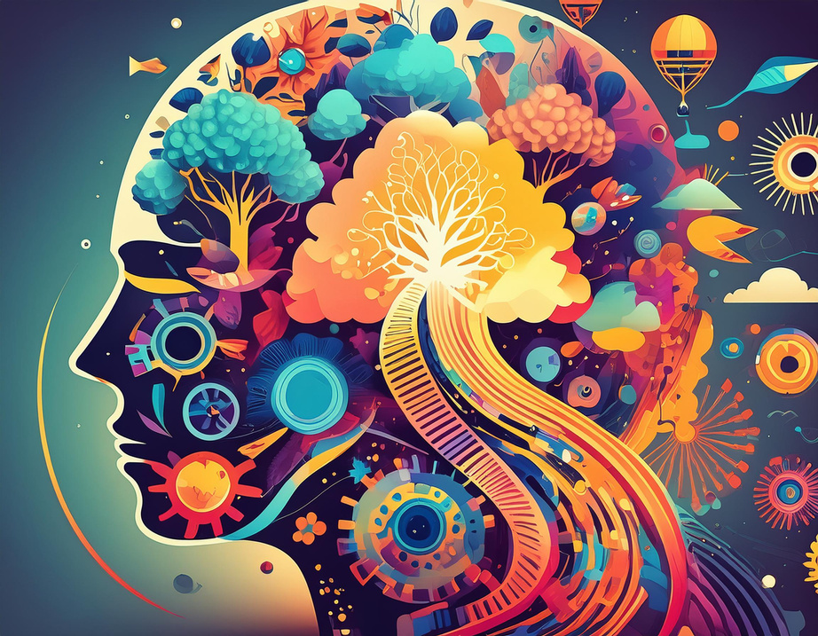
Lesson 1.1.1: What is Learning?
Learning involves acquiring and modifying knowledge, skills, strategies, beliefs, attitudes, and behaviors. People learn cognitive, linguistic, motor, and social skills, and these can take many forms.
Co-funded by the European Union. Views and opinions expressed are however those of the author(s) only and do not necessarily reflect those of the European Union or Fundacja Rozwoju Systemu Edukacji. Neither the European Union nor the granting authority can be held responsible for them. Project no. 2022-1-PL01-KA220-HED-000086524

Slide 7

Lesson 1.1.1: What is Learning?
Of course, their learning can be cognitive, social, affective, psychomotor, etc. It is not at all easy to separate. Although a learning product is not for a single area, it can show a very complex structure.
Co-funded by the European Union. Views and opinions expressed are however those of the author(s) only and do not necessarily reflect those of the European Union or Fundacja Rozwoju Systemu Edukacji. Neither the European Union nor the granting authority can be held responsible for them. Project no. 2022-1-PL01-KA220-HED-000086524

Slide 8
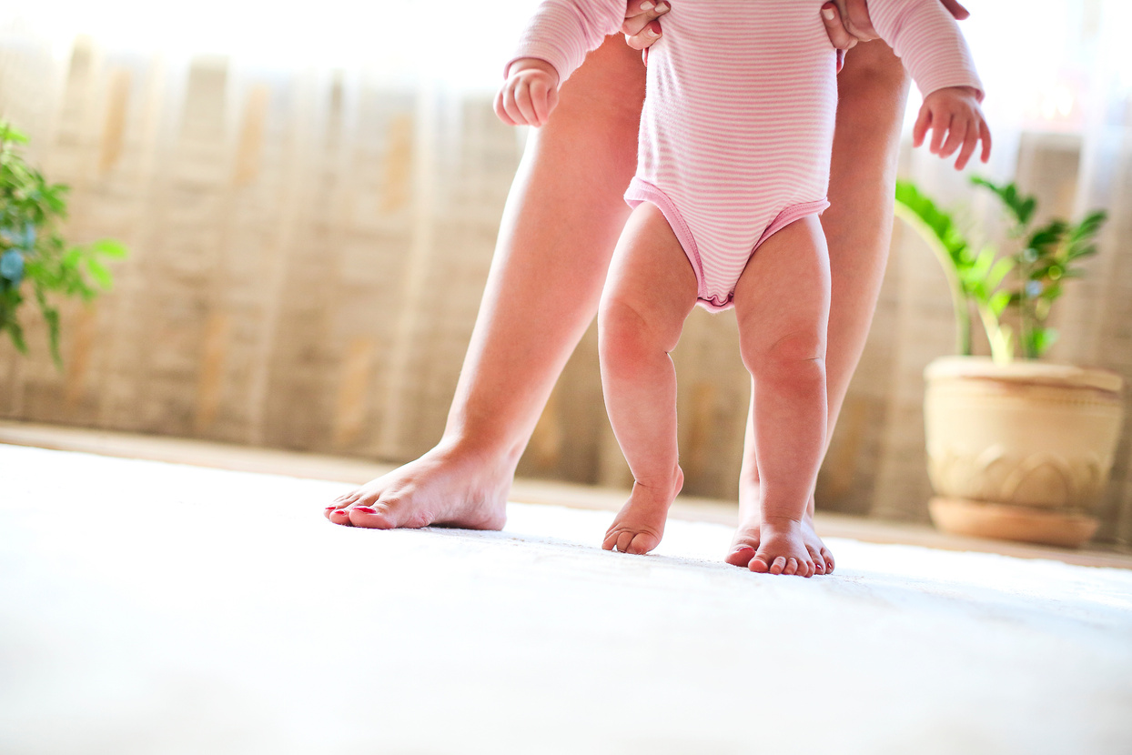
Lesson 1.1.1: What is Learning?
There have been many definitions for “learning” over the centuries, but Shuell (1986) emphasizes that there is no single definition of learning accepted by theorists, researchers and practitioners. Because the definition of learning changes according to the point of view of “learning”.
Co-funded by the European Union. Views and opinions expressed are however those of the author(s) only and do not necessarily reflect those of the European Union or Fundacja Rozwoju Systemu Edukacji. Neither the European Union nor the granting authority can be held responsible for them. Project no. 2022-1-PL01-KA220-HED-000086524

Slide 9

Lesson 1.1.1: What is Learning?
Let's form groups of 5 people in the class. And let's write a poem about LEARNING together.
Co-funded by the European Union. Views and opinions expressed are however those of the author(s) only and do not necessarily reflect those of the European Union or Fundacja Rozwoju Systemu Edukacji. Neither the European Union nor the granting authority can be held responsible for them. Project no. 2022-1-PL01-KA220-HED-000086524

Slide 10

Lesson 1.1.1: What is Learning?
Pre-service teachers are asked to collaborate and use a behavioral approach in the poetry writing process. They are asked to write the poems written in class on the board.
Co-funded by the European Union. Views and opinions expressed are however those of the author(s) only and do not necessarily reflect those of the European Union or Fundacja Rozwoju Systemu Edukacji. Neither the European Union nor the granting authority can be held responsible for them. Project no. 2022-1-PL01-KA220-HED-000086524

Slide 11


Lesson 1.1.1: What is Learning?
Teacher candidate are introduced to new concepts in this process.
Information is given about these concepts.
What is behavioral approach?
What is
collaborative
learning?
Why were groups of 5 people
created?
Co-funded by the European Union. Views and opinions expressed are however those of the author(s) only and do not necessarily reflect those of the European Union or Fundacja Rozwoju Systemu Edukacji. Neither the European Union nor the granting authority can be held responsible for them. Project no. 2022-1-PL01-KA220-HED-000086524

Slide 12

Lesson 1.1.1: What is Learning?
At the end of the lesson, teacher candidates are asked to write a poem about relearning within the theories they have learned.
Co-funded by the European Union. Views and opinions expressed are however those of the author(s) only and do not necessarily reflect those of the European Union or Fundacja Rozwoju Systemu Edukacji. Neither the European Union nor the granting authority can be held responsible for them. Project no. 2022-1-PL01-KA220-HED-000086524

Slide 13
Conclusion
In essence, learning is the fundamental action through which all living beings acquire and adapt their behaviors, skills, and knowledge.
It encompasses a diverse array of cognitive, linguistic, motor, and social abilities, forming a complex structure that defies easy categorization.
Despite the multitude of definitions proposed over the centuries, learning remains an evolving concept, shaped by various perspectives and contexts.
As Shuell (1986) noted, no single definition universally satisfies all theorists, researchers, and practitioners. Ultimately, learning is a dynamic and multifaceted process essential to the survival and development of all living organisms.
Co-funded by the European Union. Views and opinions expressed are however those of the author(s) only and do not necessarily reflect those of the European Union or Fundacja Rozwoju Systemu Edukacji. Neither the European Union nor the granting authority can be held responsible for them. Project no. 2022-1-PL01-KA220-HED-000086524

Slide 14
Thank you for your attention!
Co-funded by the European Union. Views and opinions expressed are however those of the author(s) only and do not necessarily reflect those of the European Union or Fundacja Rozwoju Systemu Edukacji. Neither the European Union nor the granting authority can be held responsible for them. Project no. 2022-1-PL01-KA220-HED-000086524

Slide 15

This document may be copied, reproduced or modified according to the above rules. In addition, an acknowledgement of the authors of the document and all applicable portions of the copyright notice must be clearly referenced.
All rights reserved. © Copyright 2023 RbtsInMath

