Slide 1

RbtsInMath: Developing Mathematics Achievement
through Using Robotics Applications in Flipped Learning
2022-1-PL01-KA220-HED-000089820
MODULE 1:
LEARNING THEORIES
Lesson 1.1.2: Learning Theories
Co-funded by the European Union. Views and opinions expressed are however those of the author(s) only and do not necessarily reflect those of the European Union or Fundacja Rozwoju Systemu Edukacji. Neither the European Union nor the granting authority can be held responsible for them.

Slide 2


MODULE 1:
LEARNING THEORIES
Lesson 1.1.2: Learning Theories
Prepared by:
All the pictures and photographs used in this publication are royalty-free, chosen from open sources.

Slide 3

Lesson 1.1.2: Learning Theories
The concept of learning, which constitutes a large part of human behavior, has been tried to be explained by many learning theories, especially under the control of behaviorists and cognitive theorists (Akman, 2018).
Co-funded by the European Union. Views and opinions expressed are however those of the author(s) only and do not necessarily reflect those of the European Union or Fundacja Rozwoju Systemu Edukacji. Neither the European Union nor the granting authority can be held responsible for them. Project no. 2022-1-PL01-KA220-HED-000086524

Slide 4

Lesson 1.1.2: Learning Theories
Regardless of which learning theory is used, both learning theorists and practitioners, namely educators, "how can education be best done?" seeks an answer to the question. Learning theories emerged with this search.
Co-funded by the European Union. Views and opinions expressed are however those of the author(s) only and do not necessarily reflect those of the European Union or Fundacja Rozwoju Systemu Edukacji. Neither the European Union nor the granting authority can be held responsible for them. Project no. 2022-1-PL01-KA220-HED-000086524

Slide 5
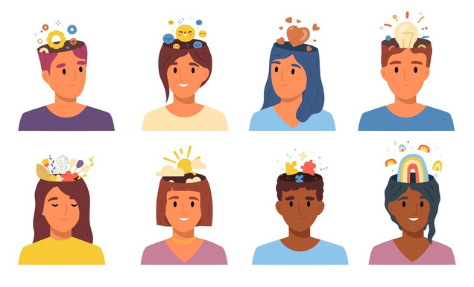
Lesson 1.1.2: Learning Theories
In this sense, the most widely accepted classification learning theories can be considered in six categories: behavioral, cognitive, affective, social, brain-based and constructivist theory.
Co-funded by the European Union. Views and opinions expressed are however those of the author(s) only and do not necessarily reflect those of the European Union or Fundacja Rozwoju Systemu Edukacji. Neither the European Union nor the granting authority can be held responsible for them. Project no. 2022-1-PL01-KA220-HED-000086524

Slide 6

Lesson 1.1.2: Learning Theories
Behavioral theories explain learning in terms of the stimulus-behavior relationship. It states that learning takes place by establishing a link between the stimulus and the behavior, and behavior is gained through reinforcement (Akkaya, 2015).
Co-funded by the European Union. Views and opinions expressed are however those of the author(s) only and do not necessarily reflect those of the European Union or Fundacja Rozwoju Systemu Edukacji. Neither the European Union nor the granting authority can be held responsible for them. Project no. 2022-1-PL01-KA220-HED-000086524

Slide 7

Lesson 1.1.2: Learning Theories
They argue that learning is only a product, and positive and desirable behaviors emerge as a result of learning. They are interested in changes in behavior and the stimuli that cause them.
Co-funded by the European Union. Views and opinions expressed are however those of the author(s) only and do not necessarily reflect those of the European Union or Fundacja Rozwoju Systemu Edukacji. Neither the European Union nor the granting authority can be held responsible for them. Project no. 2022-1-PL01-KA220-HED-000086524

Slide 8

Lesson 1.1.2: Learning Theories
Reinforcement plays an important role in learning. Repetition is important in acquiring skills and ensuring the permanence of what has been learned. In this approach, motivation has a very important place in learning (Yılmaz, 2009).
Co-funded by the European Union. Views and opinions expressed are however those of the author(s) only and do not necessarily reflect those of the European Union or Fundacja Rozwoju Systemu Edukacji. Neither the European Union nor the granting authority can be held responsible for them. Project no. 2022-1-PL01-KA220-HED-000086524

Slide 9

Lesson 1.1.2: Learning Theories
Behavioral Learning Theory
Yes, what did you learn for your classes at the end of this course?
How can you implement it?
Co-funded by the European Union. Views and opinions expressed are however those of the author(s) only and do not necessarily reflect those of the European Union or Fundacja Rozwoju Systemu Edukacji. Neither the European Union nor the granting authority can be held responsible for them. Project no. 2022-1-PL01-KA220-HED-000086524

Slide 10
Conclusion
Learning theories have long sought to explain the complex process of human behavior.
Dominated by behaviorists and cognitive theorists, these theories aim to answer the pivotal question: "How can education be best done?" Among the most recognized are six categories: behavioral, cognitive, affective, social, brain-based, and constructivist theories.
Behavioral theories, in particular, focus on the stimulus-behavior relationship, asserting that learning occurs through reinforcement and repetition, which solidify skills and behaviors.
Motivation is crucial in this process, highlighting the importance of external stimuli in shaping positive and desirable behaviors.
Co-funded by the European Union. Views and opinions expressed are however those of the author(s) only and do not necessarily reflect those of the European Union or Fundacja Rozwoju Systemu Edukacji. Neither the European Union nor the granting authority can be held responsible for them. Project no. 2022-1-PL01-KA220-HED-000086524

Slide 11
Thank you for your attention!
Co-funded by the European Union. Views and opinions expressed are however those of the author(s) only and do not necessarily reflect those of the European Union or Fundacja Rozwoju Systemu Edukacji. Neither the European Union nor the granting authority can be held responsible for them.Project no. 2022-1-PL01-KA220-HED-000086524

Slide 12

This document may be copied, reproduced or modified according to the above rules.
In addition, an acknowledgement of the authors of the document and
all applicable portions of the copyright notice must be clearly referenced.
All rights reserved. © Copyright 2023 RbtsInMath

