Slide 1

RbtsInMath: Developing Mathematics Achievement through Using Robotics Applications in Flipped Learning
2022-1-PL01-KA220-HED-000089820
MODULE 1: LEARNING THEORIES
Lesson 1.2: Cognitive
Learning Theories
Co-funded by the European Union. Views and opinions expressed are however those of the author(s) only and do not necessarily reflect those of the European Union or Fundacja Rozwoju Systemu Edukacji. Neither the European Union nor the granting authority can be held responsible for them.

Slide 2


MODULE 1: LEARNING THEORIES
Lesson 1.2: Cognitive Learning Theories
Prepared by:
All the pictures and photographs used in this publication are royalty-free, chosen from open sources.

Slide 3

Lesson 1.2: Cognitive Learning Theories
The class was divided into heterogeneous groups of five each.
Their teacher asked them to conduct research on personal theory. The students eagerly embarked on their task, spending long hours in the library, online, and pouring over reference books.
Co-funded by the European Union. Views and opinions expressed are however those of the author(s) only and do not necessarily reflect those of the European Union or Fundacja Rozwoju Systemu Edukacji. Neither the European Union nor the granting authority can be held responsible for them. Project no. 2022-1-PL01-KA220-HED-000086524

Slide 4

Lesson 1.2: Cognitive Learning Theories
Each group delved into their findings, transferring them onto mind maps. The mind maps, filled with colorful markers, large letters, and various symbols, were a reflection of each student's thoughts. Eventually, each group completed their own mind map and pinned it up on the board.
Co-funded by the European Union. Views and opinions expressed are however those of the author(s) only and do not necessarily reflect those of the European Union or Fundacja Rozwoju Systemu Edukacji. Neither the European Union nor the granting authority can be held responsible for them. Project no. 2022-1-PL01-KA220-HED-000086524

Slide 5

Lesson 1.2: Cognitive Learning Theories
The sight of the pinned mind maps drew the attention of the entire class. Students inspected each other's maps, took notes, and shared ideas. An environment for sharing knowledge had been created, and each student was brimming with new information learned from others' research.
Funded by the European Union. Views and opinions expressed are however those of the author(s) only and do not necessarily reflect those of the European Union or the European Education and Culture Executive Agency (EACEA). Neither the European Union nor EACEA can be held responsible for them. Project no. 2022-1-PL01-KA220-HED-000086524

Slide 6
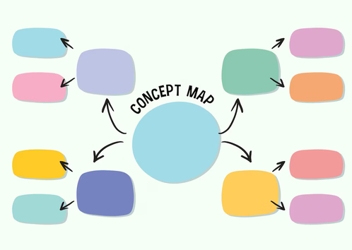
Lesson 1.2: Cognitive Learning Theories
In the end, each member of the class synthesized their group's research into a deep understanding of cognitive theory. This collaborative experience, filled with teamwork and knowledge sharing, strengthened the class bonds and provided students with a fresh perspective.
Co-funded by the European Union. Views and opinions expressed are however those of the author(s) only and do not necessarily reflect those of the European Union or Fundacja Rozwoju Systemu Edukacji. Neither the European Union nor the granting authority can be held responsible for them. Project no. 2022-1-PL01-KA220-HED-000086524

Slide 7

Lesson 1.2: Cognitive Learning Theories
Cognitive learning theories focus on mental processes in the learner's understanding of the environment in the learning process. According to them, contrary to the behavioral theory, learning is a much more complex event than the stimulus-response relationship and learning cannot be observed directly. Cognitive learning can be explained as the development and change in human mental structures.
Co-funded by the European Union. Views and opinions expressed are however those of the author(s) only and do not necessarily reflect those of the European Union or Fundacja Rozwoju Systemu Edukacji. Neither the European Union nor the granting authority can be held responsible for them. Project no. 2022-1-PL01-KA220-HED-000086524

Slide 8
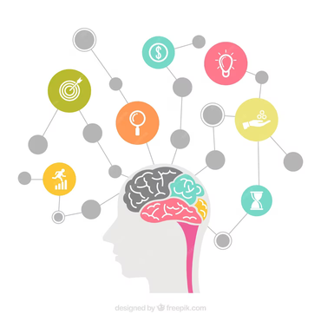
Lesson 1.2: Cognitive Learning Theories
Cognitive Theorists, unlike behaviorists in general; They state that the information is not received exactly by the individual, that the individual gives meaning to the information in his own world, that he/she passes through his/her own filter and interprets each information and that each information can change from person to person depending on the interpretation of the information.
Co-funded by the European Union. Views and opinions expressed are however those of the author(s) only and do not necessarily reflect those of the European Union or Fundacja Rozwoju Systemu Edukacji. Neither the European Union nor the granting authority can be held responsible for them. Project no. 2022-1-PL01-KA220-HED-000086524

Slide 9
Conclusion
Cognitive learning theories emphasize the intricate mental processes involved in understanding the environment, contrasting with the simpler stimulus-response framework of behavioral theories.
Cognitive theorists argue that learning involves the development and alteration of mental structures, with individuals interpreting information uniquely based on their perspectives.
Thus, learning is a complex, internal process that varies from person to person, reflecting the subjective nature of how information is processed and understood.
Co-funded by the European Union. Views and opinions expressed are however those of the author(s) only and do not necessarily reflect those of the European Union or Fundacja Rozwoju Systemu Edukacji. Neither the European Union nor the granting authority can be held responsible for them. Project no. 2022-1-PL01-KA220-HED-000086524

Slide 10
Thank you for your attention!
Co-funded by the European Union. Views and opinions expressed are however those of the author(s) only and do not necessarily reflect those of the European Union or Fundacja Rozwoju Systemu Edukacji. Neither the European Union nor the granting authority can be held responsible for them. Project no. 2022-1-PL01-KA220-HED-000086524

Slide 11

This document may be copied, reproduced or modified according to the above rules. In addition, an acknowledgement of the authors of the document and all applicable portions of the copyright notice must be clearly referenced.
All rights reserved. © Copyright 2023 RbtsInMath

