Slide 1

RbtsInMath: Developing Mathematics Achievement
through Using Robotics Applications in Flipped Learning
2022-1-PL01-KA220-HED-000089820
MODULE 1:
LEARNING THEORIES
Lesson 1.3.2: Social
Learning Theory
Co-funded by the European Union. Views and opinions expressed are however those of the author(s) only and do not necessarily reflect those of the European Union or Fundacja Rozwoju Systemu Edukacji. Neither the European Union nor the granting authority can be held responsible for them.

Slide 2


MODULE 1:
LEARNING THEORIES
Lesson 1.3.2: Social Learning Theory
Prepared by:
All the pictures and photographs used in this publication are royalty-free, chosen from open sources.

Slide 3
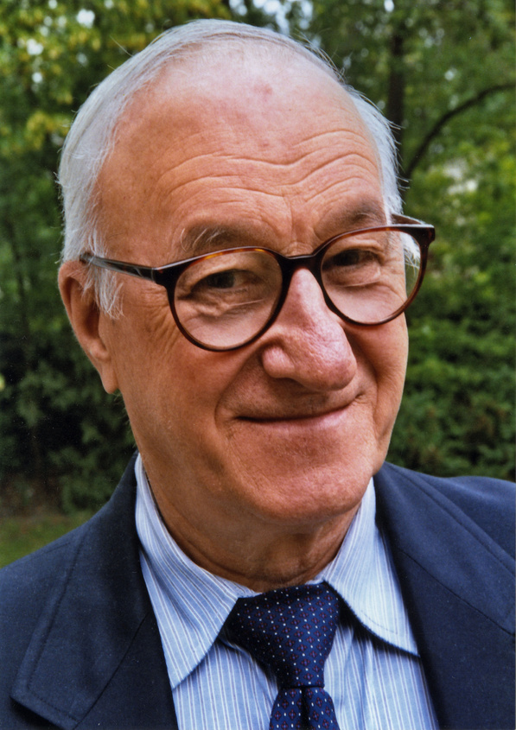
Lesson 1.3.2: Social Learning Theory
Bandura is one of the leading advocates of social learning theory and states that individuals observe other people in the environment and show behaviors that are beneficial to them (Bandura, 1991).
Co-funded by the European Union. Views and opinions expressed are however those of the author(s) only and do not necessarily reflect those of the European Union or Fundacja Rozwoju Systemu Edukacji. Neither the European Union nor the granting authority can be held responsible for them. Project no. 2022-1-PL01-KA220-HED-000086524

Slide 4

Lesson 1.3.2: Social Learning Theory
Bandura developed the concepts of "Learning through Observation" and "Learning through Modeling" (Akman, 2018).
We can explain learning by modeling as imitating the behavior of other individuals. We can explain learning by observation as learning by observing other individuals.
Co-funded by the European Union. Views and opinions expressed are however those of the author(s) only and do not necessarily reflect those of the European Union or Fundacja Rozwoju Systemu Edukacji. Neither the European Union nor the granting authority can be held responsible for them. Project no. 2022-1-PL01-KA220-HED-000086524

Slide 5

Lesson 1.3.2: Social Learning Theory
Social learning focuses on observation, not experience, as in conditioning. Slavin (2012) in learning by observation; It states that there are stages such as attention, remembering, application and motivation (Akman, 2018).
Co-funded by the European Union. Views and opinions expressed are however those of the author(s) only and do not necessarily reflect those of the European Union or Fundacja Rozwoju Systemu Edukacji. Neither the European Union nor the granting authority can be held responsible for them. Project no. 2022-1-PL01-KA220-HED-000086524

Slide 6

Lesson 1.3.2: Social Learning Theory
Social learning theory does not mean learning only by observation and repetition of behavior with reinforcement. Observation also has the function of informing the individual. Behaviors taken as a model, which is an important element in the social learning process, can be preserved and changed. Observed behaviors encoded in the memory of the individual can be recalled when necessary (Gürel, 2014; cited in Bal, 2020).
Co-funded by the European Union. Views and opinions expressed are however those of the author(s) only and do not necessarily reflect those of the European Union or Fundacja Rozwoju Systemu Edukacji. Neither the European Union nor the granting authority can be held responsible for them. Project no. 2022-1-PL01-KA220-HED-000086524

Slide 7
Conclusion
Bandura's social learning theory emphasizes learning through observation and modeling, where individuals imitate behaviors seen in their environment.
Unlike conditioning, this theory focuses on stages such as attention, remembering, application, and motivation.
Social learning extends beyond mere observation and repetition, as it also informs the individual.
Behaviors observed and encoded in memory can be recalled and modified as needed, highlighting the dynamic nature of social learning.
Co-funded by the European Union. Views and opinions expressed are however those of the author(s) only and do not necessarily reflect those of the European Union or Fundacja Rozwoju Systemu Edukacji. Neither the European Union nor the granting authority can be held responsible for them. Project no. 2022-1-PL01-KA220-HED-000086524

Slide 8
Thank you for your attention!
Co-funded by the European Union. Views and opinions expressed are however those of the author(s) only and do not necessarily reflect those of the European Union or Fundacja Rozwoju Systemu Edukacji. Neither the European Union nor the granting authority can be held responsible for them.Project no. 2022-1-PL01-KA220-HED-000086524

Slide 9

This document may be copied, reproduced or modified according to the above rules.
In addition, an acknowledgement of the authors of the document and
all applicable portions of the copyright notice must be clearly referenced.
All rights reserved. © Copyright 2023 RbtsInMath

