Slide 1
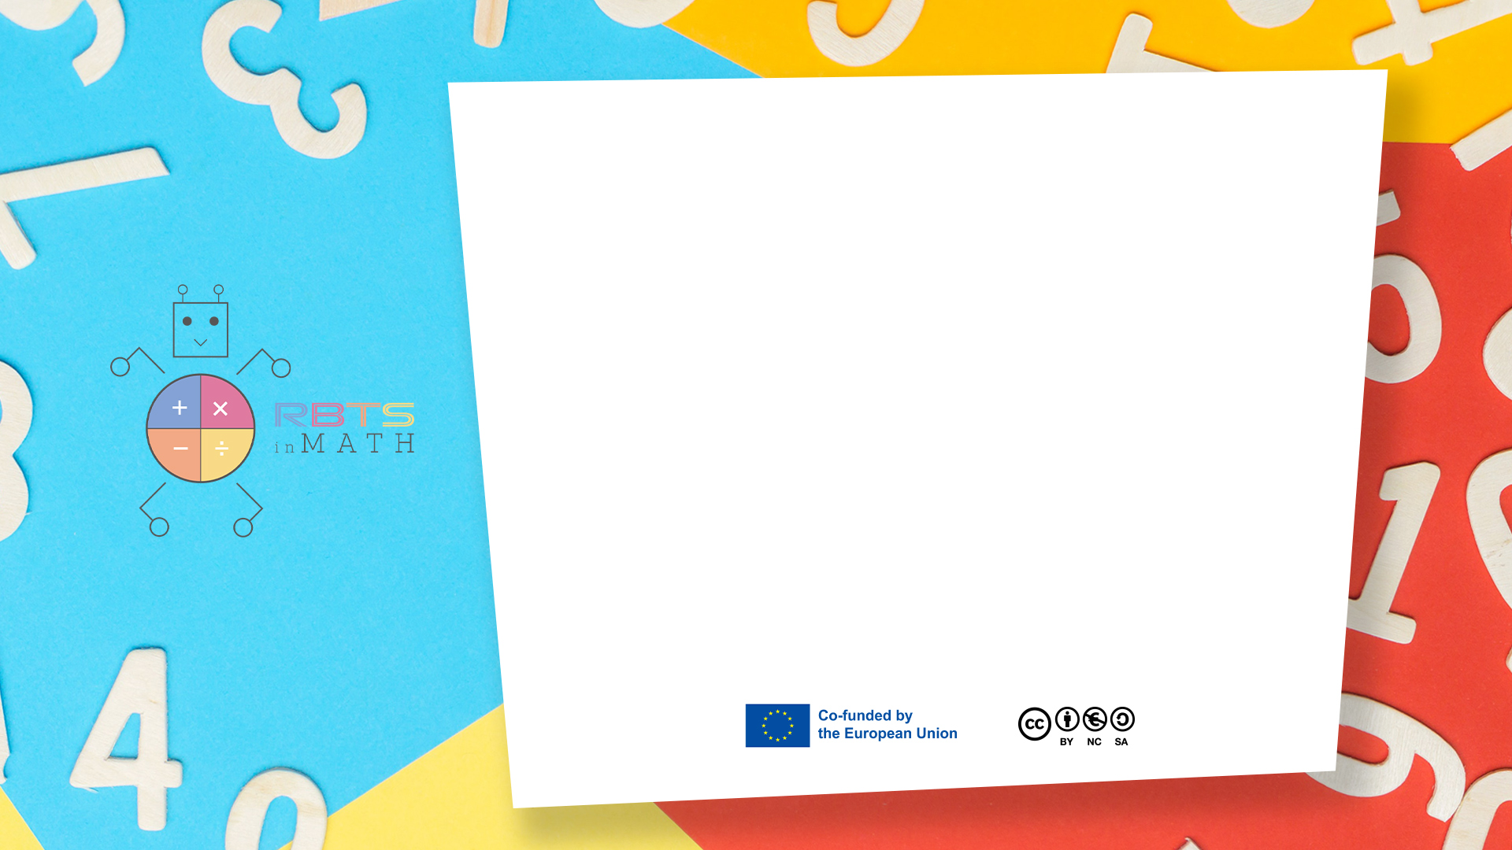
RbtsInMath: Developing Mathematics Achievement through Using Robotics Applications in Flipped Learning
2022-1-PL01-KA220-HED-000089820
MODULE 1: LEARNING THEORIES
Lesson 1.3.3: Brain Based
Learning Theory
Co-funded by the European Union. Views and opinions expressed are however those of the author(s) only and do not necessarily reflect those of the European Union or Fundacja Rozwoju Systemu Edukacji. Neither the European Union nor the granting authority can be held responsible for them.

Slide 2


MODULE 1: LEARNING THEORIES
Lesson 1.3.3: Brain Based Learning Theory
Prepared by:
All the pictures and photographs used in this publication are royalty-free, chosen from open sources.

Slide 3
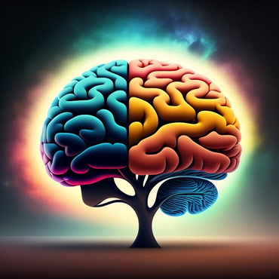
Lesson 1.3.3: Brain Based Learning Theory
Although neuroscience research has been conducted for several years in medicine and the sciences, it has recently become of interest to educators because of the instructional implications of research findings.
Co-funded by the European Union. Views and opinions expressed are however those of the author(s) only and do not necessarily reflect those of the European Union or Fundacja Rozwoju Systemu Edukacji. Neither the European Union nor the granting authority can be held responsible for them. Project no. 2022-1-PL01-KA220-HED-000086524

Slide 4

Lesson 1.3.3: Brain Based Learning Theory
Brain-Based Learning Theory, which deals with learning from a neurophysiological perspective, explains the learning process as biochemical and electrochemical changes.
According to this theory, a connection is established between brain cells during the learning process. New learning means new bonds between cells (Kaya, 2012).
Co-funded by the European Union. Views and opinions expressed are however those of the author(s) only and do not necessarily reflect those of the European Union or Fundacja Rozwoju Systemu Edukacji. Neither the European Union nor the granting authority can be held responsible for them. Project no. 2022-1-PL01-KA220-HED-000086524

Slide 5

Lesson 1.3.3: Brain Based Learning Theory
According to Hebb, one of the advocates of brain-based learning, there are certain methods and techniques of learning, and learning takes place through reasoning. The concepts of learning include inductive, deductive and specific-to-specific learning criteria. All this happens through reasoning. The method of learning through reasoning has been proven as the most effective and guaranteed method among learning techniques as a result of researches.
Co-funded by the European Union. Views and opinions expressed are however those of the author(s) only and do not necessarily reflect those of the European Union or Fundacja Rozwoju Systemu Edukacji. Neither the European Union nor the granting authority can be held responsible for them. Project no. 2022-1-PL01-KA220-HED-000086524

Slide 6
Conclusion
Brain-Based Learning Theory views learning as a process of biochemical and electrochemical changes in the brain, forming new connections between cells.
Hebb, a proponent of this theory, asserts that learning occurs through reasoning, utilizing inductive, deductive, and specific-to-specific methods.
These reasoning-based techniques are considered the most effective and reliable for learning, highlighting the importance of understanding neurophysiological processes to enhance educational practices.
Co-funded by the European Union. Views and opinions expressed are however those of the author(s) only and do not necessarily reflect those of the European Union or Fundacja Rozwoju Systemu Edukacji. Neither the European Union nor the granting authority can be held responsible for them. Project no. 2022-1-PL01-KA220-HED-000086524

Slide 7
Thank you for your attention!
Co-funded by the European Union. Views and opinions expressed are however those of the author(s) only and do not necessarily reflect those of the European Union or Fundacja Rozwoju Systemu Edukacji. Neither the European Union nor the granting authority can be held responsible for them. Project no. 2022-1-PL01-KA220-HED-000086524

Slide 8

This document may be copied, reproduced or modified according to the above rules. In addition, an acknowledgement of the authors of the document and all applicable portions of the copyright notice must be clearly referenced.
All rights reserved. © Copyright 2023 RbtsInMath

