Slide 1

RbtsInMath: Developing Mathematics Achievement
through Using Robotics Applications in Flipped Learning
2022-1-PL01-KA220-HED-000089820
MODULE 1:
LEARNING THEORIES
Lesson 1.4: What is Constructivist
Learning Theory?
Co-funded by the European Union. Views and opinions expressed are however those of the author(s) only and do not necessarily reflect those of the European Union or Fundacja Rozwoju Systemu Edukacji. Neither the European Union nor the granting authority can be held responsible for them.

Slide 2


MODULE 1:
LEARNING THEORIES
Lesson 1.4: What is Constructivist Learning Theory?
Prepared by:
All the pictures and photographs used in this publication are royalty-free, chosen from open sources.

Slide 3

Lesson 1.4: What is
Constructivist Learning Theory?
Teacher candidates form groups of 4-5 among themselves.
At the end of the 3rd lesson, the groups determined conduct research on the constructivist approach and prepare a poster on this topic.
Co-funded by the European Union. Views and opinions expressed are however those of the author(s) only and do not necessarily reflect those of the European Union or Fundacja Rozwoju Systemu Edukacji. Neither the European Union nor the granting authority can be held responsible for them. Project no. 2022-1-PL01-KA220-HED-000086524

Slide 4

Lesson 1.4: What is
Constructivist Learning Theory?
The posters are brought to the lesson. Each poster is hung on the board, and one spokesperson is selected from each group. Other teacher candidates in the classroom comment on what the posters aim to convey. When the discussion is over, the spokespersons from the groups explain their posters. After each group finishes their presentation, a concept map is prepared on the board to consolidate the information from the posters into a single piece.
Co-funded by the European Union. Views and opinions expressed are however those of the author(s) only and do not necessarily reflect those of the European Union or Fundacja Rozwoju Systemu Edukacji. Neither the European Union nor the granting authority can be held responsible for them. Project no. 2022-1-PL01-KA220-HED-000086524

Slide 5
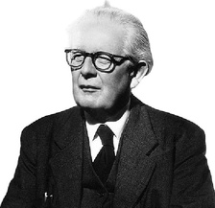
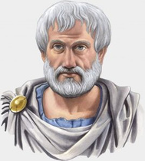
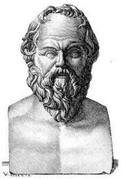
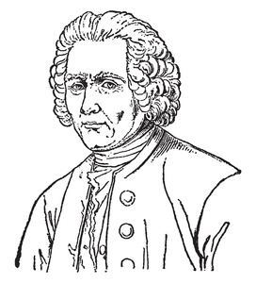
Lesson 1.4: What is
Constructivist Learning Theory?
Since constructivism approaches learning both cognitively, socially and emotionally, that is, holistically, it is more appropriate to consider it under a separate learning theory title.
Although Jean-Jacques Rousseau's work Emile forms the basis of today's understanding of constructivism, the understanding of constructivism goes back to the ideas of Aristotle, Socrates and Plato.
Jean Piaget and Immanuel Kant, who say that the individual is born with a cognitive schema, can be considered as the ancestors of the constructivist approach (Bağ, 2022).
Co-funded by the European Union. Views and opinions expressed are however those of the author(s) only and do not necessarily reflect those of the European Union or Fundacja Rozwoju Systemu Edukacji. Neither the European Union nor the granting authority can be held responsible for them. Project no. 2022-1-PL01-KA220-HED-000086524

Slide 6

Lesson 1.4: What is
Constructivist Learning Theory?
Constructivist theorists reject the idea that scientific truths exist and await discovery and verification (Schunk, 2012). The constructivist approach explains "learning" as students' reinforcing their existing knowledge and experiences with their newly acquired knowledge and associating them with daily life (Orkun, 2022).
Co-funded by the European Union. Views and opinions expressed are however those of the author(s) only and do not necessarily reflect those of the European Union or Fundacja Rozwoju Systemu Edukacji. Neither the European Union nor the granting authority can be held responsible for them. Project no. 2022-1-PL01-KA220-HED-000086524

Slide 7

Lesson 1.4: What is
Constructivist Learning Theory?
"Learning to Learn" is essential in constructivist learning theory. learning to learn; It is based on the understanding that the individual is aware of how his own learning takes place, is responsible for his learning, and learns how to learn (Ellis, 1997).
Co-funded by the European Union. Views and opinions expressed are however those of the author(s) only and do not necessarily reflect those of the European Union or Fundacja Rozwoju Systemu Edukacji. Neither the European Union nor the granting authority can be held responsible for them. Project no. 2022-1-PL01-KA220-HED-000086524

Slide 8

Lesson 1.4: What is
Constructivist Learning Theory?
The responsibility of learning belongs to the individual himself, the individual makes the decisions about his own learning. In short, in learner-centered constructivism, the individual decides how, how much, where and what to learn. The task of education and teacher is to guide the individual on how to learn (Bruner & Haste, 2010).
Co-funded by the European Union. Views and opinions expressed are however those of the author(s) only and do not necessarily reflect those of the European Union or Fundacja Rozwoju Systemu Edukacji. Neither the European Union nor the granting authority can be held responsible for them. Project no. 2022-1-PL01-KA220-HED-000086524

Slide 9

Lesson 1.4: What is
Constructivist Learning Theory?
Constructivist learning theory can be examined on the basis of three understandings in itself.
Co-funded by the European Union. Views and opinions expressed are however those of the author(s) only and do not necessarily reflect those of the European Union or Fundacja Rozwoju Systemu Edukacji. Neither the European Union nor the granting authority can be held responsible for them. Project no. 2022-1-PL01-KA220-HED-000086524

Slide 10

Lesson 1.4: What is
Constructivist Learning Theory?
1. Cognitive Constructivism:
It is based on the thoughts of Piaget, who is considered a pioneer in cognitive development, about the cognitive process (Sjoberg, 2007).
Co-funded by the European Union. Views and opinions expressed are however those of the author(s) only and do not necessarily reflect those of the European Union or Fundacja Rozwoju Systemu Edukacji. Neither the European Union nor the granting authority can be held responsible for them. Project no. 2022-1-PL01-KA220-HED-000086524

Slide 11
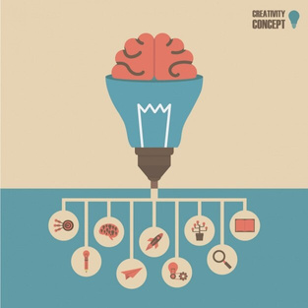
Lesson 1.4: What is
Constructivist Learning Theory?
1. Cognitive Constructivism:
Piaget stated that learning is an individual process, creating an imbalance in the learners' schemas and ensuring that the learner re-establishes the balance with the balancing process (Kaya, 2012).
The student acquires the knowledge and after the acquisition process, filters, processes, shapes and structures it through the mind. Therefore, the student is not passive in cognitive constructivism, on the contrary, he is in an active position that processes the information he has acquired (Karadağ & Korkmaz, 2007).
Co-funded by the European Union. Views and opinions expressed are however those of the author(s) only and do not necessarily reflect those of the European Union or Fundacja Rozwoju Systemu Edukacji. Neither the European Union nor the granting authority can be held responsible for them. Project no. 2022-1-PL01-KA220-HED-000086524

Slide 12
Lesson 1.4: What is
Constructivist Learning Theory?
2. Social Constructivism:
Vygotsky, who has done a lot of research on learning, argues that learning is not an individual process, on the contrary, it is a process that requires interaction within the individual's environment, and that development is achieved as a result of interactions in the social environment (Mishra, 2013).
Co-funded by the European Union. Views and opinions expressed are however those of the author(s) only and do not necessarily reflect those of the European Union or Fundacja Rozwoju Systemu Edukacji. Neither the European Union nor the granting authority can be held responsible for them. Project no. 2022-1-PL01-KA220-HED-000086524

Slide 13
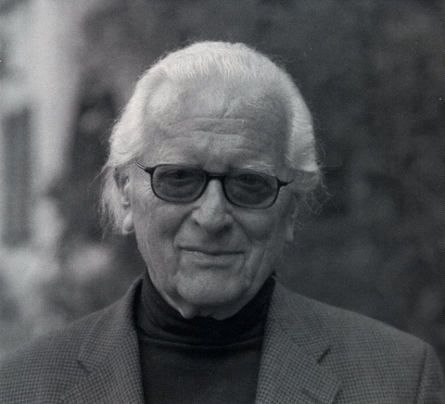
Lesson 1.4: What is
Constructivist Learning Theory?
3. Radical Constructivism:
Ernst Von Glasersfeld, who put forward the philosophy of Radical Constructivism, states that the foundation of radical constructivism is based on the Skepticism movement that started with Xenophanes in the sixth century.
Co-funded by the European Union. Views and opinions expressed are however those of the author(s) only and do not necessarily reflect those of the European Union or Fundacja Rozwoju Systemu Edukacji. Neither the European Union nor the granting authority can be held responsible for them. Project no. 2022-1-PL01-KA220-HED-000086524

Slide 14

Lesson 1.4: What is
Constructivist Learning Theory?
3. Radical Constructivism:
According to radical constructivism, the individual makes all kinds of analysis of life according to his own subjective experiences, the individual's knowledge, achievements, interpretations or syntheses are subjective and limited. In this understanding, there is no single truth or reality, there is a point of view (Akkaya, 2015).
Co-funded by the European Union. Views and opinions expressed are however those of the author(s) only and do not necessarily reflect those of the European Union or Fundacja Rozwoju Systemu Edukacji. Neither the European Union nor the granting authority can be held responsible for them. Project no. 2022-1-PL01-KA220-HED-000086524

Slide 15

Lesson 1.4: What is
Constructivist Learning Theory?
These three understandings have formed three fundamental different aspects of constructivism. Cognitive constructivism has added different aspects to this theory by arguing that the individual creates his/her knowledge with his/her own cognitive processes.
Co-funded by the European Union. Views and opinions expressed are however those of the author(s) only and do not necessarily reflect those of the European Union or Fundacja Rozwoju Systemu Edukacji. Neither the European Union nor the granting authority can be held responsible for them. Project no. 2022-1-PL01-KA220-HED-000086524

Slide 16

Lesson 1.4: What is
Constructivist Learning Theory?
Social constructivism has added different aspects to this theory, arguing that the social environment has a great influence on these processes. radical constructivism, on the other hand, added different aspects to this theory, arguing that the individual creates not only knowledge but also science and even the whole world in line with his own perceptions (Sjoberg, 2007).
Co-funded by the European Union. Views and opinions expressed are however those of the author(s) only and do not necessarily reflect those of the European Union or Fundacja Rozwoju Systemu Edukacji. Neither the European Union nor the granting authority can be held responsible for them. Project no. 2022-1-PL01-KA220-HED-000086524

Slide 17
Conclusion
Constructivism, a holistic learning theory encompassing cognitive, social, and emotional dimensions, emphasizes the active role of learners in constructing knowledge through experiences and interactions.
Rooted in the ideas of Aristotle, Socrates, Plato, Rousseau, Piaget, and Kant, it rejects absolute scientific truths, focusing instead on subjective understanding.
Key perspectives include Piaget's cognitive constructivism, Vygotsky's social constructivism, and Glasersfeld's radical constructivism, each highlighting the individual and social contexts of learning.
Co-funded by the European Union. Views and opinions expressed are however those of the author(s) only and do not necessarily reflect those of the European Union or Fundacja Rozwoju Systemu Edukacji. Neither the European Union nor the granting authority can be held responsible for them. Project no. 2022-1-PL01-KA220-HED-000086524

Slide 18
Thank you for your attention!
Co-funded by the European Union. Views and opinions expressed are however those of the author(s) only and do not necessarily reflect those of the European Union or Fundacja Rozwoju Systemu Edukacji. Neither the European Union nor the granting authority can be held responsible for them. Project no. 2022-1-PL01-KA220-HED-000086524

Slide 19

This document may be copied, reproduced or modified according to the above rules.
In addition, an acknowledgement of the authors of the document and
all applicable portions of the copyright notice must be clearly referenced.
All rights reserved. © Copyright 2023 RbtsInMath

