Slide 1
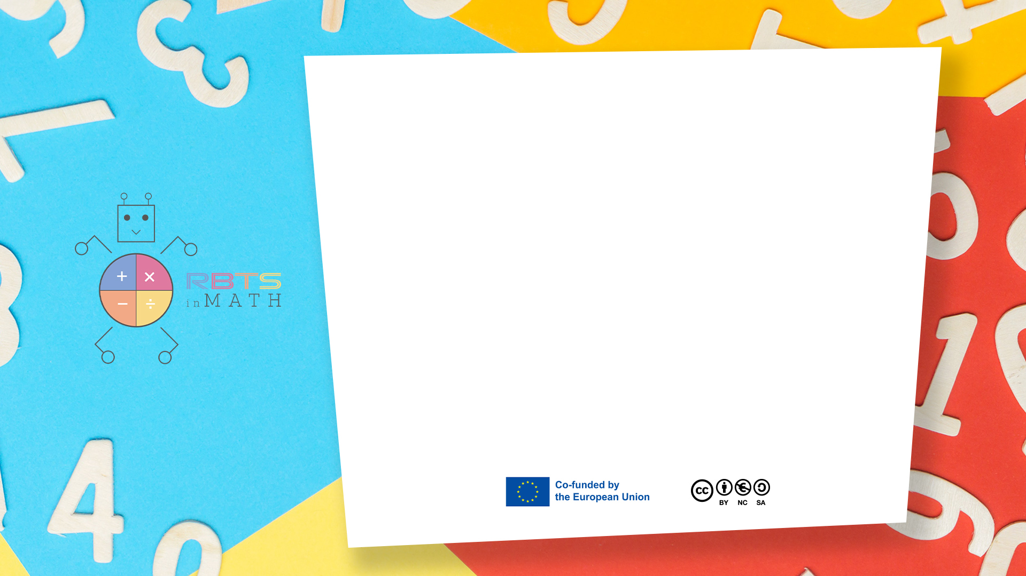
RbtsInMath: Developing Mathematics Achievement
through Using Robotics Applications in Flipped Learning
2022-1-PL01-KA220-HED-000089820
MODULE 2:
MATHS ANXIETY
Lesson 2.1: Robots and Roots: Revolutionizing Math with Technology
Co-funded by the European Union. Views and opinions expressed are however those of the author(s) only and do not necessarily reflect those of the European Union or Fundacja Rozwoju Systemu Edukacji. Neither the European Union nor the granting authority can be held responsible for them.

Slide 2


MODULE 2:
MATHS ANXIETY
Lesson 2.1:Robots and Roots: Revolutionizing Math with Technology
Prepared by:
All the pictures and photographs used in this publication are royalty-free, chosen from open sources.

Slide 3

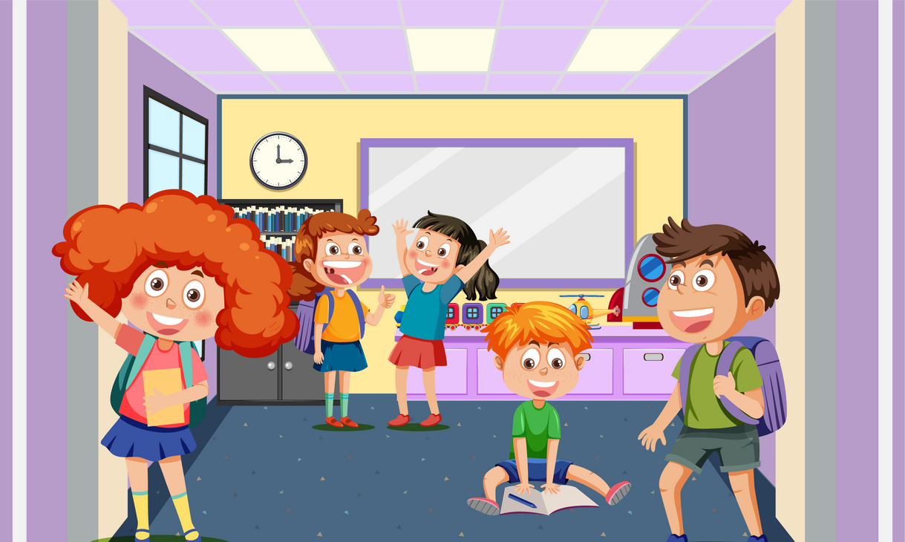
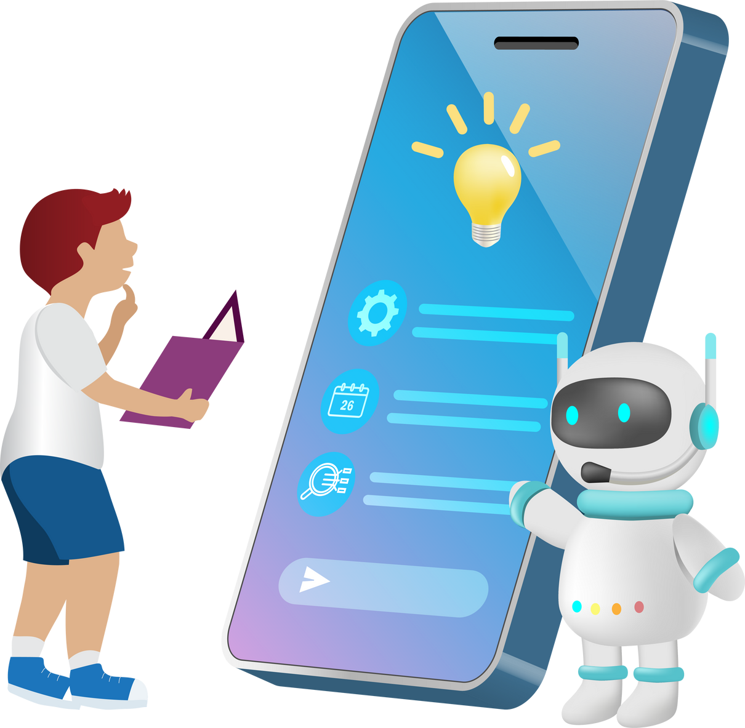
Robots and Roots: Revolutionizing Math with Technology
- Students enter a colorful, high-tech classroom filled with friendly robots, capturing their attention immediately.
- The teacher introduces math learning through interactive sessions with robots, simplifying complex concepts.
- This dynamic, hands-on approach aims to make math engaging and enjoyable, shifting away from traditional methods.
Co-funded by the European Union. Views and opinions expressed are however those of the author(s) only and do not necessarily reflect those of the European Union or Fundacja Rozwoju Systemu Edukacji. Neither the European Union nor the granting authority can be held responsible for them. Project no. 2022-1-PL01-KA220-HED-000086524

Slide 4
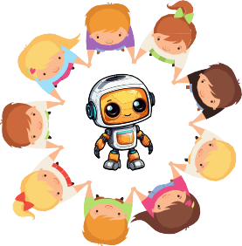
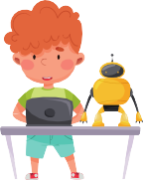
Robots and Roots: Revolutionizing Math with Technology
- Students eagerly gather around to program robots for simple arithmetic operations, with immediate, interactive feedback.
- The hands-on experience transforms abstract numbers into visible actions, enhancing intuitive understanding of math.
- The lively, interactive learning environment makes each student both an active participant and a spectator in the process.
Co-funded by the European Union. Views and opinions expressed are however those of the author(s) only and do not necessarily reflect those of the European Union or Fundacja Rozwoju Systemu Edukacji. Neither the European Union nor the granting authority can be held responsible for them. Project no. 2022-1-PL01-KA220-HED-000086524

Slide 5

Robots and Roots: Revolutionizing Math with Technology
- Students work in small groups to program robots and solve numerical puzzles, arranging numbered blocks to complete math equations or patterns.
- The activity fosters critical thinking, problem-solving, and strategy discussions as students adjust their approaches.
- In addition to improving math skills, the collaborative challenge enhances teamwork as students work together to achieve a common goal.
Co-funded by the European Union. Views and opinions expressed are however those of the author(s) only and do not necessarily reflect those of the European Union or Fundacja Rozwoju Systemu Edukacji. Neither the European Union nor the granting authority can be held responsible for them. Project no. 2022-1-PL01-KA220-HED-000086524

Slide 6
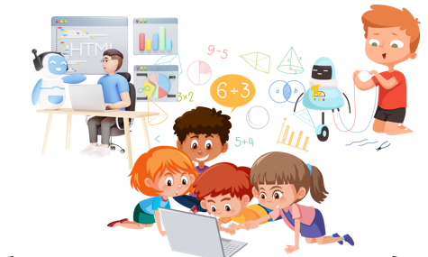
Robots and Roots: Revolutionizing Math with Technology
- A hesitant student, anxious about math, is gently approached by a robot tutor designed to recognize reluctance and provide support.
- The robot offers manageable math problems, encouraging the student with patient, non-judgmental guidance.
- This personalized interaction boosts the student's confidence, turning their initial fear into a sense of accomplishment and mastery.
Co-funded by the European Union. Views and opinions expressed are however those of the author(s) only and do not necessarily reflect those of the European Union or Fundacja Rozwoju Systemu Edukacji. Neither the European Union nor the granting authority can be held responsible for them. Project no. 2022-1-PL01-KA220-HED-000086524

Slide 7
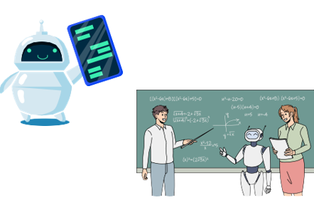
Robots and Roots: Revolutionizing Math with Technology
- As students master basic arithmetic, they progress to more complex concepts like geometry and algebra, assisted by advanced robot programming.
- The robots help students construct geometric shapes and visualize angles, shapes, and algebraic functions through dynamic movements and interactive displays.
- This approach makes abstract mathematical concepts tangible and easier to grasp in real time.
Co-funded by the European Union. Views and opinions expressed are however those of the author(s) only and do not necessarily reflect those of the European Union or Fundacja Rozwoju Systemu Edukacji. Neither the European Union nor the granting authority can be held responsible for them. Project no. 2022-1-PL01-KA220-HED-000086524

Slide 8
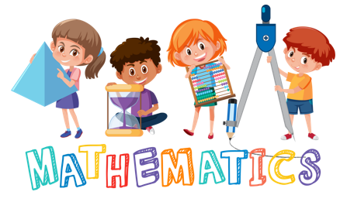
Robots and Roots: Revolutionizing Math with Technology
- Students reflect on their day's work with robots, sharing how their initial math apprehensions turned into enthusiasm and curiosity.
- They discuss how hands-on experiences made math more logical and less intimidating, highlighting breakthrough moments of understanding.
- This reflection consolidates their learning and reinforces their positive attitude toward math, fostering continued eagerness to explore and learn.
Co-funded by the European Union. Views and opinions expressed are however those of the author(s) only and do not necessarily reflect those of the European Union or Fundacja Rozwoju Systemu Edukacji. Neither the European Union nor the granting authority can be held responsible for them. Project no. 2022-1-PL01-KA220-HED-000086524

Slide 9
Conclusion
- Robotics integration transforms math learning into a dynamic, interactive experience, boosting engagement and comprehension.
- Students develop not only mathematical skills but also essential 21st-century skills like problem-solving, critical thinking, and teamwork.
- The program leads to increased confidence and reduced math anxiety, marking a successful shift in educational methods.
Co-funded by the European Union. Views and opinions expressed are however those of the author(s) only and do not necessarily reflect those of the European Union or Fundacja Rozwoju Systemu Edukacji. Neither the European Union nor the granting authority can be held responsible for them. Project no. 2022-1-PL01-KA220-HED-000086524

Slide 10
Thank you for your attention!
Co-funded by the European Union. Views and opinions expressed are however those of the author(s) only and do not necessarily reflect those of the European Union or Fundacja Rozwoju Systemu Edukacji. Neither the European Union nor the granting authority can be held responsible for them. Project no. 2022-1-PL01-KA220-HED-000086524

Slide 11
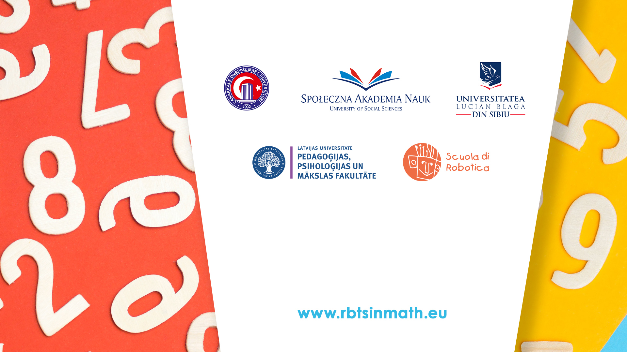
This document may be copied, reproduced or modified according to the above rules.
In addition, an acknowledgement of the authors of the document and
all applicable portions of the copyright notice must be clearly referenced.
All rights reserved. © Copyright 2023 RbtsInMath

