Slide 1
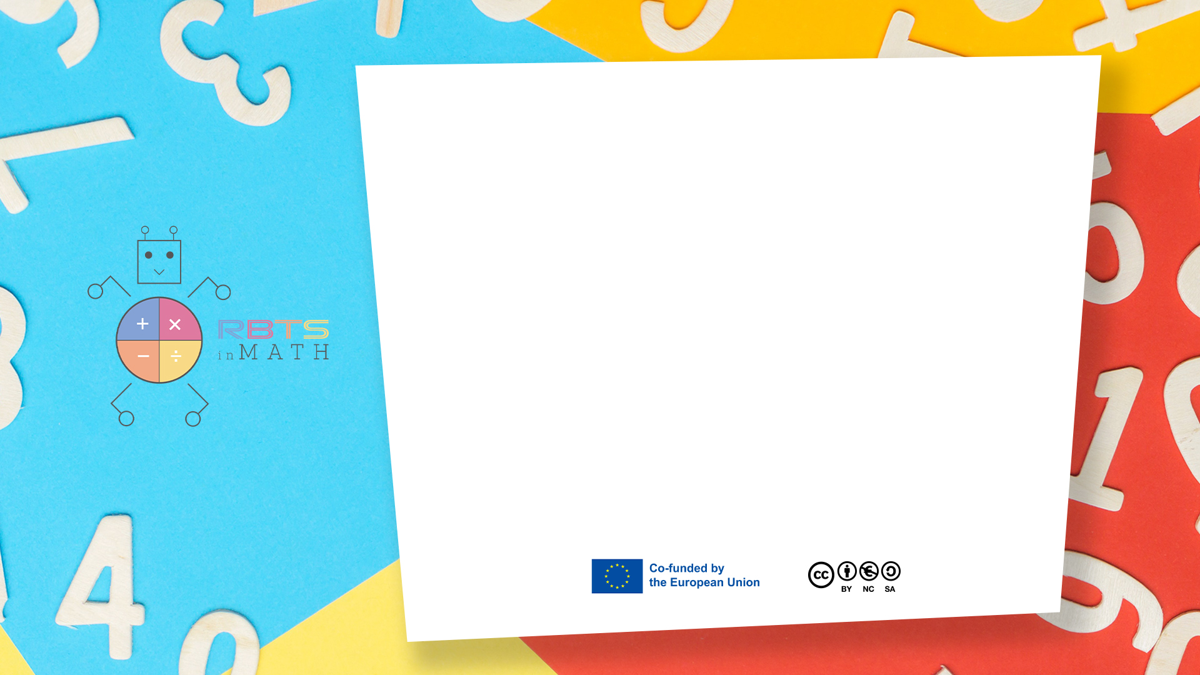
RbtsInMath: Developing Mathematics Achievement through Using Robotics Applications in Flipped Learning
2022-1-PL01-KA220-HED-000089820
MODULE 2: MATHS ANXIETY
Lesson 2.2: Numbers in Our Lives:
Tackling Math Anxiety
Through Everyday Simulations
Co-funded by the European Union. Views and opinions expressed are however those of the author(s) only and do not necessarily reflect those of the European Union or Fundacja Rozwoju Systemu Edukacji. Neither the European Union nor the granting authority can be held responsible for them.

Slide 2


MODULE 2: MATHS ANXIETY
Lesson 2.2:Numbers in Our Lives: Tackling Math Anxiety Through Everyday Simulations
Prepared by:
All the pictures and photographs used in this publication are royalty-free, chosen from open sources.

Slide 3

Numbers in Our Lives: Tackling Math Anxiety Through Everyday Simulations
- Four friends enjoy lunch together, their relaxed mood shifting when the bill arrives, prompting a sudden pause as they consider how to split it fairly.
- The situation presents a relatable moment of everyday math, highlighting the practical and emotional challenges of dividing expenses.
- This common scenario serves as a lesson in handling real-life math problems, emphasizing both the logical and social aspects of the task.
Co-funded by the European Union. Views and opinions expressed are however those of the author(s) only and do not necessarily reflect those of the European Union or Fundacja Rozwoju Systemu Edukacji. Neither the European Union nor the granting authority can be held responsible for them. Project no. 2022-1-PL01-KA220-HED-000086524

Slide 4

Numbers in Our Lives: Tackling Math Anxiety Through Everyday Simulations
- The group of friends turns the table into a forum for debate, discussing how to best divide the bill while tapping away at calculators.
- Despite their efforts, anxiety and second-guessing creep in, with the fear of making mistakes or seeming inept at math stalling their progress.
- This familiar struggle highlights the tension between numbers and nerves, as math anxiety interferes with reaching a fair solution.
Co-funded by the European Union. Views and opinions expressed are however those of the author(s) only and do not necessarily reflect those of the European Union or Fundacja Rozwoju Systemu Edukacji. Neither the European Union nor the granting authority can be held responsible for them. Project no. 2022-1-PL01-KA220-HED-000086524

Slide 5

Numbers in Our Lives: Tackling Math Anxiety Through Everyday Simulations
- Amid rising tension, one friend calmly steps in, proposing a simple and fair method for dividing the bill, cutting through the confusion.
- With clear instructions and a demonstration on a napkin, they guide the group through straightforward steps, bringing relief to the table.
- This friend’s confidence, stemming from their own efforts to overcome math anxiety, becomes a source of clarity and reassurance for everyone.
Co-funded by the European Union. Views and opinions expressed are however those of the author(s) only and do not necessarily reflect those of the European Union or Fundacja Rozwoju Systemu Edukacji. Neither the European Union nor the granting authority can be held responsible for them. Project no. 2022-1-PL01-KA220-HED-000086524

Slide 6

Numbers in Our Lives: Tackling Math Anxiety Through Everyday Simulations
Encouraged by the clear explanation, the friends adopt the suggested method, quickly finding their respective shares of the bill with newfound confidence.
Each calculation is double-checked and met with nods of approval, as the anxiety that once clouded their judgement dissipates.
The entire process, efficient and error-free, fosters a collective sense of accomplishment and relief among the friends.
Co-funded by the European Union. Views and opinions expressed are however those of the author(s) only and do not necessarily reflect those of the European Union or Fundacja Rozwoju Systemu Edukacji. Neither the European Union nor the granting authority can be held responsible for them. Project no. 2022-1-PL01-KA220-HED-000086524

Slide 7

Numbers in Our Lives: Tackling Math Anxiety Through Everyday Simulations
- On their walk home, the friends reflect on the earlier challenge, realizing how vital math is for managing everyday tasks and decisions.
- They discuss how overcoming math anxiety has boosted their confidence in routine calculations, such as splitting bills, and handling financial matters.
- This newfound appreciation inspires them to further improve their math skills, recognizing its positive impact on their daily lives.
Co-funded by the European Union. Views and opinions expressed are however those of the author(s) only and do not necessarily reflect those of the European Union or Fundacja Rozwoju Systemu Edukacji. Neither the European Union nor the granting authority can be held responsible for them. Project no. 2022-1-PL01-KA220-HED-000086524

Slide 8
Conclusion
The interactive simulations provided through prove effective in reducing math anxiety by incorporating familiar) real-life contexts into the learning process. By engaging with everyday scenarios such as splitting a bill or budgeting) participants develop practical mathematical skills alongside emotional management techniques. These experiences not only enhance their numerical fluency but also foster a positive relationship with math) transforming anxiety into confidence.
Co-funded by the European Union. Views and opinions expressed are however those of the author(s) only and do not necessarily reflect those of the European Union or Fundacja Rozwoju Systemu Edukacji. Neither the European Union nor the granting authority can be held responsible for them. Project no. 2022-1-PL01-KA220-HED-000086524

Slide 9
Thank you for your attention!
Co-funded by the European Union. Views and opinions expressed are however those of the author(s) only and do not necessarily reflect those of the European Union or Fundacja Rozwoju Systemu Edukacji. Neither the European Union nor the granting authority can be held responsible for them. Project no. 2022-1-PL01-KA220-HED-000086524

Slide 10

This document may be copied, reproduced or modified according to the above rules. In addition, an acknowledgement of the authors of the document and all applicable portions of the copyright notice must be clearly referenced.
All rights reserved. © Copyright 2023 RbtsInMath

