Slide 1
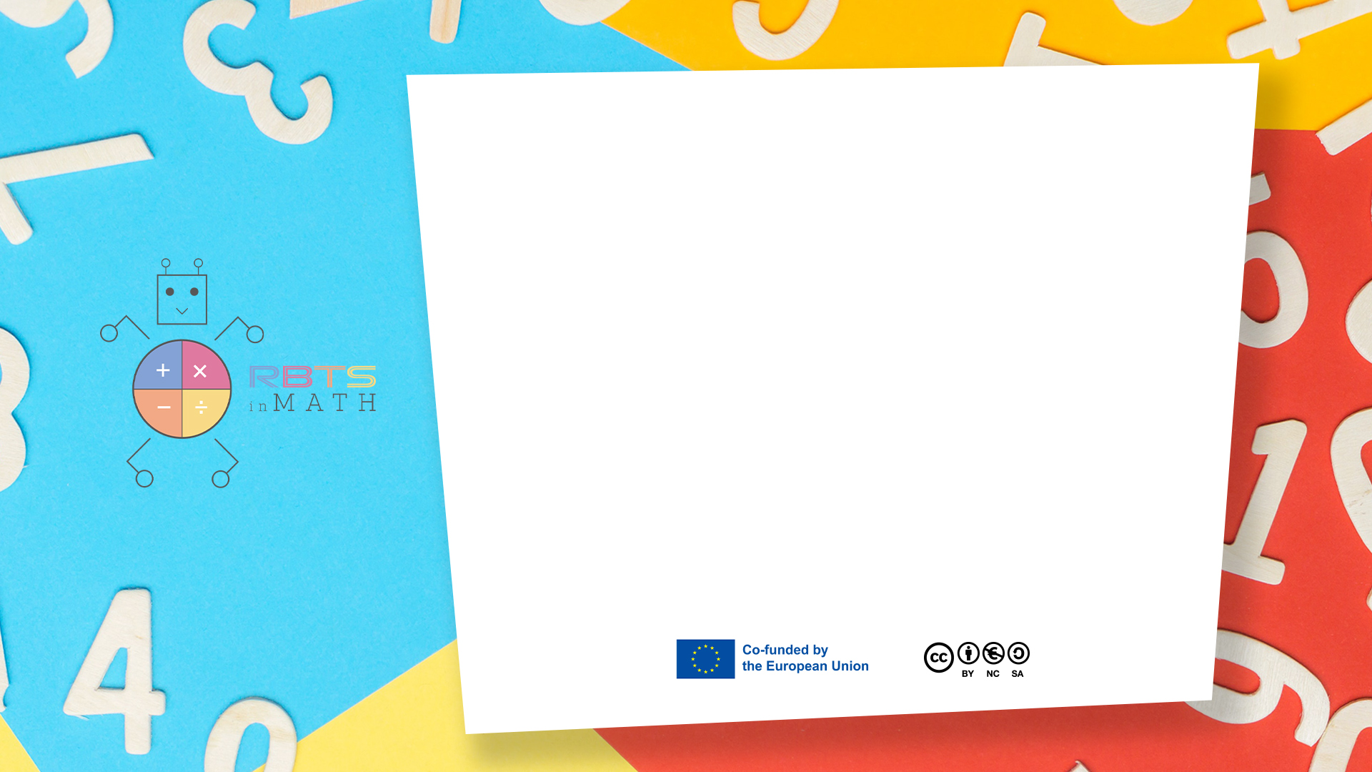
RbtsInMath: Developing Mathematics Achievement through Using Robotics Applications in Flipped Learning
2022-1-PL01-KA220-HED-000089820
MODULE 2: MATHS ANXIETY
Lesson 2.5: Strategies to overcome
math anxiety at school
Co-funded by the European Union. Views and opinions expressed are however those of the author(s) only and do not necessarily reflect those of the European Union or Fundacja Rozwoju Systemu Edukacji. Neither the European Union nor the granting authority can be held responsible for them.

Slide 2


MODULE 2: MATHS ANXIETY
Lesson 2.5:Strategies to overcome math anxiety at school
Prepared by:
All the pictures and photographs used in this publication are royalty-free, chosen from open sources.

Slide 3

Strategies to overcome math anxiety at school
Professor presents the course topic to the students and explain what is math anxiety.
The teacher notices that certain students are anxious or hesitant about participating.
Co-funded by the European Union. Views and opinions expressed are however those of the author(s) only and do not necessarily reflect those of the European Union or Fundacja Rozwoju Systemu Edukacji. Neither the European Union nor the granting authority can be held responsible for them. Project no. 2022-1-PL01-KA220-HED-000086524

Slide 4

Strategies to overcome math anxiety at school
The teacher stands at the front of the classroom, encouraging all students.
The teacher reassures students that it's okay to make mistakes.
The classroom is decorated with positive math posters, like "Math is Fun!" and "Everyone can be good at math
Co-funded by the European Union. Views and opinions expressed are however those of the author(s) only and do not necessarily reflect those of the European Union or Fundacja Rozwoju Systemu Edukacji. Neither the European Union nor the granting authority can be held responsible for them. Project no. 2022-1-PL01-KA220-HED-000086524

Slide 5

Strategies to overcome math anxiety at school
The teacher works one-on-one with a student, showing how to solve a math problem in smaller, manageable steps. The teacher explains, "Let’s take it step by step," and uses visuals or manipulatives to simplify the concepts.
Co-funded by the European Union. Views and opinions expressed are however those of the author(s) only and do not necessarily reflect those of the European Union or Fundacja Rozwoju Systemu Edukacji. Neither the European Union nor the granting authority can be held responsible for them. Project no. 2022-1-PL01-KA220-HED-000086524

Slide 6
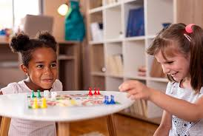
Strategies to overcome math anxiety at school
Students playing an interactive math game in groups, smiling and engaged. The teacher uses games and activities to make math more enjoyable. The atmosphere is light-hearted, and students look like they’re having fun while learning.
Co-funded by the European Union. Views and opinions expressed are however those of the author(s) only and do not necessarily reflect those of the European Union or Fundacja Rozwoju Systemu Edukacji. Neither the European Union nor the granting authority can be held responsible for them. Project no. 2022-1-PL01-KA220-HED-000086524

Slide 7

Strategies to overcome math anxiety at school
The teacher celebrates a student’s progress, handing them a "Math Star" badge. The teacher praises students for their efforts and improvement, not just correct answers.
Co-funded by the European Union. Views and opinions expressed are however those of the author(s) only and do not necessarily reflect those of the European Union or Fundacja Rozwoju Systemu Edukacji. Neither the European Union nor the granting authority can be held responsible for them. Project no. 2022-1-PL01-KA220-HED-000086524

Slide 8
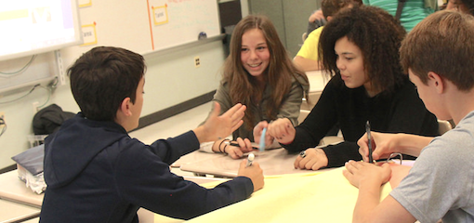
Strategies to overcome math anxiety at school
Students are working in pairs or small groups, helping each other solve math problems.
The teacher promotes collaboration, where students help explain math concepts to each other. The classroom is filled with students talking and sharing ideas.
Co-funded by the European Union. Views and opinions expressed are however those of the author(s) only and do not necessarily reflect those of the European Union or Fundacja Rozwoju Systemu Edukacji. Neither the European Union nor the granting authority can be held responsible for them. Project no. 2022-1-PL01-KA220-HED-000086524

Slide 9
Conclusion
Math anxiety among primary school students is a significant concern that can hinder their academic progress and overall well-being.
By fostering a positive attitude towards math and building students' confidence in their mathematical abilities from an early age, educators can empower primary school students to overcome math anxiety and develop a lifelong love for learning mathematics.
Co-funded by the European Union. Views and opinions expressed are however those of the author(s) only and do not necessarily reflect those of the European Union or Fundacja Rozwoju Systemu Edukacji. Neither the European Union nor the granting authority can be held responsible for them. Project no. 2022-1-PL01-KA220-HED-000086524

Slide 10
Thank you for your attention!
Co-funded by the European Union. Views and opinions expressed are however those of the author(s) only and do not necessarily reflect those of the European Union or Fundacja Rozwoju Systemu Edukacji. Neither the European Union nor the granting authority can be held responsible for them. Project no. 2022-1-PL01-KA220-HED-000086524

Slide 11

This document may be copied, reproduced or modified according to the above rules. In addition, an acknowledgement of the authors of the document and all applicable portions of the copyright notice must be clearly referenced.
All rights reserved. © Copyright 2023 RbtsInMath

