Slide 1
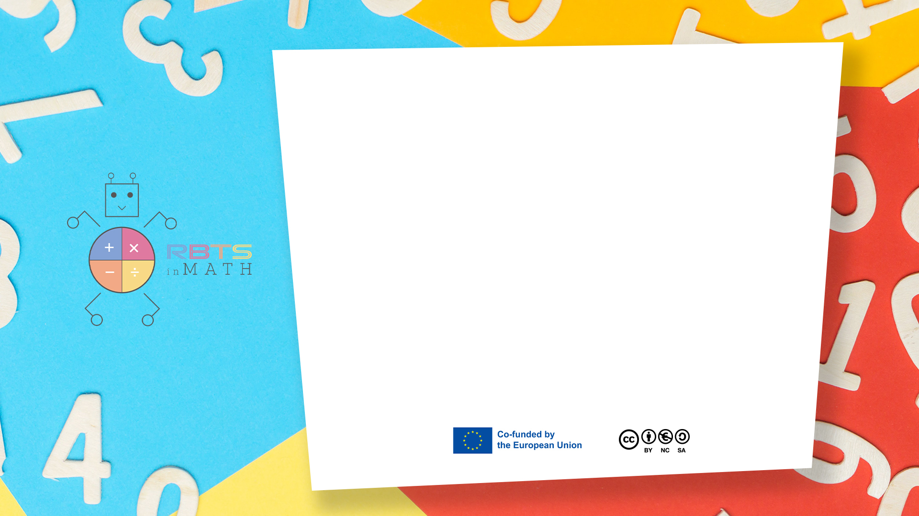
RbtsInMath: Developing Mathematics Achievement through Using Robotics Applications in Flipped Learning
2022-1-PL01-KA220-HED-000089820
MODULE 3: The History of Robotics Applications
in education
Lesson 3.1: Geometry
Co-funded by the European Union. Views and opinions expressed are however those of the author(s) only and do not necessarily reflect those of the European Union or Fundacja Rozwoju Systemu Edukacji. Neither the European Union nor the granting authority can be held responsible for them.

Slide 2


MODULE 3: THE HISTORY OF ROBOTICS APPLICATIONS IN EDUCATION
Lesson 3.1: Geometry
Prepared by:
All the pictures and photographs used in this publication are royalty-free, chosen from open sources.

Slide 3
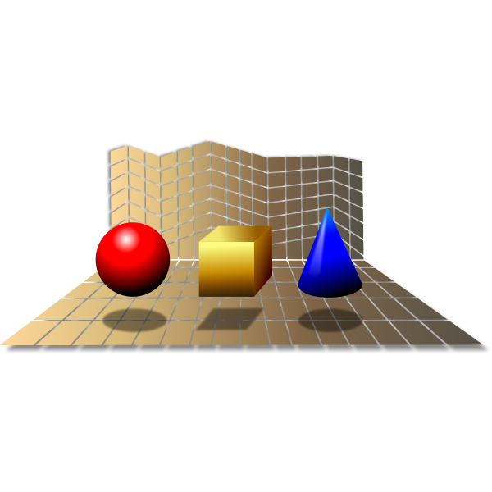
Geometry
We need to familiarize with different ways to creae geometrical shapes.
Co-funded by the European Union. Views and opinions expressed are however those of the author(s) only and do not necessarily reflect those of the European Union or Fundacja Rozwoju Systemu Edukacji. Neither the European Union nor the granting authority can be held responsible for them. Project no. 2022-1-PL01-KA220-HED-000086524

Slide 4
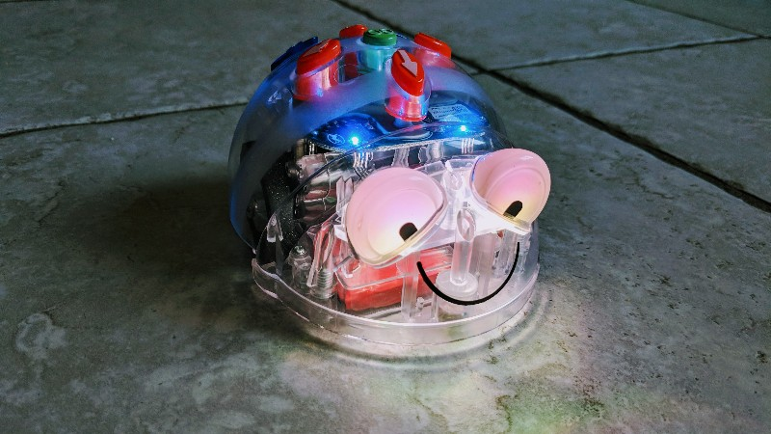
Geometry different experiences
System used – Bee bot, Blue bot, mTiny, TaleBot.
Educational robots like Bee Bot, Blue Bot, mTiny, and TaleBot are ideal tools for engaging children in hands-on learning of geometrical shapes. Through simple programming and guided activities, students can interact with these robots to understand and create shapes such as squares, rectangles, triangles, and circles.
Co-funded by the European Union. Views and opinions expressed are however those of the author(s) only and do not necessarily reflect those of the European Union or Fundacja Rozwoju Systemu Edukacji. Neither the European Union nor the granting authority can be held responsible for them. Project no. 2022-1-PL01-KA220-HED-000086524

Slide 5
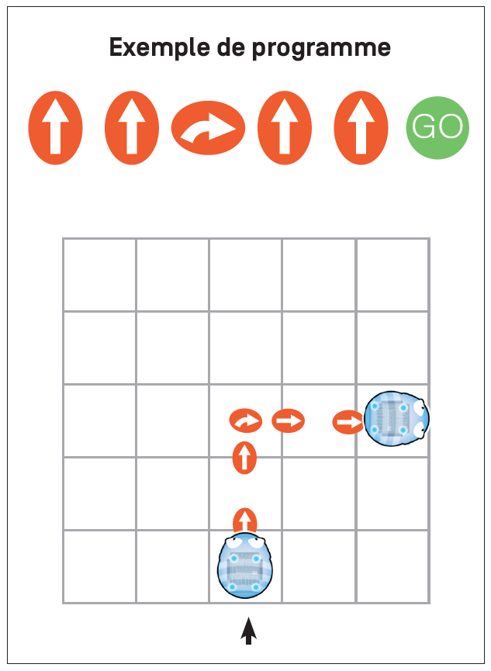
Simple Shapes
Materials Needed:
- Shape-themed playmat (with shapes like squares, triangles, circles, etc.)
- Bee Bot or Blue Bot robots
Instructions:
Place the robot at the starting point.
Ask students to program the robot to reach a specific shape (e.g., a triangle).
Provide instructions like "Move forward two steps, turn 90° right, and move forward one step" to reach the target shape.
Discuss the properties of the shape once the robot arrives.
CC BY
Co-funded by the European Union. Views and opinions expressed are however those of the author(s) only and do not necessarily reflect those of the European Union or Fundacja Rozwoju Systemu Edukacji. Neither the European Union nor the granting authority can be held responsible for them. Project no. 2022-1-PL01-KA220-HED-000086524

Slide 6
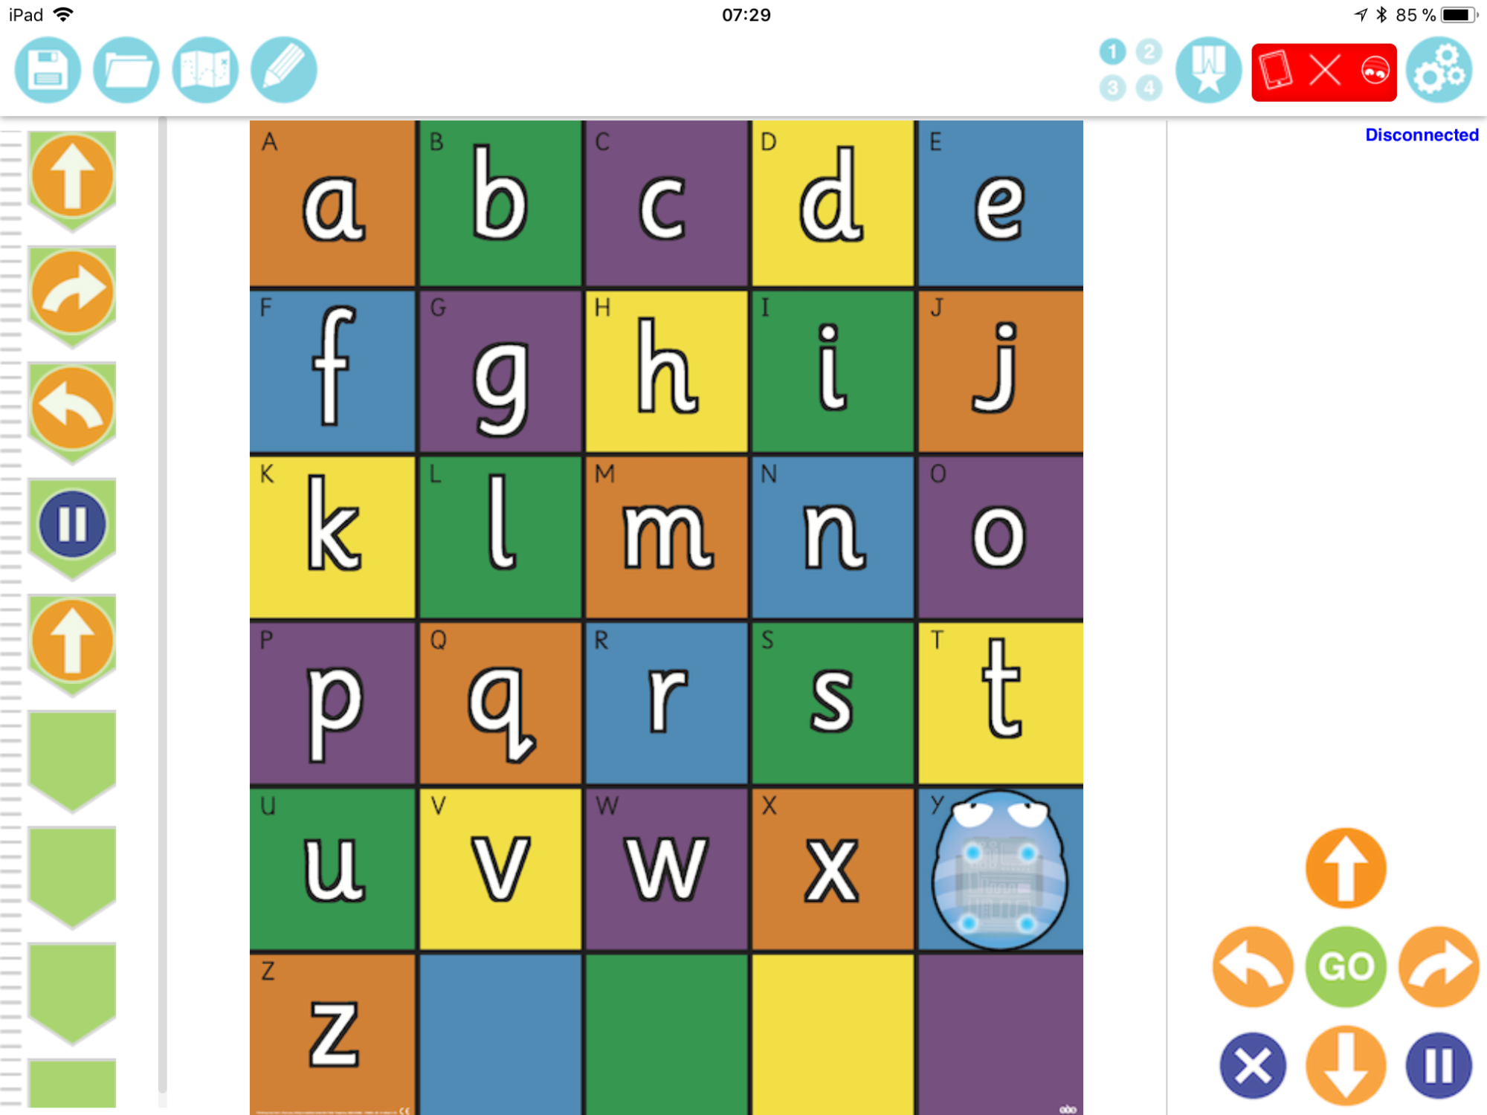
Questa foto di Autore sconosciuto è concesso in licenza da CC BY-SA-NC

Slide 7
Questa foto di Autore sconosciuto è concesso in licenza da CC BY-SA-NC

Slide 8
Questa foto di Autore sconosciuto è concesso in licenza da CC BY-SA-NC

Slide 9
Questa foto di Autore sconosciuto è concesso in licenza da CC BY-SA-NC

Slide 10
Questa foto di Autore sconosciuto è concesso in licenza da CC BY-SA-NC

Slide 11
Questa foto di Autore sconosciuto è concesso in licenza da CC BY-SA-NC

Slide 12
Questa foto di Autore sconosciuto è concesso in licenza da CC BY-SA-NC

Slide 13
Questa foto di Autore sconosciuto è concesso in licenza da CC BY-SA-NC

Slide 14
Questa foto di Autore sconosciuto è concesso in licenza da CC BY-SA-NC

Slide 15
Questa foto di Autore sconosciuto è concesso in licenza da CC BY-SA-NC

Slide 16
Questa foto di Autore sconosciuto è concesso in licenza da CC BY-SA-NC

Slide 17
Questa foto di Autore sconosciuto è concesso in licenza da CC BY-SA-NC

Slide 18
Questa foto di Autore sconosciuto è concesso in licenza da CC BY-SA-NC

Slide 19

Geometry
Learning Outcome:
1.Recognize and name geometrical shapes.
2. Understand directions and angles (e.g., 90° turns).
Co-funded by the European Union. Views and opinions expressed are however those of the author(s) only and do not necessarily reflect those of the European Union or Fundacja Rozwoju Systemu Edukacji. Neither the European Union nor the granting authority can be held responsible for them. Project no. 2022-1-PL01-KA220-HED-000086524

Slide 20
Thank you for your attention!
Co-funded by the European Union. Views and opinions expressed are however those of the author(s) only and do not necessarily reflect those of the European Union or Fundacja Rozwoju Systemu Edukacji. Neither the European Union nor the granting authority can be held responsible for them. Project no. 2022-1-PL01-KA220-HED-000086524

Slide 21
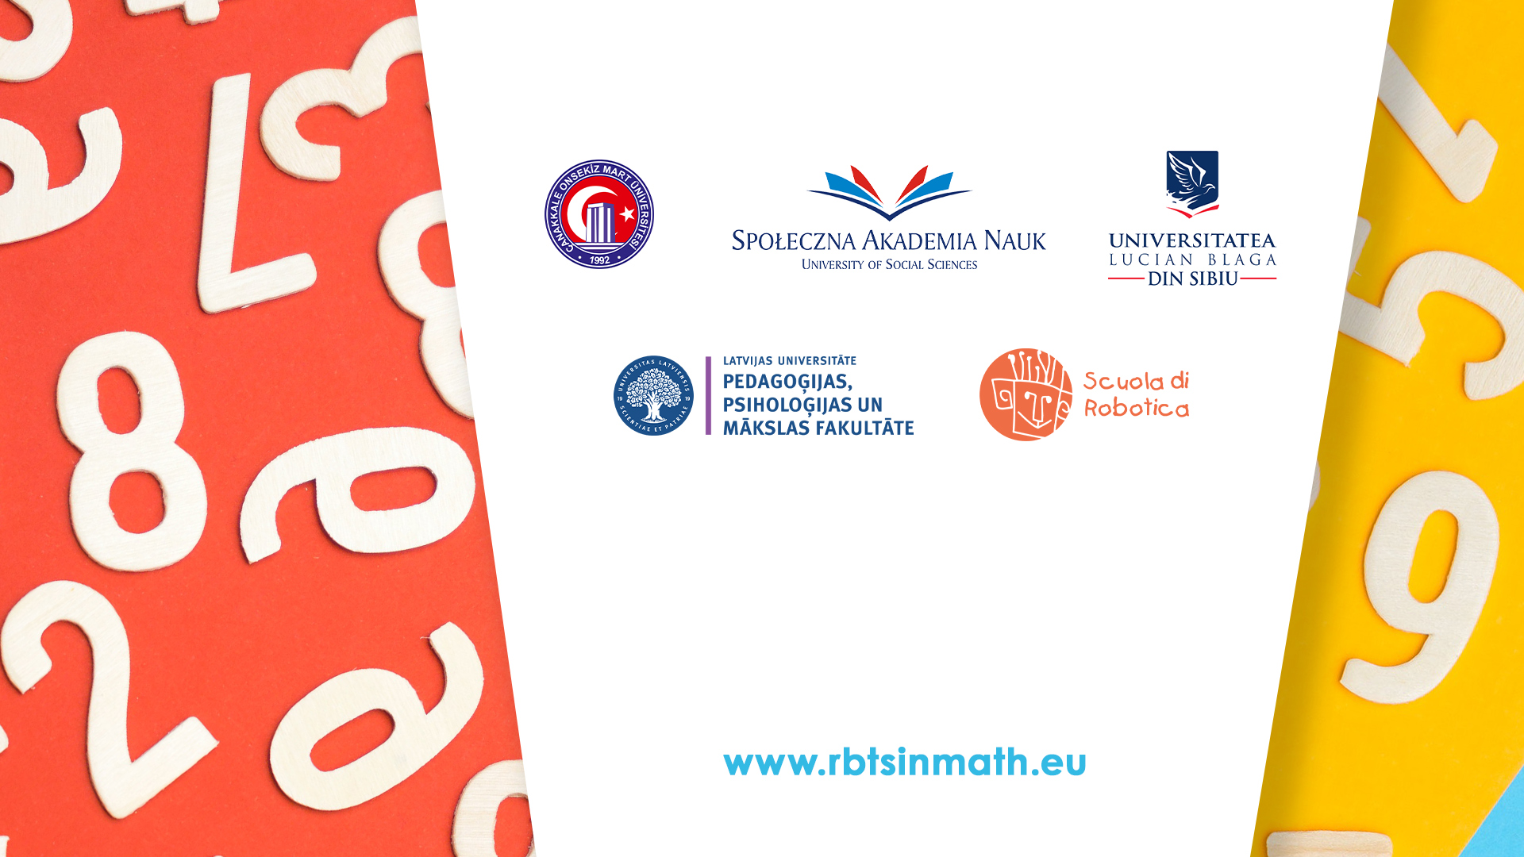
This document may be copied, reproduced or modified according to the above rules. In addition, an acknowledgement of the authors of the document and all applicable portions of the copyright notice must be clearly referenced.
All rights reserved. © Copyright 2023 RbtsInMath

