Slide 1

RbtsInMath: Developing Mathematics Achievement through Using Robotics Applications in Flipped Learning
2022-1-PL01-KA220-HED-000089820
MODULE 3: The History of Robotics Applications
in education
Lesson 3.2: Moral Machine
with LEGO SPIKE
Co-funded by the European Union. Views and opinions expressed are however those of the author(s) only and do not necessarily reflect those of the European Union or Fundacja Rozwoju Systemu Edukacji. Neither the European Union nor the granting authority can be held responsible for them.

Slide 2


MODULE 3: THE HISTORY OF ROBOTICS APPLICATIONS IN EDUCATION
Lesson 3.2:Moral Machine with LEGO SPIKE
Prepared by:
All the pictures and photographs used in this publication are royalty-free, chosen from open sources.

Slide 3
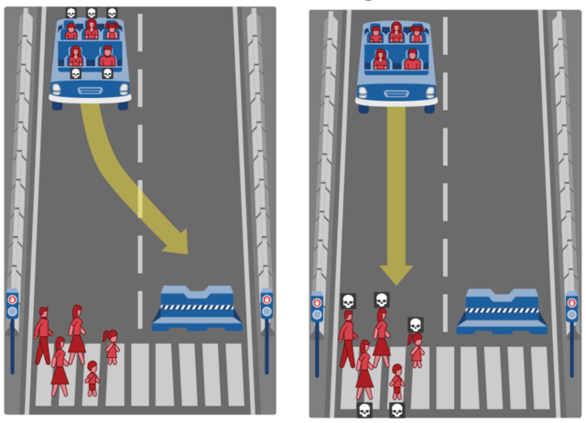
Moral Machine
The activity is inspired by the MIT Moral Machine project, which explores ethical decision-making in autonomous systems. Here’s how to adapt it for LEGO Spike:
Objective
Teach students about ethical dilemmas and decision-making in AI using LEGO Spike Prime robots.
Co-funded by the European Union. Views and opinions expressed are however those of the author(s) only and do not necessarily reflect those of the European Union or Fundacja Rozwoju Systemu Edukacji. Neither the European Union nor the granting authority can be held responsible for them. Project no. 2022-1-PL01-KA220-HED-000086524

Slide 4
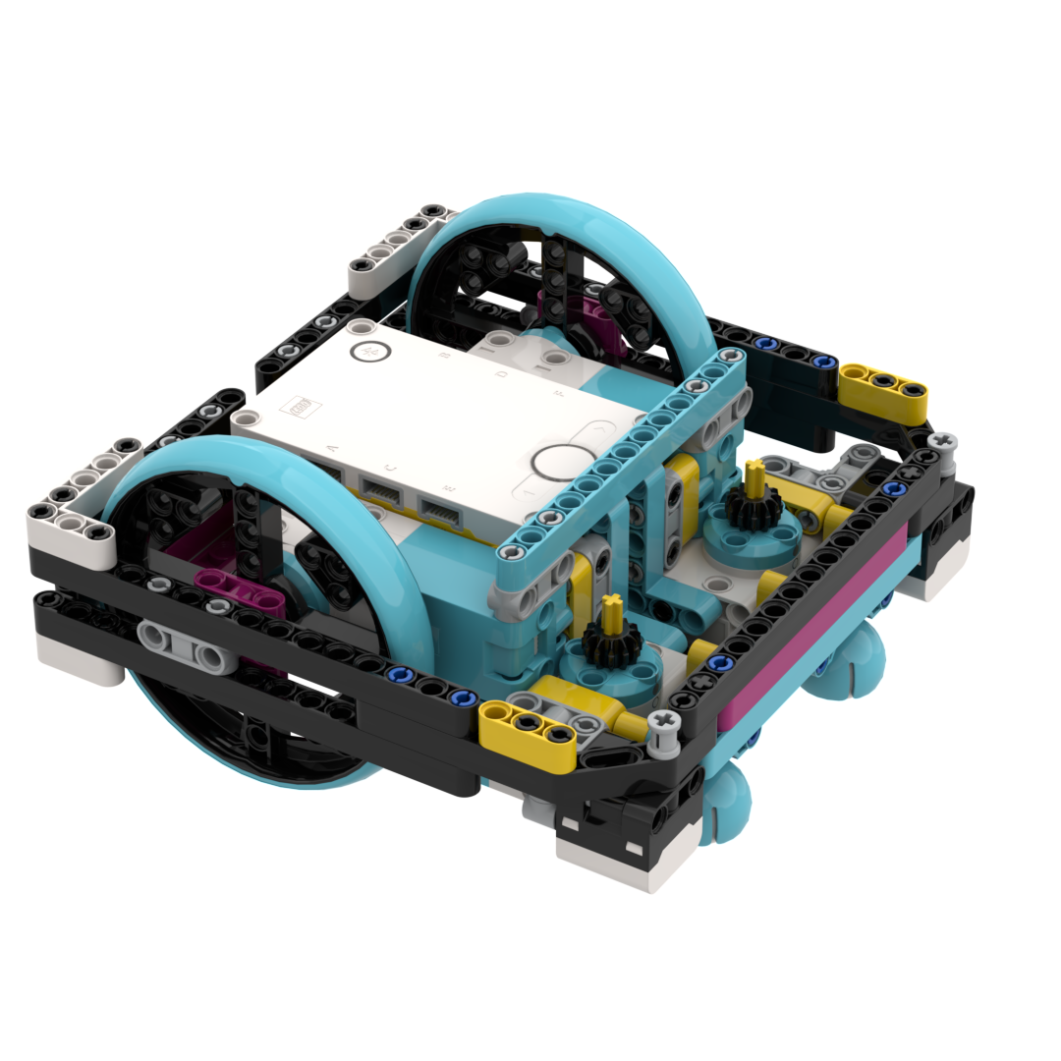
How to set the activity
Create a Track: Build a track with LEGO components, including forks where the robot must decide between two paths. Add elements like:
Pedestrian figures
Obstacles (e.g., rocks, animals)
Traffic lights or stop signs
Program the Robot: Students program the LEGO Spike robot to simulate a self-driving car. They set decision rules for how the robot should act when encountering a moral dilemma (e.g., prioritizing pedestrians over obstacles).
Scenarios: One path has a group of pedestrians, and the other has an obstacle.
The robot must choose between damaging itself or endangering others.
Questa foto di Autore sconosciuto è concesso in licenza da CC BY-SA-NC
Co-funded by the European Union. Views and opinions expressed are however those of the author(s) only and do not necessarily reflect those of the European Union or Fundacja Rozwoju Systemu Edukacji. Neither the European Union nor the granting authority can be held responsible for them. Project no. 2022-1-PL01-KA220-HED-000086524

Slide 5
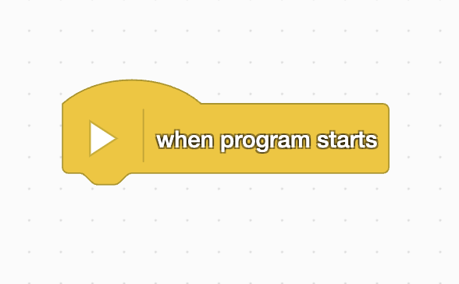
How to program
Co-funded by the European Union. Views and opinions expressed are however those of the author(s) only and do not necessarily reflect those of the European Union or Fundacja Rozwoju Systemu Edukacji. Neither the European Union nor the granting authority can be held responsible for them. Project no. 2022-1-PL01-KA220-HED-000086524

Slide 6
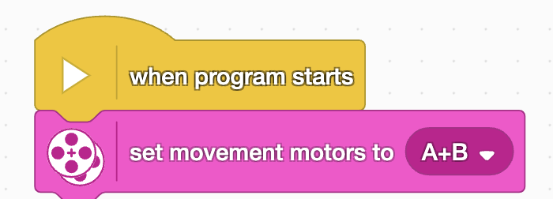
How to program
Co-funded by the European Union. Views and opinions expressed are however those of the author(s) only and do not necessarily reflect those of the European Union or Fundacja Rozwoju Systemu Edukacji. Neither the European Union nor the granting authority can be held responsible for them. Project no. 2022-1-PL01-KA220-HED-000086524

Slide 7
How to program
Co-funded by the European Union. Views and opinions expressed are however those of the author(s) only and do not necessarily reflect those of the European Union or Fundacja Rozwoju Systemu Edukacji. Neither the European Union nor the granting authority can be held responsible for them. Project no. 2022-1-PL01-KA220-HED-000086524

Slide 8
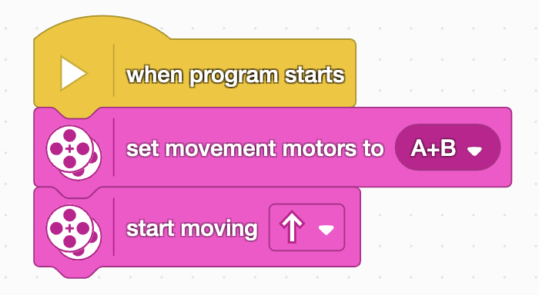
How to program
Co-funded by the European Union. Views and opinions expressed are however those of the author(s) only and do not necessarily reflect those of the European Union or Fundacja Rozwoju Systemu Edukacji. Neither the European Union nor the granting authority can be held responsible for them. Project no. 2022-1-PL01-KA220-HED-000086524

Slide 9
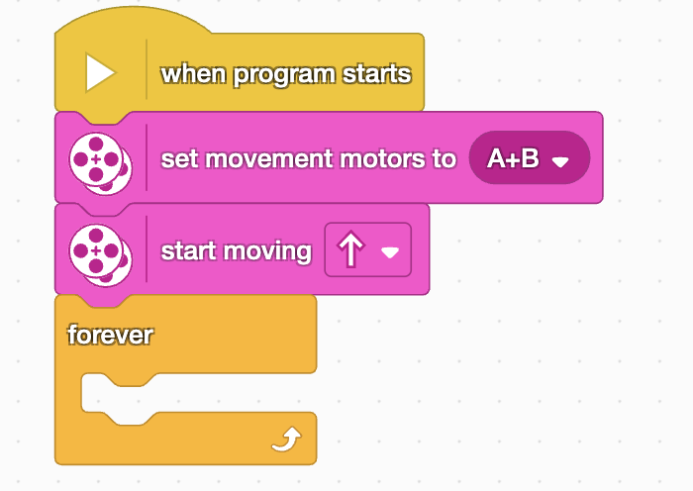
How to program
Co-funded by the European Union. Views and opinions expressed are however those of the author(s) only and do not necessarily reflect those of the European Union or Fundacja Rozwoju Systemu Edukacji. Neither the European Union nor the granting authority can be held responsible for them. Project no. 2022-1-PL01-KA220-HED-000086524

Slide 10
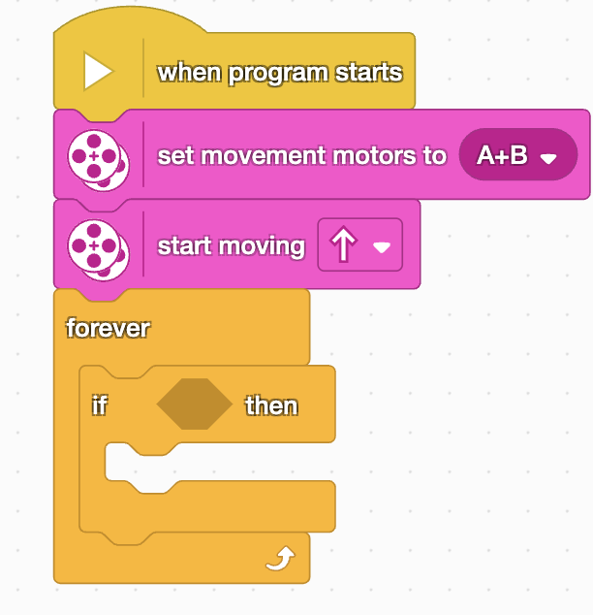
How to program
Co-funded by the European Union. Views and opinions expressed are however those of the author(s) only and do not necessarily reflect those of the European Union or Fundacja Rozwoju Systemu Edukacji. Neither the European Union nor the granting authority can be held responsible for them. Project no. 2022-1-PL01-KA220-HED-000086524

Slide 11
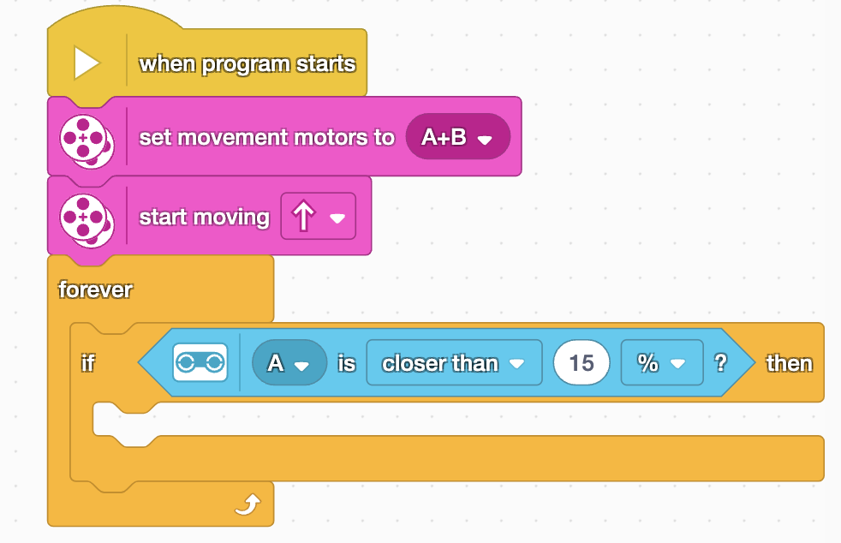
How to program
Co-funded by the European Union. Views and opinions expressed are however those of the author(s) only and do not necessarily reflect those of the European Union or Fundacja Rozwoju Systemu Edukacji. Neither the European Union nor the granting authority can be held responsible for them. Project no. 2022-1-PL01-KA220-HED-000086524

Slide 12
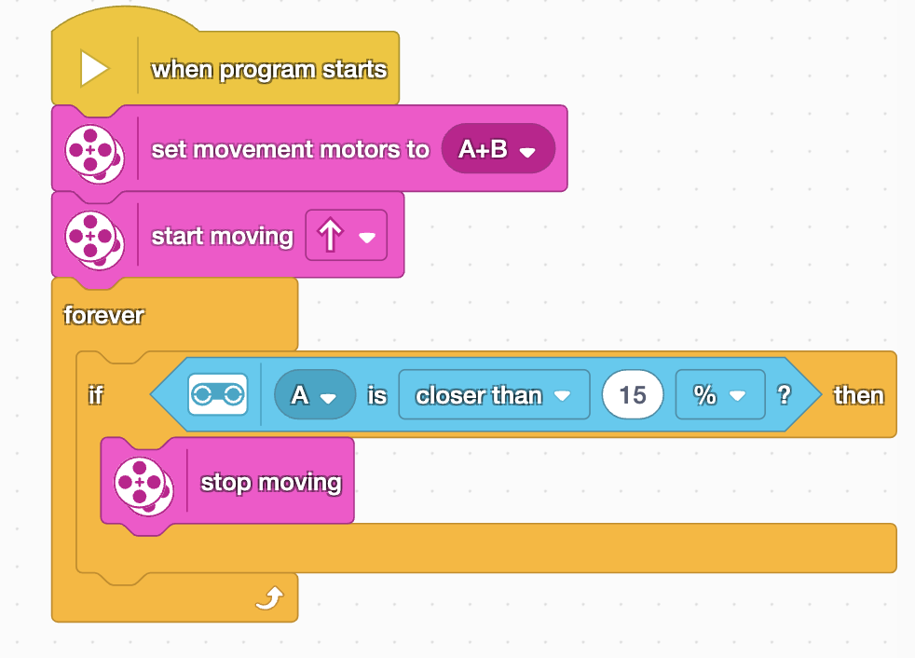
How to program
Funded by the European Union. Views and opinions expressed are however those of the author(s) only and do not necessarily reflect those of the European Union or the European Education and Culture Executive Agency (EACEA). Neither the European Union nor EACEA can be held responsible for them. Project no. 2022-1-PL01-KA220-HED-000086524

Slide 13

Activity Flow
Introduction: Explain autonomous systems and ethical dilemmas.
Programming: Students program the robot with decision-making rules.
Testing: Let the robot navigate the track and make decisions.
Discussion: Discuss the robot’s choices and the ethical implications of different programming rules.
Co-funded by the European Union. Views and opinions expressed are however those of the author(s) only and do not necessarily reflect those of the European Union or Fundacja Rozwoju Systemu Edukacji. Neither the European Union nor the granting authority can be held responsible for them. Project no. 2022-1-PL01-KA220-HED-000086524

Slide 14
Thank you for your attention!
Co-funded by the European Union. Views and opinions expressed are however those of the author(s) only and do not necessarily reflect those of the European Union or Fundacja Rozwoju Systemu Edukacji. Neither the European Union nor the granting authority can be held responsible for them. Project no. 2022-1-PL01-KA220-HED-000086524

Slide 15

This document may be copied, reproduced or modified according to the above rules. In addition, an acknowledgement of the authors of the document and all applicable portions of the copyright notice must be clearly referenced.
All rights reserved. © Copyright 2023 RbtsInMath

