Slide 1
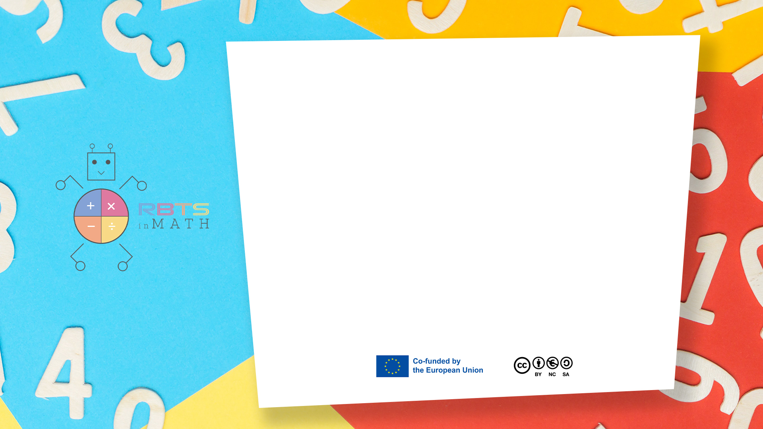
RbtsInMath: Developing Mathematics Achievement through Using Robotics Applications in Flipped Learning
2022-1-PL01-KA220-HED-000089820
MODULE 3: The History of Robotics Applications
in education
Lesson 3.3: Dance with Bees
Co-funded by the European Union. Views and opinions expressed are however those of the author(s) only and do not necessarily reflect those of the European Union or Fundacja Rozwoju Systemu Edukacji. Neither the European Union nor the granting authority can be held responsible for them.

Slide 2


MODULE 3: THE HISTORY OF ROBOTICS APPLICATIONS IN EDUCATION
Lesson 3.3:Dance with Bees
Prepared by:
All the pictures and photographs used in this publication are royalty-free, chosen from open sources.

Slide 3
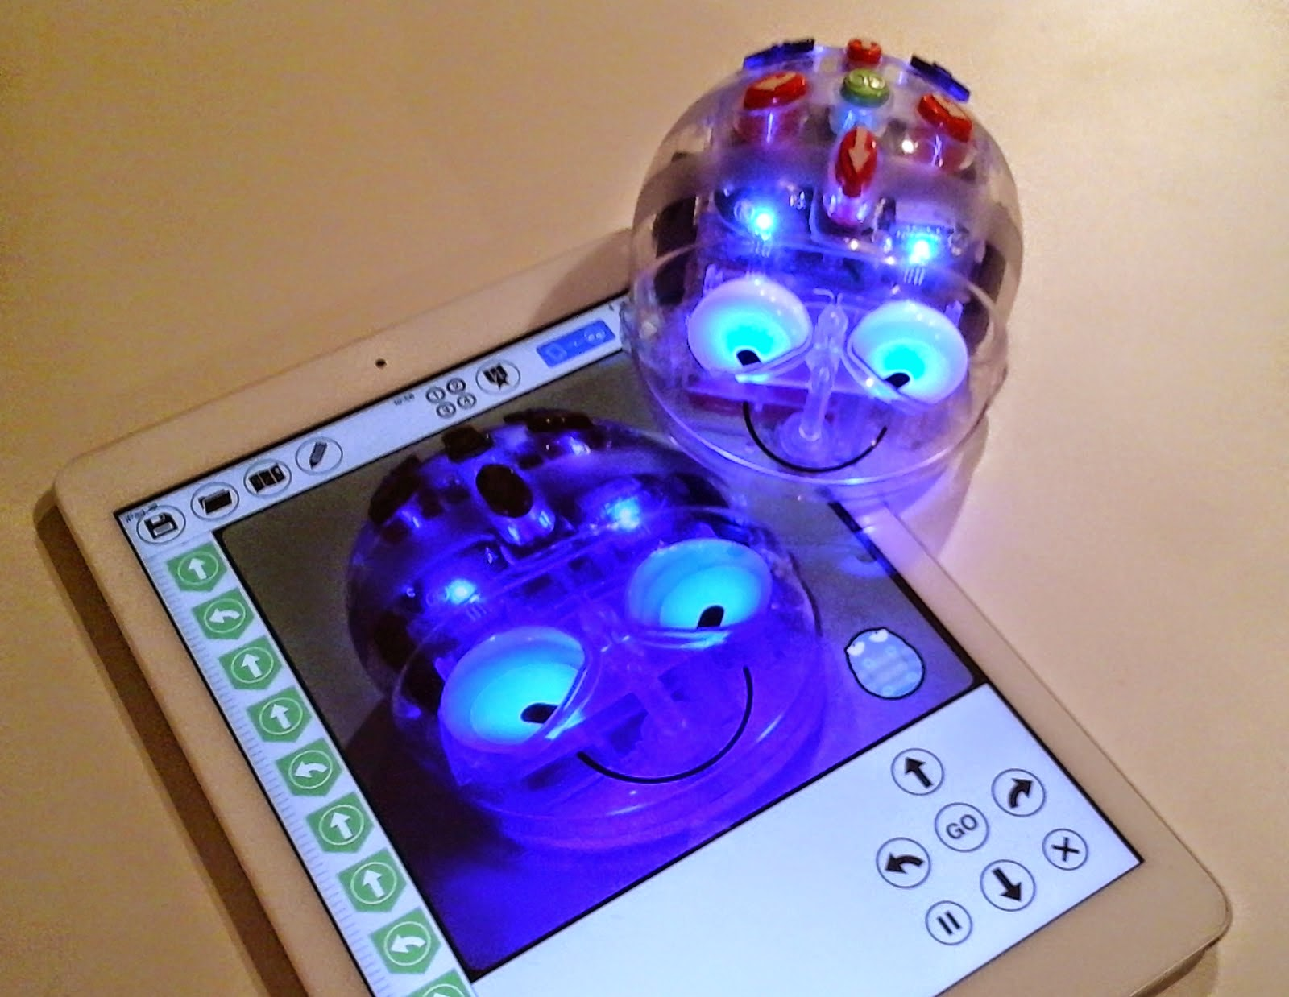
Dance with bees
Objective:
To teach students about paths, sequences, and spatial awareness while exploring geometrical concepts (rectangles) and programming.
Co-funded by the European Union. Views and opinions expressed are however those of the author(s) only and do not necessarily reflect those of the European Union or Fundacja Rozwoju Systemu Edukacji. Neither the European Union nor the granting authority can be held responsible for them. Project no. 2022-1-PL01-KA220-HED-000086524

Slide 4
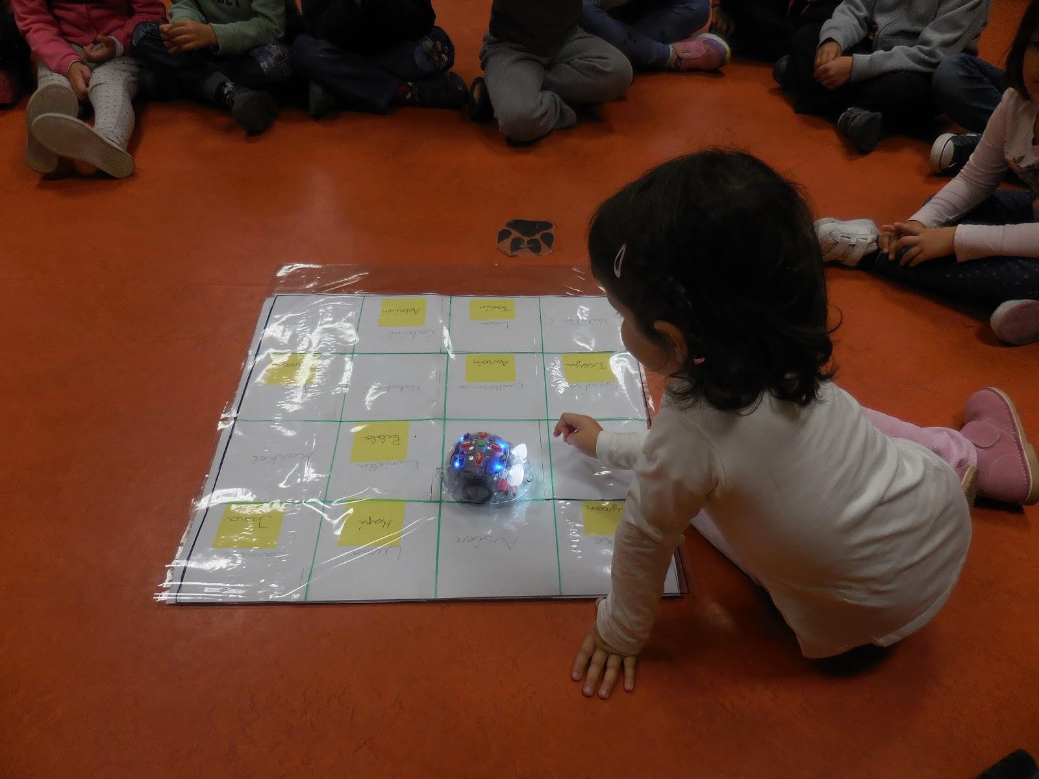
How to set the activity
Materials Needed:
Blue-Bot robots (one per group of students).
A large rectangular playmat or table marked with grid lines to form a rectangle.
Colored stickers or markers to designate different starting points around the rectangle.
A flag or a specific symbol to indicate the common arrival point.
Co-funded by the European Union. Views and opinions expressed are however those of the author(s) only and do not necessarily reflect those of the European Union or Fundacja Rozwoju Systemu Edukacji. Neither the European Union nor the granting authority can be held responsible for them. Project no. 2022-1-PL01-KA220-HED-000086524

Slide 5

Activity Flow
Discussion Points:
Geometry: Discuss the properties of the rectangle, such as opposite sides being equal in length.
Programming: Highlight the importance of precision in commands and testing sequences.
Collaboration: Reflect on how the groups worked together to program their Blue-Bot.
Co-funded by the European Union. Views and opinions expressed are however those of the author(s) only and do not necessarily reflect those of the European Union or Fundacja Rozwoju Systemu Edukacji. Neither the European Union nor the granting authority can be held responsible for them. Project no. 2022-1-PL01-KA220-HED-000086524

Slide 6
Thank you for your attention!
Co-funded by the European Union. Views and opinions expressed are however those of the author(s) only and do not necessarily reflect those of the European Union or Fundacja Rozwoju Systemu Edukacji. Neither the European Union nor the granting authority can be held responsible for them. Project no. 2022-1-PL01-KA220-HED-000086524

Slide 7

This document may be copied, reproduced or modified according to the above rules. In addition, an acknowledgement of the authors of the document and all applicable portions of the copyright notice must be clearly referenced.
All rights reserved. © Copyright 2023 RbtsInMath

