Slide 1
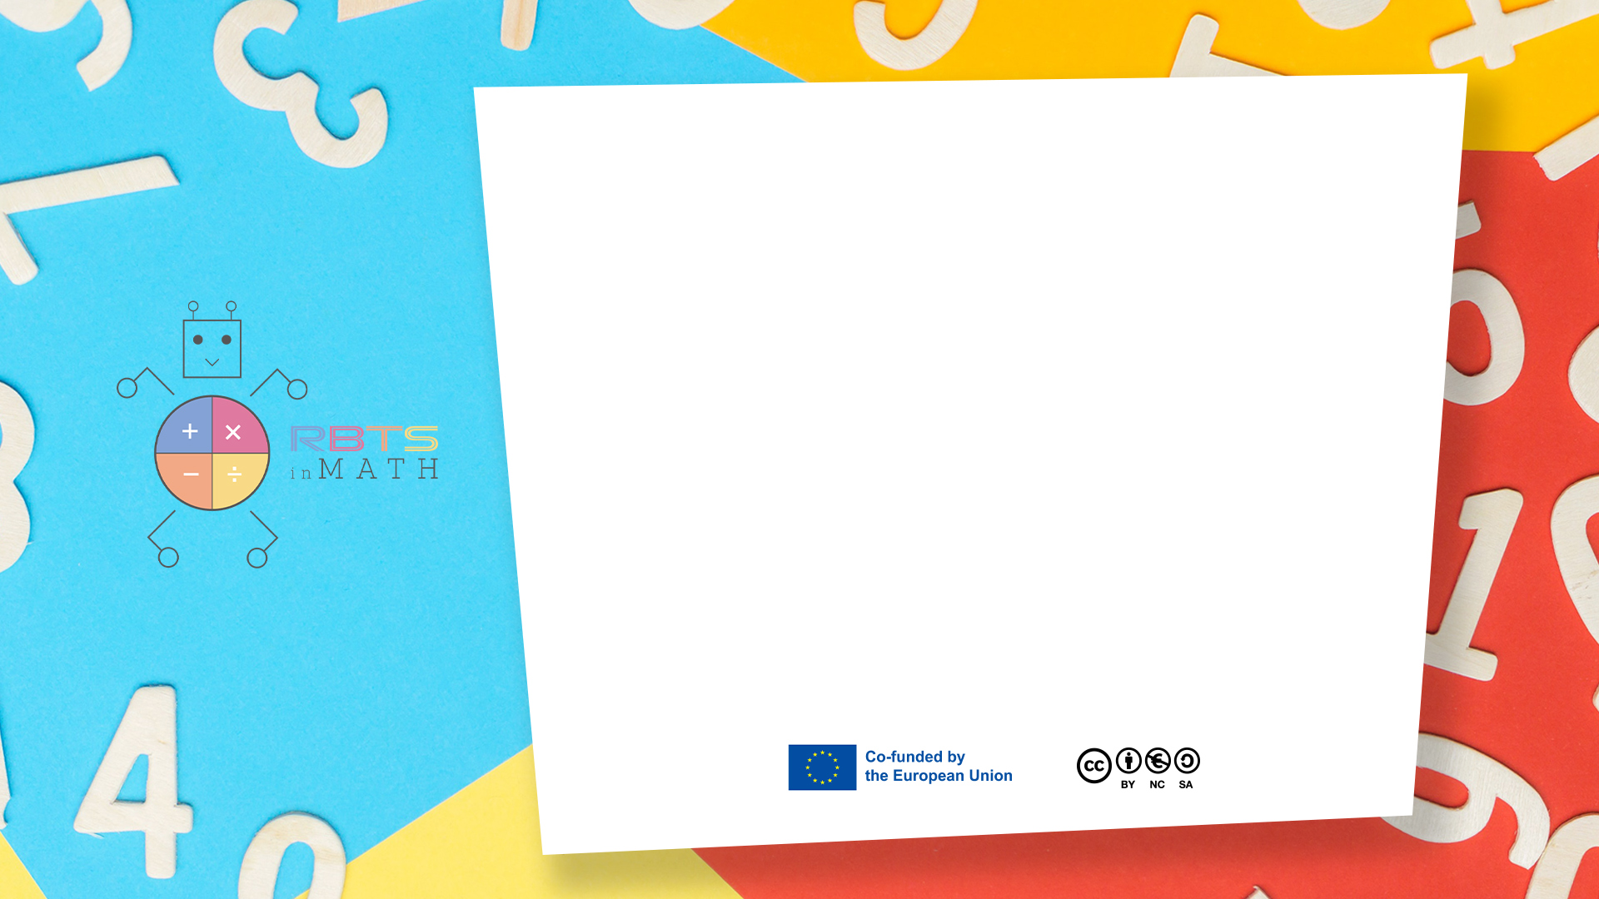
RbtsInMath: Developing Mathematics Achievement through Using Robotics Applications in Flipped Learning
2022-1-PL01-KA220-HED-000089820
MODULE 3: The History of Robotics Applications
in education
Lesson 3.4: Discovering Robotics and Math Connection
Co-funded by the European Union. Views and opinions expressed are however those of the author(s) only and do not necessarily reflect those of the European Union or Fundacja Rozwoju Systemu Edukacji. Neither the European Union nor the granting authority can be held responsible for them.

Slide 2


MODULE 3: THE HISTORY OF ROBOTICS APPLICATIONS IN EDUCATION
Lesson 3.4: Discovering Robotics and Math Connection
Prepared by:
All the pictures and photographs used in this publication are royalty-free, chosen from open sources.

Slide 3
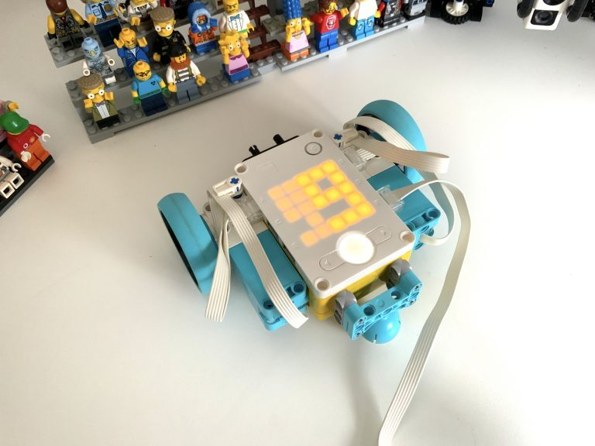
Discovering Robotics and Math Connection
Objective: Teach students about geometric shapes and their properties by programming a LEGO Spike Prime robot to trace them.
Questa foto di Autore sconosciuto è concesso in licenza da CC BY-SA-NC
Co-funded by the European Union. Views and opinions expressed are however those of the author(s) only and do not necessarily reflect those of the European Union or Fundacja Rozwoju Systemu Edukacji. Neither the European Union nor the granting authority can be held responsible for them. Project no. 2022-1-PL01-KA220-HED-000086524

Slide 4
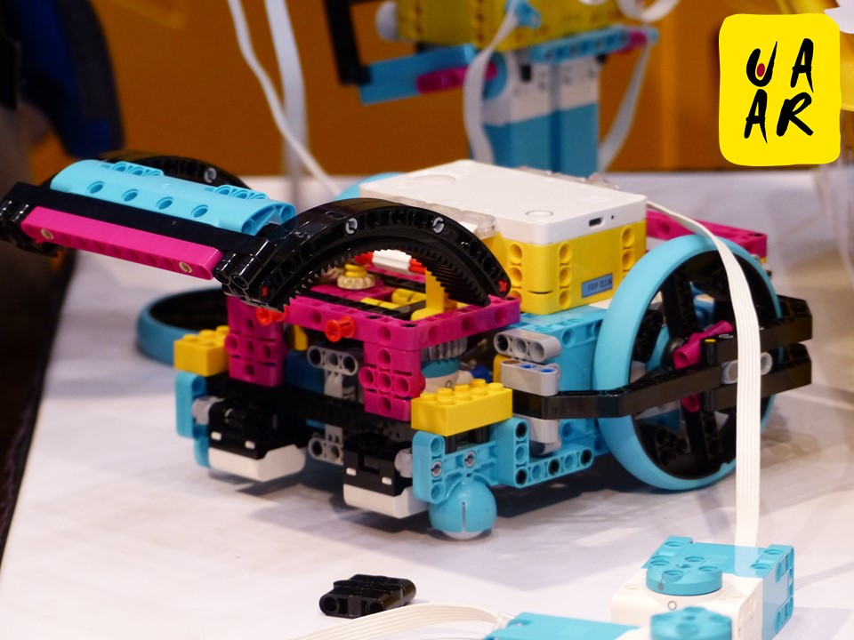
How to set the activity
Setup the Grid:
Create a grid with numbers or patterns on each cell.
Place the robot at the starting position.
Programming Challenge:
Provide students with a task like:
"Guide the robot to the cell with the largest number while avoiding obstacles."
"Collect data points (e.g., all even numbers) and return to the starting point."
Students must write a program using loops, conditions, and directional commands to achieve the task.
Analysis:
After completing the task, students discuss the path the robot took and how decisions were made.
Encourage students to reflect on how robots use data to make choices in real-world applications.
Questa foto di Autore sconosciuto è concesso in licenza da CC BY-NC-ND
Co-funded by the European Union. Views and opinions expressed are however those of the author(s) only and do not necessarily reflect those of the European Union or Fundacja Rozwoju Systemu Edukacji. Neither the European Union nor the granting authority can be held responsible for them. Project no. 2022-1-PL01-KA220-HED-000086524

Slide 5

Activity Flow
Learning Outcome:
Understanding of patterns, data collection, and logic in decision-making.
Development of coding and critical thinking skills.
Co-funded by the European Union. Views and opinions expressed are however those of the author(s) only and do not necessarily reflect those of the European Union or Fundacja Rozwoju Systemu Edukacji. Neither the European Union nor the granting authority can be held responsible for them. Project no. 2022-1-PL01-KA220-HED-000086524

Slide 6
Thank you for your attention!
Co-funded by the European Union. Views and opinions expressed are however those of the author(s) only and do not necessarily reflect those of the European Union or Fundacja Rozwoju Systemu Edukacji. Neither the European Union nor the granting authority can be held responsible for them. Project no. 2022-1-PL01-KA220-HED-000086524

Slide 7

This document may be copied, reproduced or modified according to the above rules. In addition, an acknowledgement of the authors of the document and all applicable portions of the copyright notice must be clearly referenced.
All rights reserved. © Copyright 2023 RbtsInMath

