Slide 1
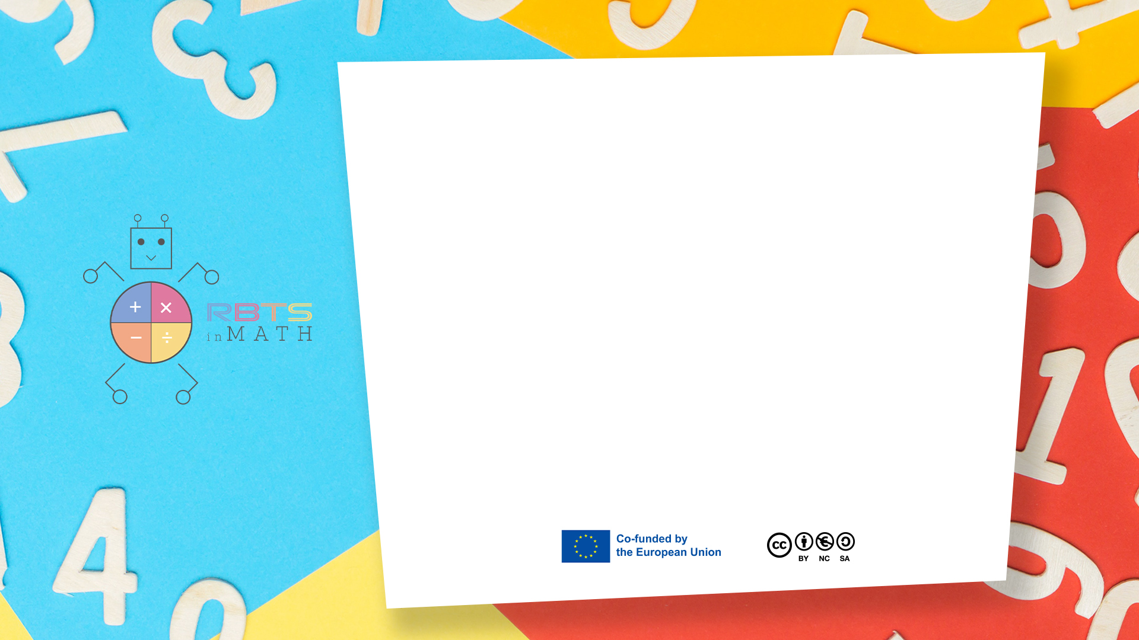
RbtsInMath: Developing Mathematics Achievement through Using Robotics Applications in Flipped Learning
2022-1-PL01-KA220-HED-000089820
MODULE 3: The History of Robotics Applications
in education
Lesson 3.5: Right and Left
Co-funded by the European Union. Views and opinions expressed are however those of the author(s) only and do not necessarily reflect those of the European Union or Fundacja Rozwoju Systemu Edukacji. Neither the European Union nor the granting authority can be held responsible for them.

Slide 2


MODULE 3: THE HISTORY OF ROBOTICS APPLICATIONS IN EDUCATION
Lesson 3.5: Right and Left
Prepared by:
All the pictures and photographs used in this publication are royalty-free, chosen from open sources.

Slide 3
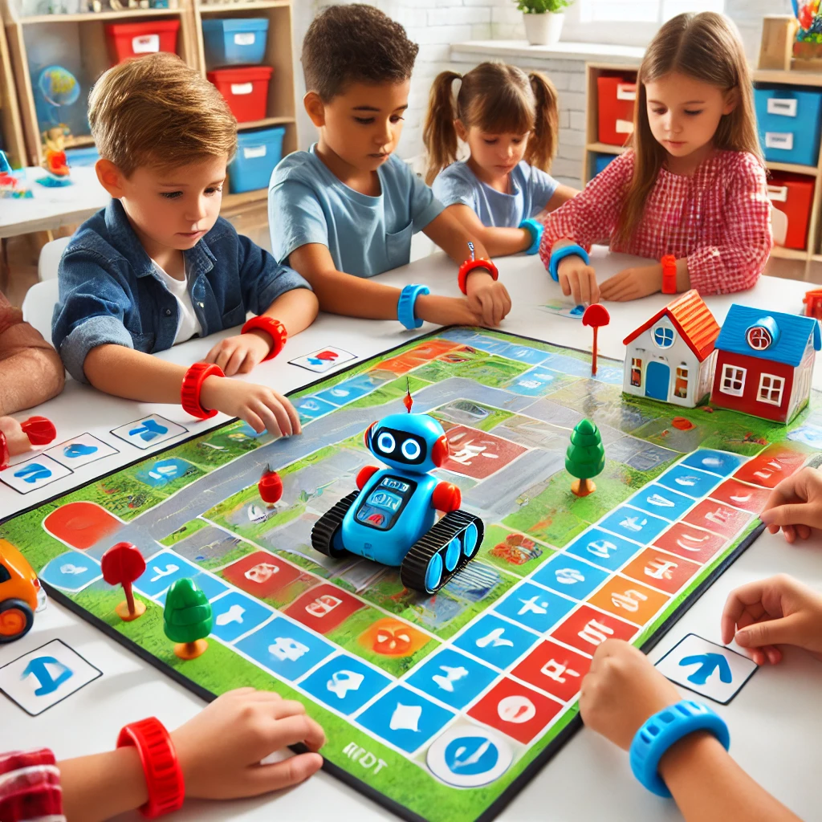
Right and Left
This activity combines the use of Blue-Bot and mTiny with a hands-on approach to teach children the concepts of "right" and "left" through movement and visual aids like colored bracelets.
Co-funded by the European Union. Views and opinions expressed are however those of the author(s) only and do not necessarily reflect those of the European Union or Fundacja Rozwoju Systemu Edukacji. Neither the European Union nor the granting authority can be held responsible for them. Project no. 2022-1-PL01-KA220-HED-000086524

Slide 4
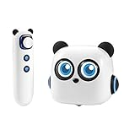
How to set the activity
Instructions:
Introduction:
Have students wear colored bracelets: red on their right wrist and blue on their left wrist.
Explain that the robot will follow their instructions to turn right or left, matching the bracelet colors.
Programming the Path:
Ask students to program the Blue-Bot to move to specific landmarks by using directional commands (e.g., forward, turn right, turn left).
As they program, encourage them to match the bracelet colors with the robot’s turning direction.
Challenge:
Increase complexity by introducing multiple turns or requiring the robot to visit checkpoints in a specific order.
Co-funded by the European Union. Views and opinions expressed are however those of the author(s) only and do not necessarily reflect those of the European Union or Fundacja Rozwoju Systemu Edukacji. Neither the European Union nor the granting authority can be held responsible for them. Project no. 2022-1-PL01-KA220-HED-000086524

Slide 5

Activity Flow
Learning Outcome:
Students will connect the concept of "right" and "left" with physical movement and visual cues (bracelets).
Co-funded by the European Union. Views and opinions expressed are however those of the author(s) only and do not necessarily reflect those of the European Union or Fundacja Rozwoju Systemu Edukacji. Neither the European Union nor the granting authority can be held responsible for them. Project no. 2022-1-PL01-KA220-HED-000086524

Slide 6
Thank you for your attention!
Co-funded by the European Union. Views and opinions expressed are however those of the author(s) only and do not necessarily reflect those of the European Union or Fundacja Rozwoju Systemu Edukacji. Neither the European Union nor the granting authority can be held responsible for them. Project no. 2022-1-PL01-KA220-HED-000086524

Slide 7
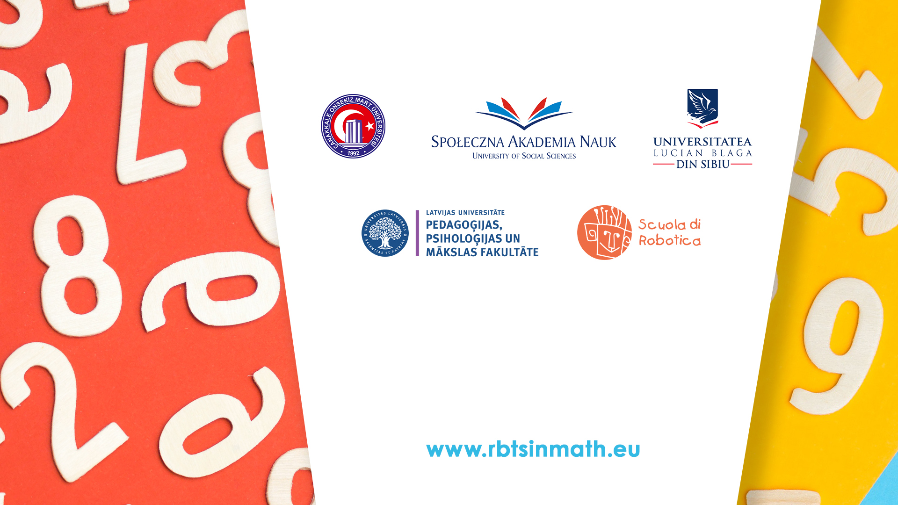
This document may be copied, reproduced or modified according to the above rules. In addition, an acknowledgement of the authors of the document and all applicable portions of the copyright notice must be clearly referenced.
All rights reserved. © Copyright 2023 RbtsInMath

