Slide 1
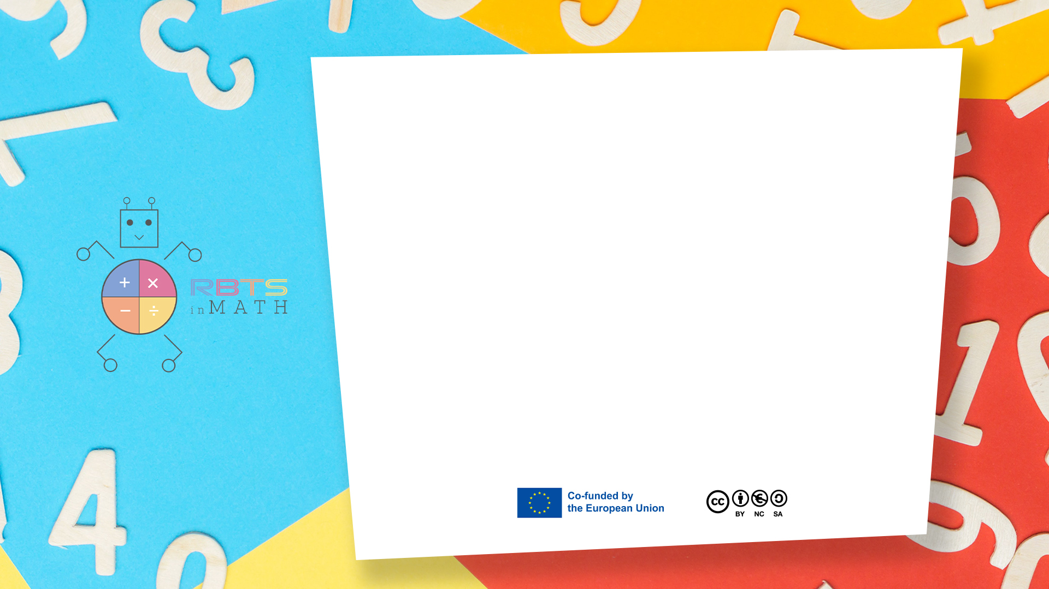
RbtsInMath: Developing Mathematics Achievement through Using Robotics Applications in Flipped Learning
2022-1-PL01-KA220-HED-000089820
MODULE 4: LEARNING MATH AS A GAME
Lesson 4.1: Benefits of using games in mathematics education
Co-funded by the European Union. Views and opinions expressed are however those of the author(s) only and do not necessarily reflect those of the European Union or Fundacja Rozwoju Systemu Edukacji. Neither the European Union nor the granting authority can be held responsible for them.

Slide 2


MODULE 4: LEARNING MATH AS A GAME
Lesson 4.1: Benefits of using games in mathematics education
Prepared by:
All the pictures and photographs used in this publication are royalty-free, chosen from open sources.

Slide 3

Benefits of using games in mathematics education
Math games makes practicing time more enjoyable and successful
Co-funded by the European Union. Views and opinions expressed are however those of the author(s) only and do not necessarily reflect those of the European Union or Fundacja Rozwoju Systemu Edukacji. Neither the European Union nor the granting authority can be held responsible for them. Project no. 2022-1-PL01-KA220-HED-000086524

Slide 4
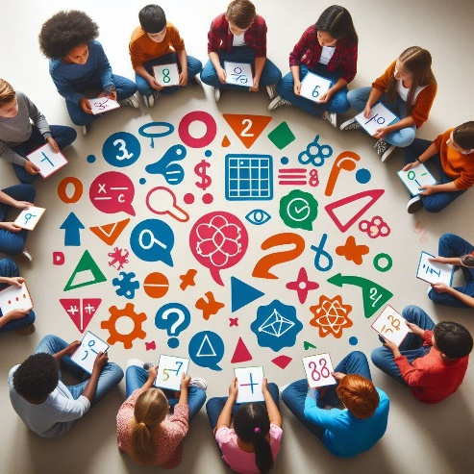
Benefits of using games in mathematics education
Math games enrich mathematics vocabulary
Co-funded by the European Union. Views and opinions expressed are however those of the author(s) only and do not necessarily reflect those of the European Union or Fundacja Rozwoju Systemu Edukacji. Neither the European Union nor the granting authority can be held responsible for them. Project no. 2022-1-PL01-KA220-HED-000086524

Slide 5
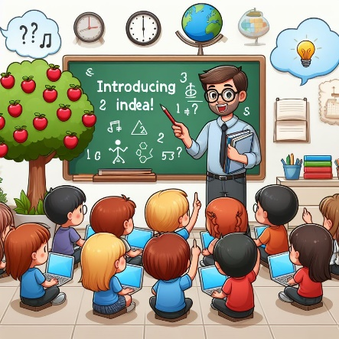
Benefits of using games in mathematics education
Math games introduce new math ideas
Co-funded by the European Union. Views and opinions expressed are however those of the author(s) only and do not necessarily reflect those of the European Union or Fundacja Rozwoju Systemu Edukacji. Neither the European Union nor the granting authority can be held responsible for them. Project no. 2022-1-PL01-KA220-HED-000086524

Slide 6
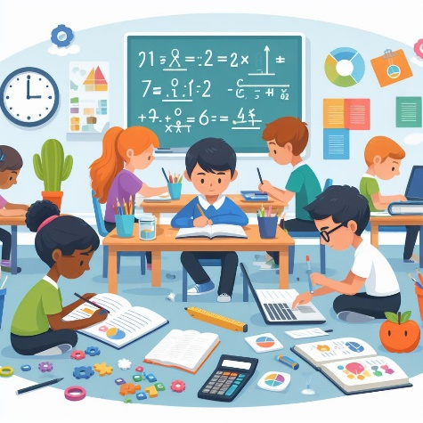
Benefits of using games in mathematics education
Math games are reviewing different maths skills or reinforcing specific skills
Co-funded by the European Union. Views and opinions expressed are however those of the author(s) only and do not necessarily reflect those of the European Union or Fundacja Rozwoju Systemu Edukacji. Neither the European Union nor the granting authority can be held responsible for them. Project no. 2022-1-PL01-KA220-HED-000086524

Slide 7

Benefits of using games in mathematics education
Math games create interest and enthusiasm for learning mathematics
Co-funded by the European Union. Views and opinions expressed are however those of the author(s) only and do not necessarily reflect those of the European Union or Fundacja Rozwoju Systemu Edukacji. Neither the European Union nor the granting authority can be held responsible for them. Project no. 2022-1-PL01-KA220-HED-000086524

Slide 8
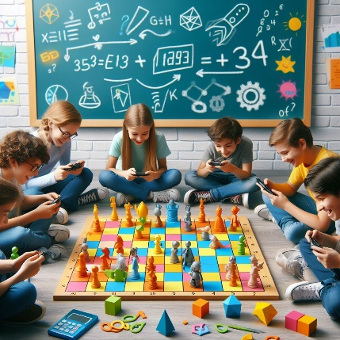
Benefits of using games in mathematics education
Math games are developing positive attitudes towards mathematics
Co-funded by the European Union. Views and opinions expressed are however those of the author(s) only and do not necessarily reflect those of the European Union or Fundacja Rozwoju Systemu Edukacji. Neither the European Union nor the granting authority can be held responsible for them. Project no. 2022-1-PL01-KA220-HED-000086524

Slide 9
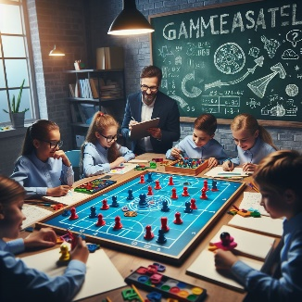
Benefits of using games in mathematics education
Math games are developing a sense of competitiveness, satisfaction and enjoyment
Co-funded by the European Union. Views and opinions expressed are however those of the author(s) only and do not necessarily reflect those of the European Union or Fundacja Rozwoju Systemu Edukacji. Neither the European Union nor the granting authority can be held responsible for them. Project no. 2022-1-PL01-KA220-HED-000086524

Slide 10
Conclusion
Mathematical games are tasks designed to foster a competitive spirit, a sense of fulfillment, and enjoyment. Additionally, they contribute to promoting creativity in mathematical thinking and facilitating meaningful learning that addresses societal requirements.
Co-funded by the European Union. Views and opinions expressed are however those of the author(s) only and do not necessarily reflect those of the European Union or Fundacja Rozwoju Systemu Edukacji. Neither the European Union nor the granting authority can be held responsible for them. Project no. 2022-1-PL01-KA220-HED-000086524

Slide 11
Thank you for your attention!
Co-funded by the European Union. Views and opinions expressed are however those of the author(s) only and do not necessarily reflect those of the European Union or Fundacja Rozwoju Systemu Edukacji. Neither the European Union nor the granting authority can be held responsible for them. Project no. 2022-1-PL01-KA220-HED-000086524

Slide 12
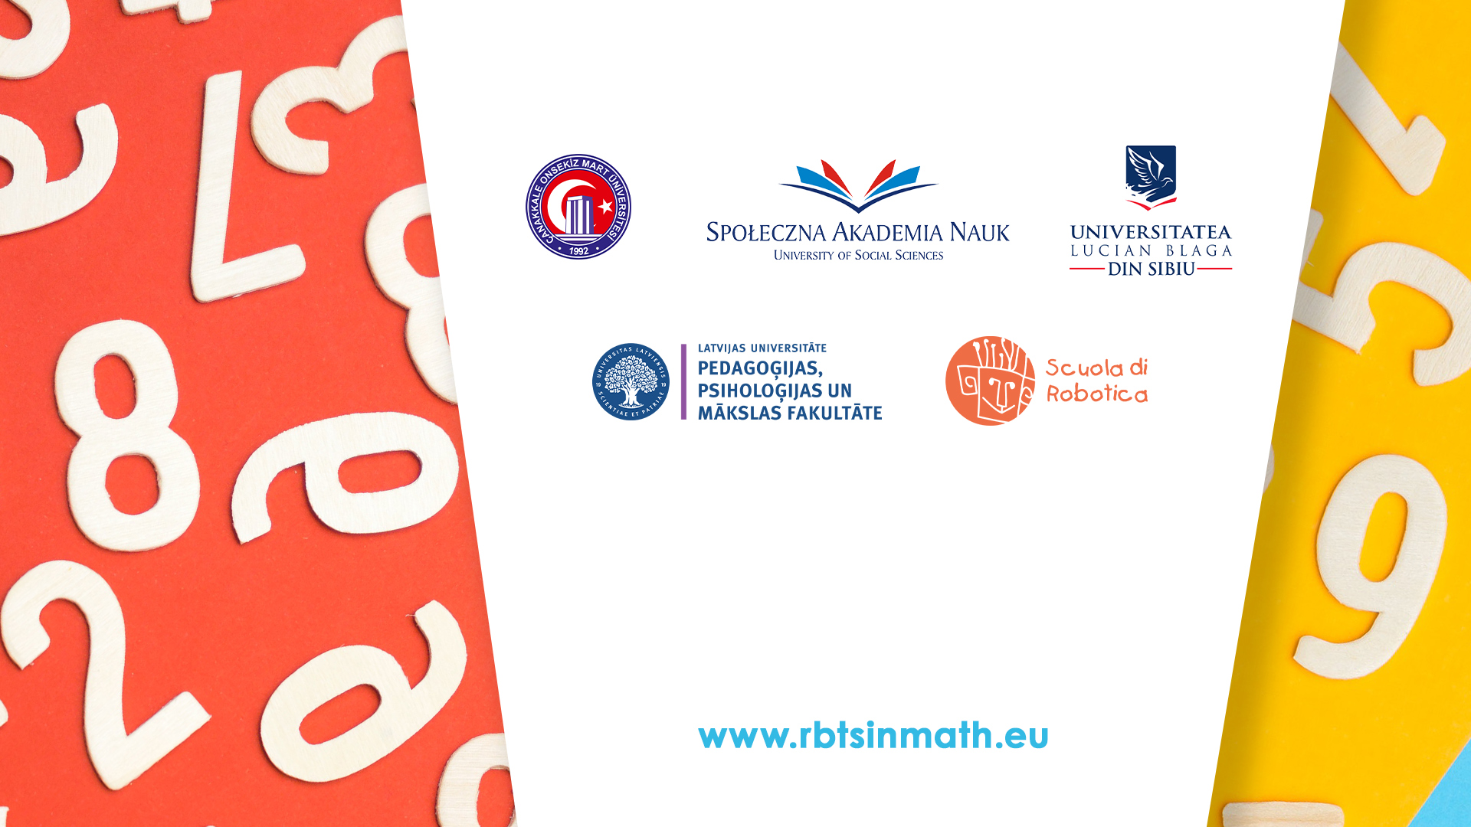
This document may be copied, reproduced or modified according to the above rules. In addition, an acknowledgement of the authors of the document and all applicable portions of the copyright notice must be clearly referenced.
All rights reserved. © Copyright 2023 RbtsInMath

