Slide 1
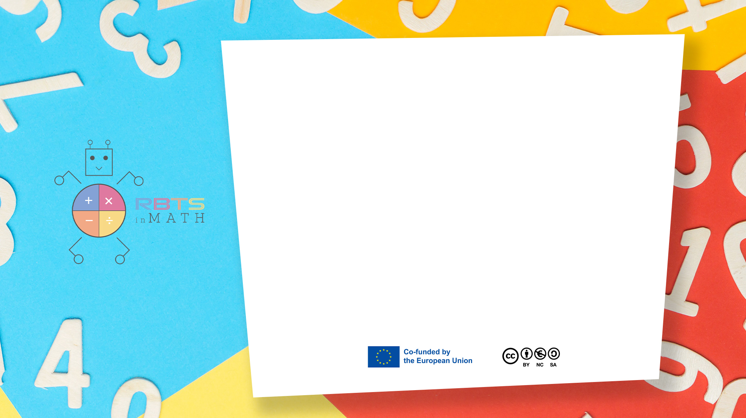
RbtsInMath: Developing Mathematics Achievement through Using Robotics Applications in Flipped Learning
2022-1-PL01-KA220-HED-000089820
MODULE 4: LEARNING MATH AS A GAME
Lesson 4.1.1: Game-based learning
Co-funded by the European Union. Views and opinions expressed are however those of the author(s) only and do not necessarily reflect those of the European Union or Fundacja Rozwoju Systemu Edukacji. Neither the European Union nor the granting authority can be held responsible for them.

Slide 2


MODULE 4: LEARNING MATH AS A GAME
Lesson 4.1.1: Game-based learning
Prepared by:
All the pictures and photographs used in this publication are royalty-free, chosen from open sources.

Slide 3

Game-based learning
Game-based learning is a method for learning new concepts and skills through digital and non-digital games
Co-funded by the European Union. Views and opinions expressed are however those of the author(s) only and do not necessarily reflect those of the European Union or Fundacja Rozwoju Systemu Edukacji. Neither the European Union nor the granting authority can be held responsible for them. Project no. 2022-1-PL01-KA220-HED-000086524

Slide 4

Game-based learning
Game-based learning aims to balance theoretical content and learning through games
Co-funded by the European Union. Views and opinions expressed are however those of the author(s) only and do not necessarily reflect those of the European Union or Fundacja Rozwoju Systemu Edukacji. Neither the European Union nor the granting authority can be held responsible for them. Project no. 2022-1-PL01-KA220-HED-000086524

Slide 5

Game-based learning
Game-based learning allows students to explore a rigorous learning environment and concepts and target learning outcomes
Co-funded by the European Union. Views and opinions expressed are however those of the author(s) only and do not necessarily reflect those of the European Union or Fundacja Rozwoju Systemu Edukacji. Neither the European Union nor the granting authority can be held responsible for them. Project no. 2022-1-PL01-KA220-HED-000086524

Slide 6
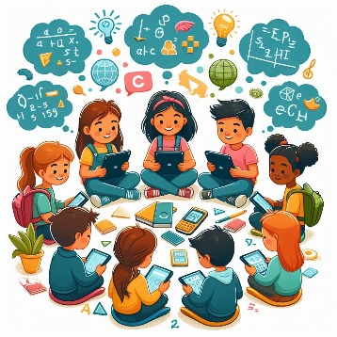
Game-based learning
Game-based learning increase student engagement
Co-funded by the European Union. Views and opinions expressed are however those of the author(s) only and do not necessarily reflect those of the European Union or Fundacja Rozwoju Systemu Edukacji. Neither the European Union nor the granting authority can be held responsible for them. Project no. 2022-1-PL01-KA220-HED-000086524

Slide 7

Game-based learning
Game-based learning improve motivation and increase students' interest in the subject
Co-funded by the European Union. Views and opinions expressed are however those of the author(s) only and do not necessarily reflect those of the European Union or Fundacja Rozwoju Systemu Edukacji. Neither the European Union nor the granting authority can be held responsible for them. Project no. 2022-1-PL01-KA220-HED-000086524

Slide 8

Game-based learning
Game-based learning improve students' critical thinking, interpersonal communication and debating
Co-funded by the European Union. Views and opinions expressed are however those of the author(s) only and do not necessarily reflect those of the European Union or Fundacja Rozwoju Systemu Edukacji. Neither the European Union nor the granting authority can be held responsible for them. Project no. 2022-1-PL01-KA220-HED-000086524

Slide 9
Conclusion
Game-based learning becomes more than just a teaching tool—it becomes a catalyst for the development of essential 21st-century skills that are crucial for success in a rapidly evolving world. As students engage in immersive gameplay, they hone their critical thinking, interpersonal communication, and debating skills, empowering them to become confident, capable, and engaged citizens of the future
Co-funded by the European Union. Views and opinions expressed are however those of the author(s) only and do not necessarily reflect those of the European Union or Fundacja Rozwoju Systemu Edukacji. Neither the European Union nor the granting authority can be held responsible for them. Project no. 2022-1-PL01-KA220-HED-000086524

Slide 10
Thank you for your attention!
Co-funded by the European Union. Views and opinions expressed are however those of the author(s) only and do not necessarily reflect those of the European Union or Fundacja Rozwoju Systemu Edukacji. Neither the European Union nor the granting authority can be held responsible for them. Project no. 2022-1-PL01-KA220-HED-000086524

Slide 11

This document may be copied, reproduced or modified according to the above rules. In addition, an acknowledgement of the authors of the document and all applicable portions of the copyright notice must be clearly referenced.
All rights reserved. © Copyright 2023 RbtsInMath

