Slide 1
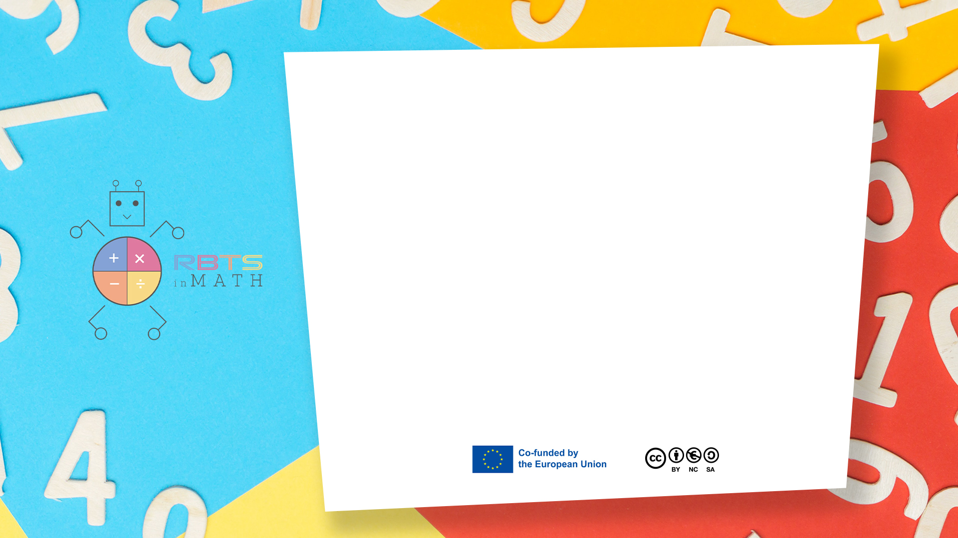
RbtsInMath: Developing Mathematics Achievement through Using Robotics Applications in Flipped Learning
2022-1-PL01-KA220-HED-000089820
MODULE 4: LEARNING MATH AS A GAME
Lesson 4.2: Designing of math game
Co-funded by the European Union. Views and opinions expressed are however those of the author(s) only and do not necessarily reflect those of the European Union or Fundacja Rozwoju Systemu Edukacji. Neither the European Union nor the granting authority can be held responsible for them.

Slide 2


MODULE 4: LEARNING MATH AS A GAME
Lesson 4.2:Designing of math game
Prepared by:
All the pictures and photographs used in this publication are royalty-free, chosen from open sources.

Slide 3
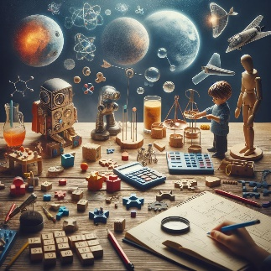
Principles of educationally - rich math games
Understanding the principles of educationally rich mathematical games can help educators create new games and evaluate existing ones
Co-funded by the European Union. Views and opinions expressed are however those of the author(s) only and do not necessarily reflect those of the European Union or Fundacja Rozwoju Systemu Edukacji. Neither the European Union nor the granting authority can be held responsible for them. Project no. 2022-1-PL01-KA220-HED-000086524

Slide 4
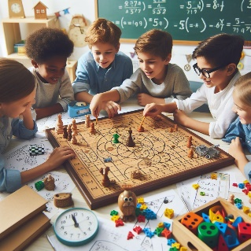
Principles of educationally - rich math games
The maths game gets the students involved. Maths games should be engaging, fun and stimulate mathematical discussion
Co-funded by the European Union. Views and opinions expressed are however those of the author(s) only and do not necessarily reflect those of the European Union or Fundacja Rozwoju Systemu Edukacji. Neither the European Union nor the granting authority can be held responsible for them. Project no. 2022-1-PL01-KA220-HED-000086524

Slide 5
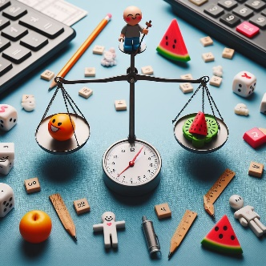
Principles of educationally - rich math games
In mathematical games, skill and luck must be balanced. There is a balance between skill and luck
Co-funded by the European Union. Views and opinions expressed are however those of the author(s) only and do not necessarily reflect those of the European Union or Fundacja Rozwoju Systemu Edukacji. Neither the European Union nor the granting authority can be held responsible for them. Project no. 2022-1-PL01-KA220-HED-000086524

Slide 6

Principles of educationally - rich math games
Mathematics is at the heart of maths games. Exploring and practicing maths concepts and skills is central to strategy and play
Co-funded by the European Union. Views and opinions expressed are however those of the author(s) only and do not necessarily reflect those of the European Union or Fundacja Rozwoju Systemu Edukacji. Neither the European Union nor the granting authority can be held responsible for them. Project no. 2022-1-PL01-KA220-HED-000086524

Slide 7
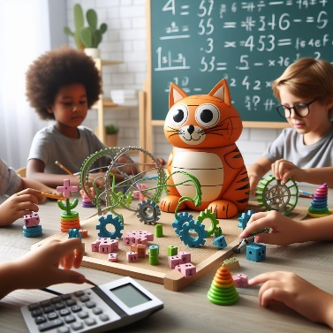
Principles of educationally - rich math games
Flexibility in the learning and teaching process. Mathematics games should be differentiated to suit different learners and should be adaptable to learn different concepts
Co-funded by the European Union. Views and opinions expressed are however those of the author(s) only and do not necessarily reflect those of the European Union or Fundacja Rozwoju Systemu Edukacji. Neither the European Union nor the granting authority can be held responsible for them. Project no. 2022-1-PL01-KA220-HED-000086524

Slide 8

Principles of educationally - rich math games
The link between home and school should be promoted through maths games
Co-funded by the European Union. Views and opinions expressed are however those of the author(s) only and do not necessarily reflect those of the European Union or Fundacja Rozwoju Systemu Edukacji. Neither the European Union nor the granting authority can be held responsible for them. Project no. 2022-1-PL01-KA220-HED-000086524

Slide 9
Conclusion
An understanding of these principles can prove beneficial for educators engaged in the development of new games and the evaluation of existing ones.
Co-funded by the European Union. Views and opinions expressed are however those of the author(s) only and do not necessarily reflect those of the European Union or Fundacja Rozwoju Systemu Edukacji. Neither the European Union nor the granting authority can be held responsible for them. Project no. 2022-1-PL01-KA220-HED-000086524

Slide 10
Thank you for your attention!
Co-funded by the European Union. Views and opinions expressed are however those of the author(s) only and do not necessarily reflect those of the European Union or Fundacja Rozwoju Systemu Edukacji. Neither the European Union nor the granting authority can be held responsible for them. Project no. 2022-1-PL01-KA220-HED-000086524

Slide 11

This document may be copied, reproduced or modified according to the above rules. In addition, an acknowledgement of the authors of the document and all applicable portions of the copyright notice must be clearly referenced.
All rights reserved. © Copyright 2023 RbtsInMath

