Slide 1
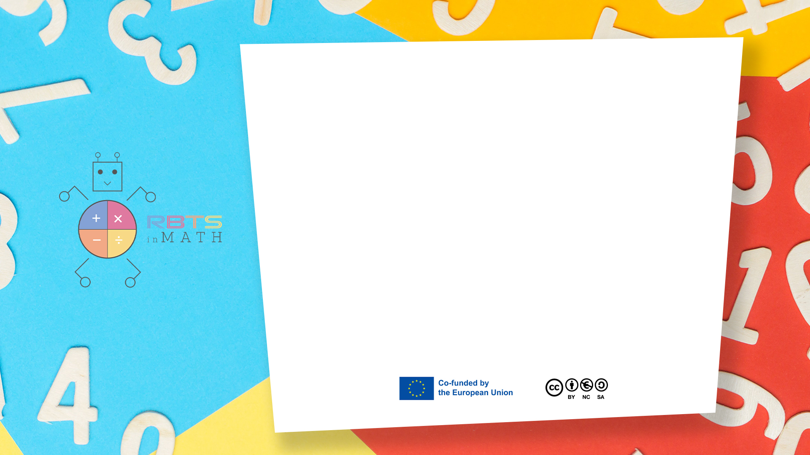
RbtsInMath: Developing Mathematics Achievement
through Using Robotics Applications in Flipped Learning
2022-1-PL01-KA220-HED-000089820
MODULE 4:
LEARNING MATH AS A GAME
Lesson 4.2.1: Types of games
Co-funded by the European Union. Views and opinions expressed are however those of the author(s) only and do not necessarily reflect those of the European Union or Fundacja Rozwoju Systemu Edukacji. Neither the European Union nor the granting authority can be held responsible for them.

Slide 2


MODULE 4:
LEARNING MATH AS A GAME
Lesson 4.2.1:Types of games
Prepared by:
All the pictures and photographs used in this publication are royalty-free, chosen from open sources.

Slide 3
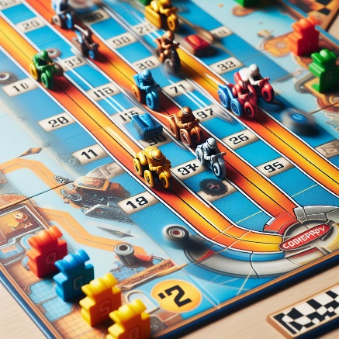
Several types of games
Race-themed board games involve moving pieces toward a finishing point, as well as some games that incorporate time-based challenges.
Remember that while some of these games emphasize mathematical concepts (like counting, probability, and strategy), others are more focused on fun and entertainment. Choose games that align with your interests and learning goals!
Co-funded by the European Union. Views and opinions expressed are however those of the author(s) only and do not necessarily reflect those of the European Union or Fundacja Rozwoju Systemu Edukacji. Neither the European Union nor the granting authority can be held responsible for them. Project no. 2022-1-PL01-KA220-HED-000086524

Slide 4
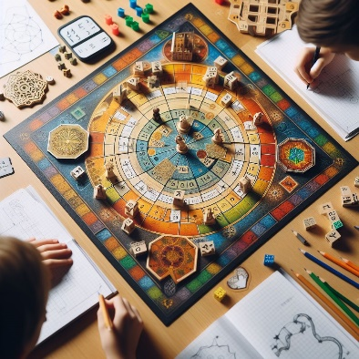
Several types of games
Board games. Engaging Board games incorporate mathematical concepts while players move around the board to achieve specific goals. These games can be adapted to include math problems and puzzles, enhancing their educational value
Remember, adapting these games by incorporating math problems and puzzles can make them even more valuable in the classroom. Enjoy playing and learning!
Co-funded by the European Union. Views and opinions expressed are however those of the author(s) only and do not necessarily reflect those of the European Union or Fundacja Rozwoju Systemu Edukacji. Neither the European Union nor the granting authority can be held responsible for them. Project no. 2022-1-PL01-KA220-HED-000086524

Slide 5

Several types of games
Spatial strategy games engage players in moving pieces around the board to outwit opponents, capture key positions, or block their progress
Remember, these games offer a blend of strategy, tactics, and spatial reasoning. Whether you’re maneuvering knights in chess or sliding stones in Go, each move shapes the outcome!
Co-funded by the European Union. Views and opinions expressed are however those of the author(s) only and do not necessarily reflect those of the European Union or Fundacja Rozwoju Systemu Edukacji. Neither the European Union nor the granting authority can be held responsible for them. Project no. 2022-1-PL01-KA220-HED-000086524

Slide 6
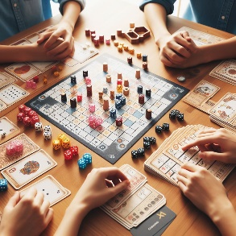
Several types of games
Numerical strategy games challenge players to remove pieces strategically in order to achieve specific goals. These games often involve analyzing moves, patterns, and mathematical reasoning.
Remember that these games offer opportunities for mathematical exploration, especially when players adapt strategies, explore variations, and extend the rules. Enjoy the challenge!
Co-funded by the European Union. Views and opinions expressed are however those of the author(s) only and do not necessarily reflect those of the European Union or Fundacja Rozwoju Systemu Edukacji. Neither the European Union nor the granting authority can be held responsible for them. Project no. 2022-1-PL01-KA220-HED-000086524

Slide 7
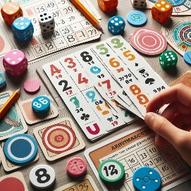
Several types of games
Engaging math card games that you can play using a standard deck of cards. These games help reinforce math skills while having fun.
Remember, these games make math enjoyable and provide valuable practice. Feel free to adapt the rules or create your own variations!
Co-funded by the European Union. Views and opinions expressed are however those of the author(s) only and do not necessarily reflect those of the European Union or Fundacja Rozwoju Systemu Edukacji. Neither the European Union nor the granting authority can be held responsible for them. Project no. 2022-1-PL01-KA220-HED-000086524

Slide 8
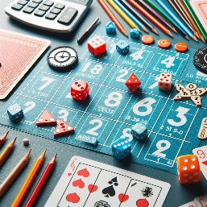
Several types of games
Arithmetic games that use cards, dice, or targets to create numbers, which players then calculate according to specific rules. These games often incorporate an element of chance, making them engaging and fun.
Remember, these games combine math skills with an element of chance, making them both educational and entertaining!
Co-funded by the European Union. Views and opinions expressed are however those of the author(s) only and do not necessarily reflect those of the European Union or Fundacja Rozwoju Systemu Edukacji. Neither the European Union nor the granting authority can be held responsible for them. Project no. 2022-1-PL01-KA220-HED-000086524

Slide 9
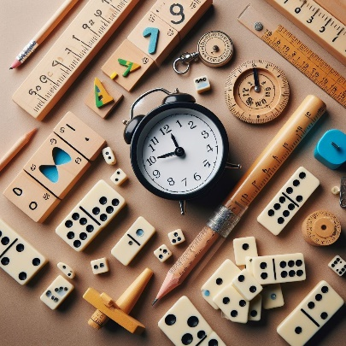
Several types of games
Matching games using dominoes that involve matching ends or creating patterns.
Remember, dominoes offer a versatile and fun way to explore math concepts!
Co-funded by the European Union. Views and opinions expressed are however those of the author(s) only and do not necessarily reflect those of the European Union or Fundacja Rozwoju Systemu Edukacji. Neither the European Union nor the granting authority can be held responsible for them. Project no. 2022-1-PL01-KA220-HED-000086524

Slide 10
Conclusion
Game strategy and mathematical proficiency are separately important constructs to consider when selecting and designing games for mathematics learning.
Co-funded by the European Union. Views and opinions expressed are however those of the author(s) only and do not necessarily reflect those of the European Union or Fundacja Rozwoju Systemu Edukacji. Neither the European Union nor the granting authority can be held responsible for them. Project no. 2022-1-PL01-KA220-HED-000086524

Slide 11
Thank you for your attention!
Co-funded by the European Union. Views and opinions expressed are however those of the author(s) only and do not necessarily reflect those of the European Union or Fundacja Rozwoju Systemu Edukacji. Neither the European Union nor the granting authority can be held responsible for them. Project no. 2022-1-PL01-KA220-HED-000086524

Slide 12
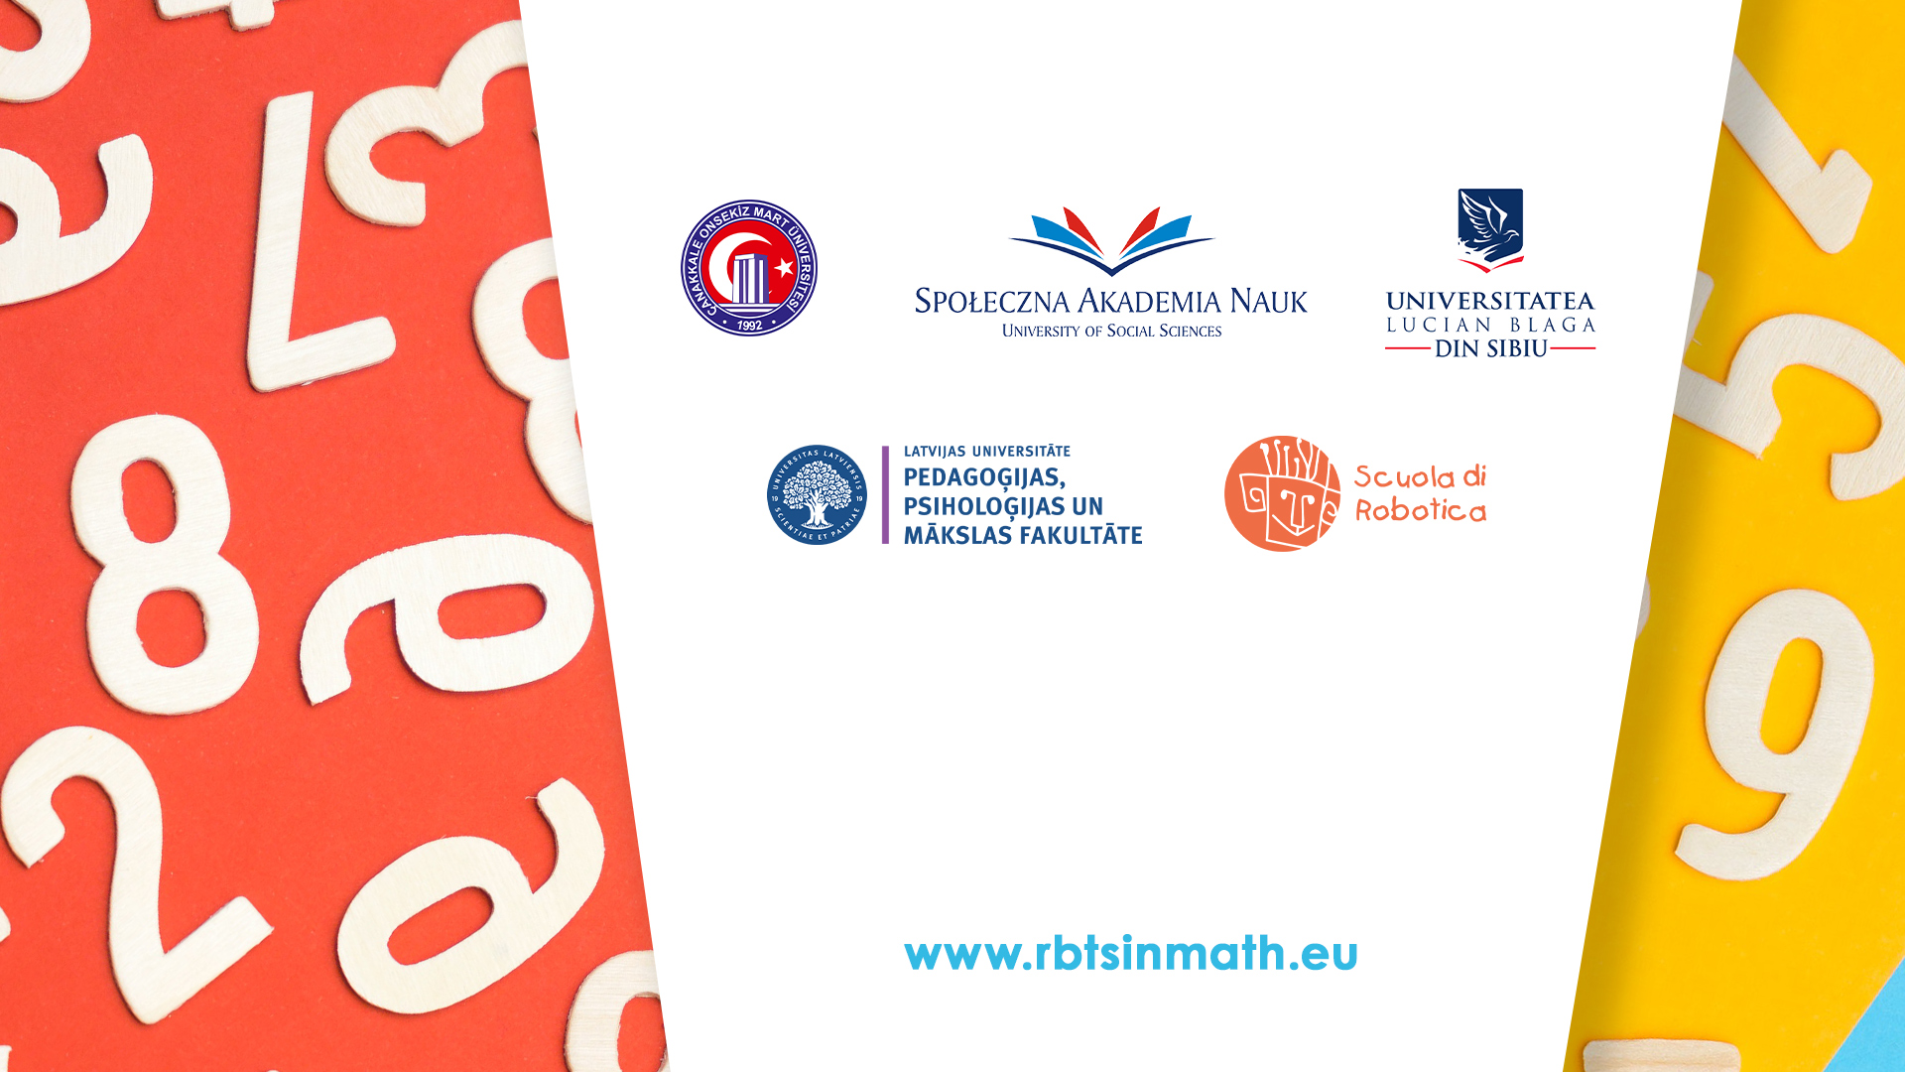
This document may be copied, reproduced or modified according to the above rules.
In addition, an acknowledgement of the authors of the document and
all applicable portions of the copyright notice must be clearly referenced.
All rights reserved. © Copyright 2023 RbtsInMath

