Slide 1
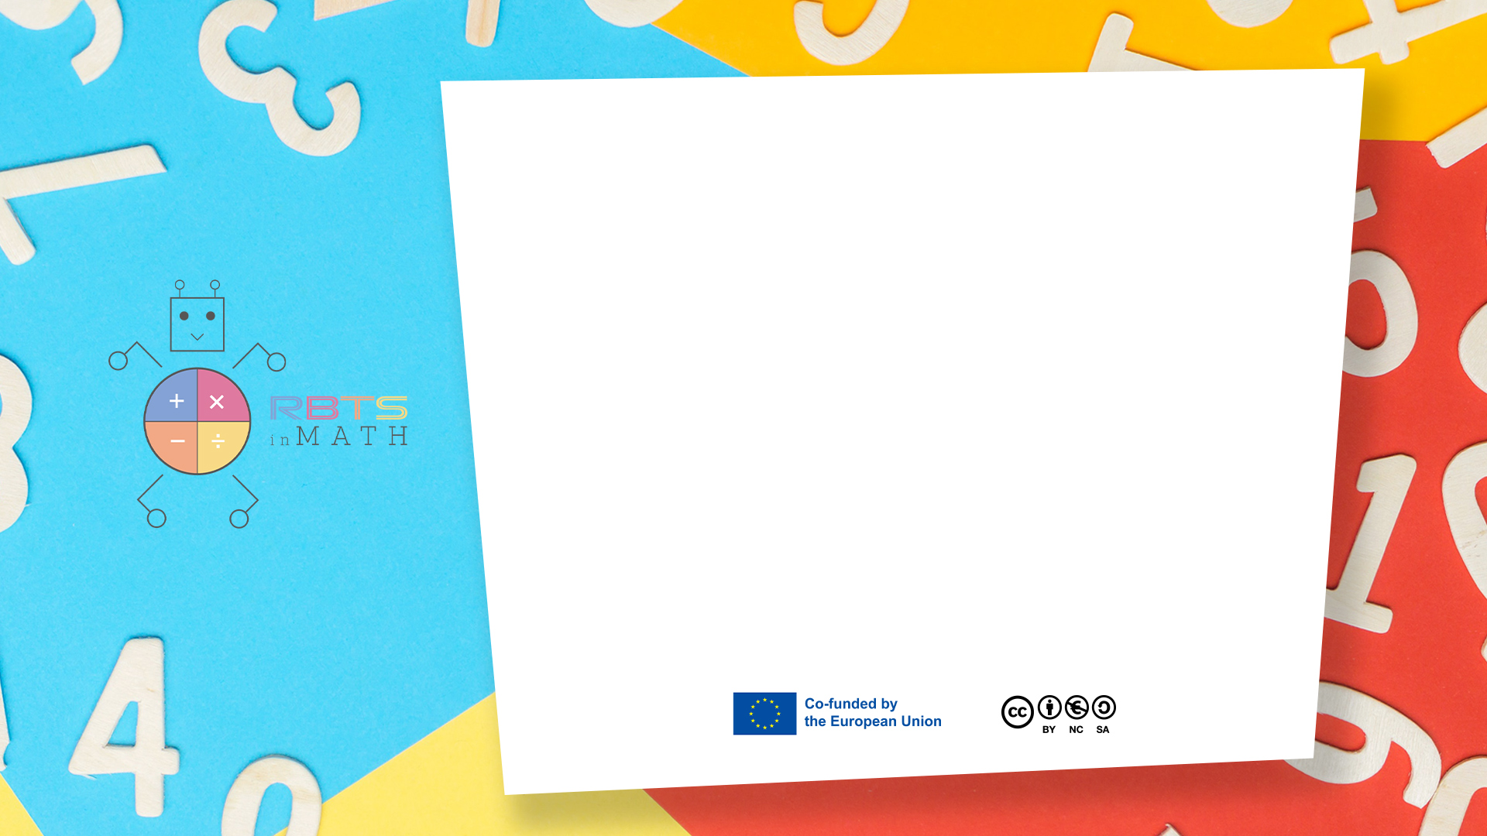
RbtsInMath: Developing Mathematics Achievement
through Using Robotics Applications in Flipped Learning
2022-1-PL01-KA220-HED-000089820
MODULE 4:
LEARNING MATH AS A GAME
Lesson 4.3: Practices on using games in mathematics education in primary schools
Co-funded by the European Union. Views and opinions expressed are however those of the author(s) only and do not necessarily reflect those of the European Union or Fundacja Rozwoju Systemu Edukacji. Neither the European Union nor the granting authority can be held responsible for them.

Slide 2


MODULE 4:
LEARNING MATH AS A GAME
Lesson 4.3:Practices on using games in mathematics education in primary schools
Prepared by:
All the pictures and photographs used in this publication are royalty-free, chosen from open sources.

Slide 3

Tips for successful classroom games
Ensure that the game fulfills the mathematical objectives
Co-funded by the European Union. Views and opinions expressed are however those of the author(s) only and do not necessarily reflect those of the European Union or Fundacja Rozwoju Systemu Edukacji. Neither the European Union nor the granting authority can be held responsible for them. Project no. 2022-1-PL01-KA220-HED-000086524

Slide 4
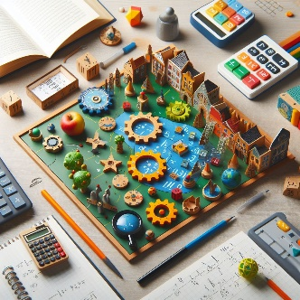
Tips for successful classroom games
The use of games for specific purposes, not just as a way to pass the time
Co-funded by the European Union. Views and opinions expressed are however those of the author(s) only and do not necessarily reflect those of the European Union or Fundacja Rozwoju Systemu Edukacji. Neither the European Union nor the granting authority can be held responsible for them. Project no. 2022-1-PL01-KA220-HED-000086524

Slide 5
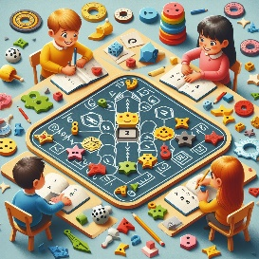
Tips for successful classroom games
The number of players should be between two and four, so that turn changes take place quickly
Co-funded by the European Union. Views and opinions expressed are however those of the author(s) only and do not necessarily reflect those of the European Union or Fundacja Rozwoju Systemu Edukacji. Neither the European Union nor the granting authority can be held responsible for them. Project no. 2022-1-PL01-KA220-HED-000086524

Slide 6

Tips for successful classroom games
There should be enough of an element of chance in the game so that the weaker students feel that they have a chance of winning
Co-funded by the European Union. Views and opinions expressed are however those of the author(s) only and do not necessarily reflect those of the European Union or Fundacja Rozwoju Systemu Edukacji. Neither the European Union nor the granting authority can be held responsible for them. Project no. 2022-1-PL01-KA220-HED-000086524

Slide 7
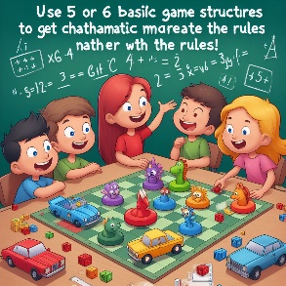
Tips for successful classroom games
Use five or six 'basic' game structures to get children used to the rules - vary the mathematics rather than the rules
Co-funded by the European Union. Views and opinions expressed are however those of the author(s) only and do not necessarily reflect those of the European Union or Fundacja Rozwoju Systemu Edukacji. Neither the European Union nor the granting authority can be held responsible for them. Project no. 2022-1-PL01-KA220-HED-000086524

Slide 8
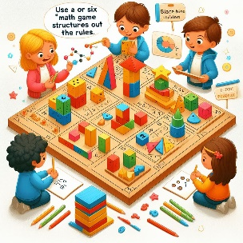
Tips for successful classroom games
Invite children to create their own games or to adapt existing ones
Co-funded by the European Union. Views and opinions expressed are however those of the author(s) only and do not necessarily reflect those of the European Union or Fundacja Rozwoju Systemu Edukacji. Neither the European Union nor the granting authority can be held responsible for them. Project no. 2022-1-PL01-KA220-HED-000086524

Slide 9
Conclusion
It is the responsibility of the teacher to select games that contain concepts relevant to the students, ensuring that the games chosen are appropriate for the age and ability of the students.
Co-funded by the European Union. Views and opinions expressed are however those of the author(s) only and do not necessarily reflect those of the European Union or Fundacja Rozwoju Systemu Edukacji. Neither the European Union nor the granting authority can be held responsible for them. Project no. 2022-1-PL01-KA220-HED-000086524

Slide 10
Thank you for your attention!
Co-funded by the European Union. Views and opinions expressed are however those of the author(s) only and do not necessarily reflect those of the European Union or Fundacja Rozwoju Systemu Edukacji. Neither the European Union nor the granting authority can be held responsible for them. Project no. 2022-1-PL01-KA220-HED-000086524

Slide 11

This document may be copied, reproduced or modified according to the above rules.
In addition, an acknowledgement of the authors of the document and
all applicable portions of the copyright notice must be clearly referenced.
All rights reserved. © Copyright 2023 RbtsInMath

