Slide 1
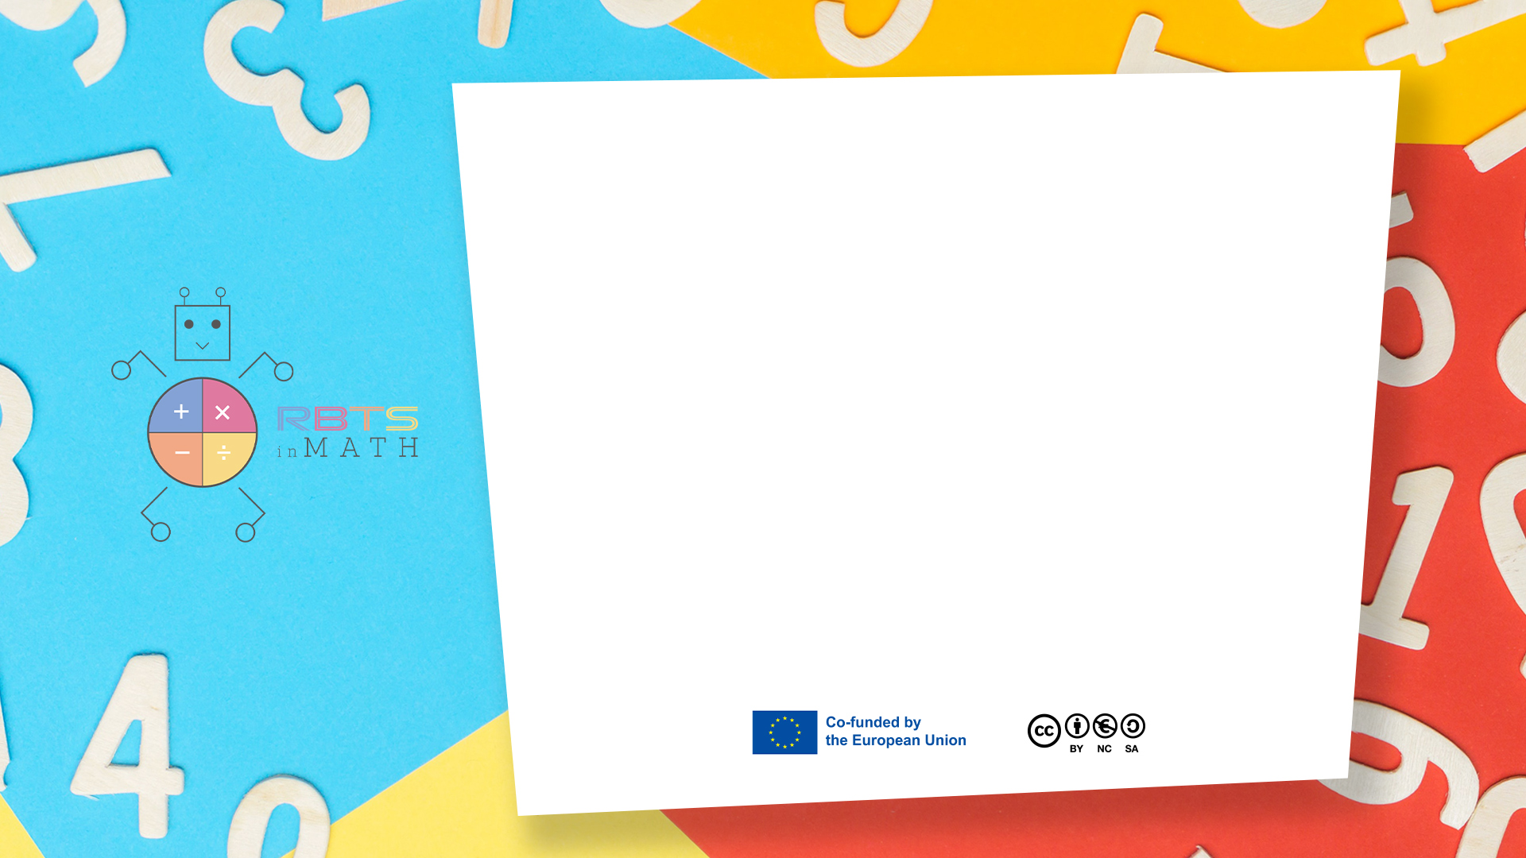
RbtsInMath: Developing Mathematics Achievement through Using Robotics Applications in Flipped Learning
2022-1-PL01-KA220-HED-000089820
MODULE 5: THE USE OF ROBOTICS IN MATHEMATICS EDUCATION IN PRIMARY SCHOOLS
Lesson 5.1: Colourful Program
Co-funded by the European Union. Views and opinions expressed are however those of the author(s) only and do not necessarily reflect those of the European Union or Fundacja Rozwoju Systemu Edukacji. Neither the European Union nor the granting authority can be held responsible for them.

Slide 2


MODULE 5: THE USE OF ROBOTICS IN MATHEMATICS EDUCATION IN PRIMARY SCHOOLS
Lesson 5.1: Colourful Program
Prepared by:
All the pictures and photographs used in this publication are royalty-free, chosen from open sources.

Slide 3
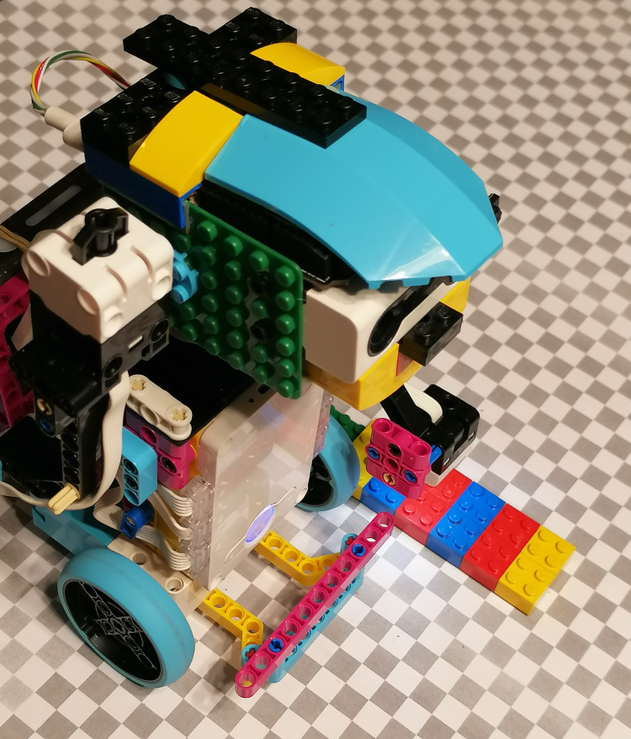
Colourful Program
This game familiarizes children with basic programming concepts by allowing them to direct the robot using color-coded commands.
Co-funded by the European Union. Views and opinions expressed are however those of the author(s) only and do not necessarily reflect those of the European Union or Fundacja Rozwoju Systemu Edukacji. Neither the European Union nor the granting authority can be held responsible for them. Project no. 2022-1-PL01-KA220-HED-000086524

Slide 4
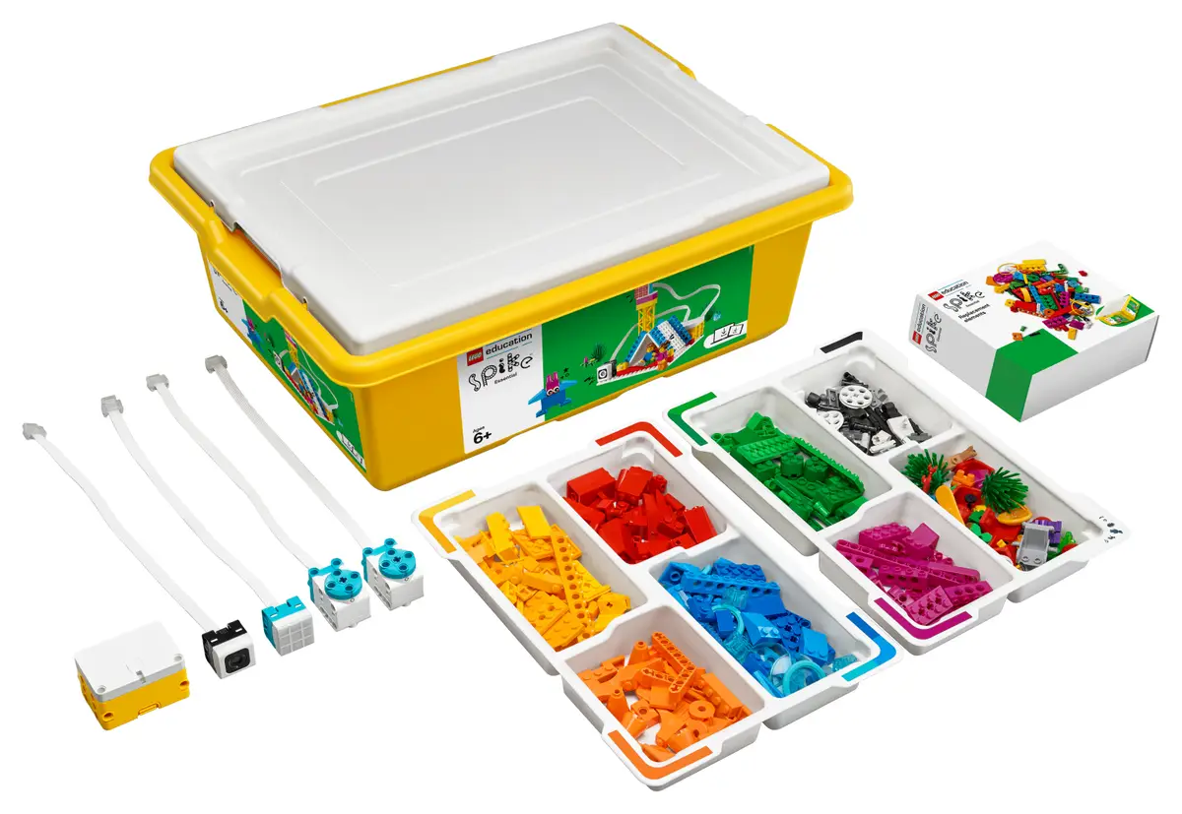
Colourful Program
System used - LEGO Spike Prime:
LEGO Spike Prime is a STEAM-focused robotics kit aimed at educational environments, combining programmable LEGO blocks with motors and sensors. It features a powerful programmable hub, equipped with a 6-axis gyroscope, and various sensors, including a color sensor, force sensor, and distance sensor.
Co-funded by the European Union. Views and opinions expressed are however those of the author(s) only and do not necessarily reflect those of the European Union or Fundacja Rozwoju Systemu Edukacji. Neither the European Union nor the granting authority can be held responsible for them. Project no. 2022-1-PL01-KA220-HED-000086524

Slide 5
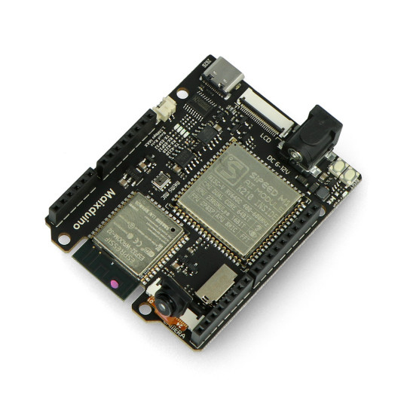
Colourful Program
Additional hardware - Maixduino Development Board:
Maixduino is a development board designed for AI and IoT applications, featuring the K210 AI chip with dual-core RISC-V processors. It includes onboard capabilities for machine vision, sound processing, and other edge AI applications.
Co-funded by the European Union. Views and opinions expressed are however those of the author(s) only and do not necessarily reflect those of the European Union or Fundacja Rozwoju Systemu Edukacji. Neither the European Union nor the granting authority can be held responsible for them. Project no. 2022-1-PL01-KA220-HED-000086524

Slide 6

Colourful Program
Scenario outline:
1. Explanation of the rules of the game
2. Example of a child playing with a robot
3. Summary
Co-funded by the European Union. Views and opinions expressed are however those of the author(s) only and do not necessarily reflect those of the European Union or Fundacja Rozwoju Systemu Edukacji. Neither the European Union nor the granting authority can be held responsible for them. Project no. 2022-1-PL01-KA220-HED-000086524

Slide 7
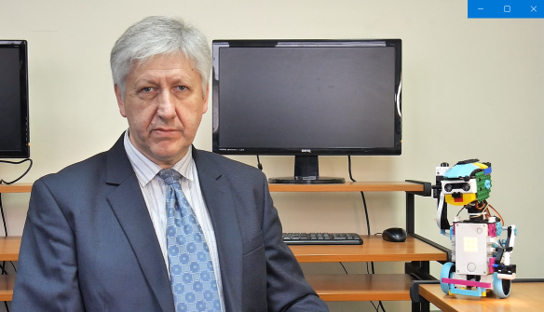
Colourful Program
Explanation of the rules of the game
The teacher introduces himself and announces the presentation of the game
Co-funded by the European Union. Views and opinions expressed are however those of the author(s) only and do not necessarily reflect those of the European Union or Fundacja Rozwoju Systemu Edukacji. Neither the European Union nor the granting authority can be held responsible for them. Project no. 2022-1-PL01-KA220-HED-000086524

Slide 8
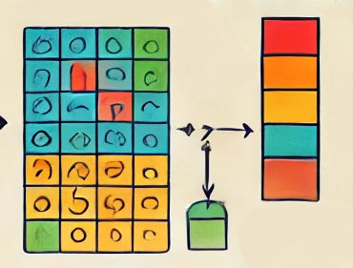
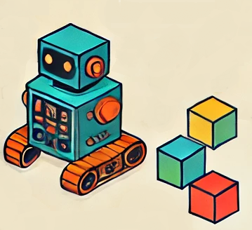
Colourful Program
Explanation of the rules of the game
The teacher explains what the game looks like, what is necessary to run it and how the game works step by step
Co-funded by the European Union. Views and opinions expressed are however those of the author(s) only and do not necessarily reflect those of the European Union or Fundacja Rozwoju Systemu Edukacji. Neither the European Union nor the granting authority can be held responsible for them. Project no. 2022-1-PL01-KA220-HED-000086524

Slide 9
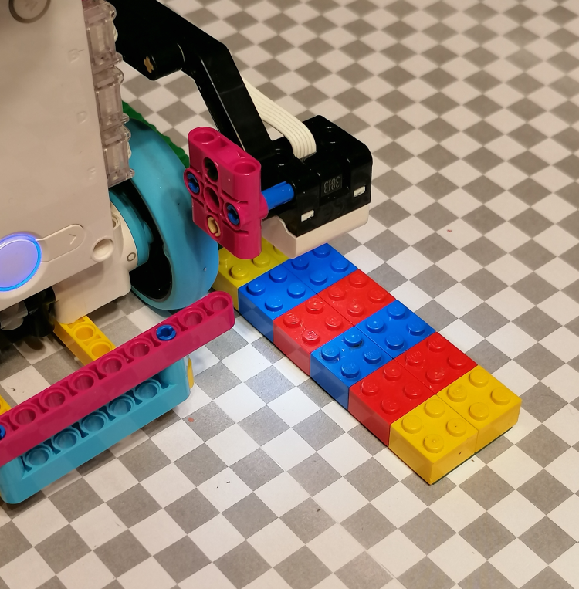
Colourful Program
Explanation of the rules of the game
The teacher focuses on the role of the robot’s colour sensor and motors
Co-funded by the European Union. Views and opinions expressed are however those of the author(s) only and do not necessarily reflect those of the European Union or Fundacja Rozwoju Systemu Edukacji. Neither the European Union nor the granting authority can be held responsible for them. Project no. 2022-1-PL01-KA220-HED-000086524

Slide 10
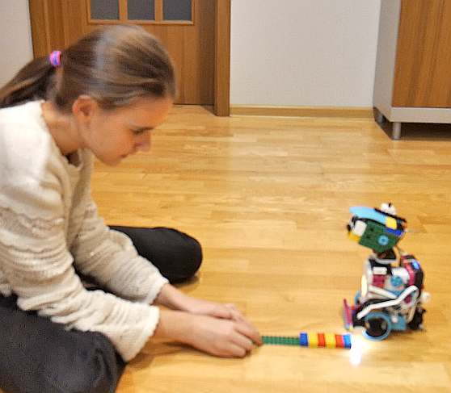
Colourful Program
Example of a child playing with a robot
The child creates their own sequence of colored blocks, placing them on the floor to build a path for the robot.
Co-funded by the European Union. Views and opinions expressed are however those of the author(s) only and do not necessarily reflect those of the European Union or Fundacja Rozwoju Systemu Edukacji. Neither the European Union nor the granting authority can be held responsible for them. Project no. 2022-1-PL01-KA220-HED-000086524

Slide 11
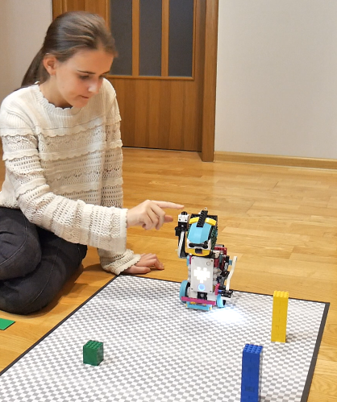
Colourful Program
Example of a child playing with a robot
The robot starts at a designated starting position, and the child presses a button to activate the program.
Co-funded by the European Union. Views and opinions expressed are however those of the author(s) only and do not necessarily reflect those of the European Union or Fundacja Rozwoju Systemu Edukacji. Neither the European Union nor the granting authority can be held responsible for them. Project no. 2022-1-PL01-KA220-HED-000086524

Slide 12
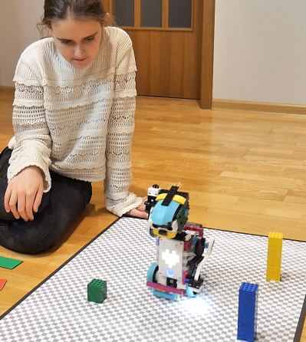
Colourful Program
Example of a child playing with a robot
The robot follows the sequence of colors, moving along the path according to the child’s arrangement.
Co-funded by the European Union. Views and opinions expressed are however those of the author(s) only and do not necessarily reflect those of the European Union or Fundacja Rozwoju Systemu Edukacji. Neither the European Union nor the granting authority can be held responsible for them. Project no. 2022-1-PL01-KA220-HED-000086524

Slide 13
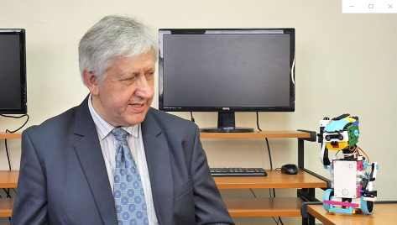
Colourful Program
Summary
The teacher concludes that arranging color-coded blocks teaches students the basics of programming by guiding the robot along a set path. This activity fosters logical thinking, sequencing, and creativity as students control the robot’s journey.
Co-funded by the European Union. Views and opinions expressed are however those of the author(s) only and do not necessarily reflect those of the European Union or Fundacja Rozwoju Systemu Edukacji. Neither the European Union nor the granting authority can be held responsible for them. Project no. 2022-1-PL01-KA220-HED-000086524

Slide 14
Conclusion
Through arranging color-coded blocks, students begin to understand programming logic as they instruct the robot to move along a designated path. This game builds sequencing and problem-solving skills by connecting each color with a specific action. It introduces students to foundational coding concepts in a hands-on way, fostering creativity and strategic thinking as they plan the robot’s journey.
Co-funded by the European Union. Views and opinions expressed are however those of the author(s) only and do not necessarily reflect those of the European Union or Fundacja Rozwoju Systemu Edukacji. Neither the European Union nor the granting authority can be held responsible for them. Project no. 2022-1-PL01-KA220-HED-000086524

Slide 15
Thank you for your attention!
Co-funded by the European Union. Views and opinions expressed are however those of the author(s) only and do not necessarily reflect those of the European Union or Fundacja Rozwoju Systemu Edukacji. Neither the European Union nor the granting authority can be held responsible for them. Project no. 2022-1-PL01-KA220-HED-000086524

Slide 16

This document may be copied, reproduced or modified according to the above rules. In addition, an acknowledgement of the authors of the document and all applicable portions of the copyright notice must be clearly referenced.
All rights reserved. © Copyright 2023 RbtsInMath

