Slide 1
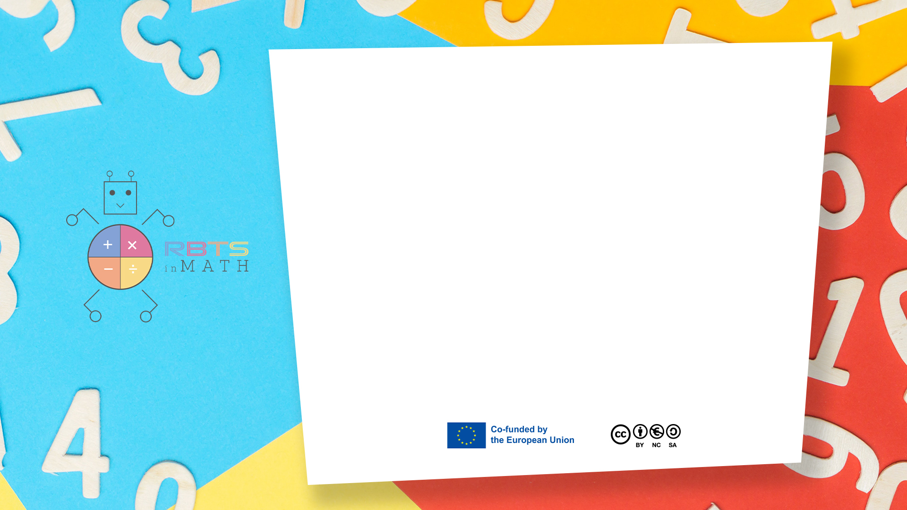
RbtsInMath: Developing Mathematics Achievement
through Using Robotics Applications in Flipped Learning
2022-1-PL01-KA220-HED-000089820
MODULE 5:
THE USE OF ROBOTICS IN MATHEMATICS EDUCATION IN PRIMARY SCHOOLS
Lesson 5.2: How Many Points?
Co-funded by the European Union. Views and opinions expressed are however those of the author(s) only and do not necessarily reflect those of the European Union or Fundacja Rozwoju Systemu Edukacji. Neither the European Union nor the granting authority can be held responsible for them.

Slide 2


MODULE 5:
THE USE OF ROBOTICS IN MATHEMATICS EDUCATION IN PRIMARY SCHOOLS
Lesson 5.2:How Many Points?
Prepared by:
All the pictures and photographs used in this publication are royalty-free, chosen from open sources.

Slide 3
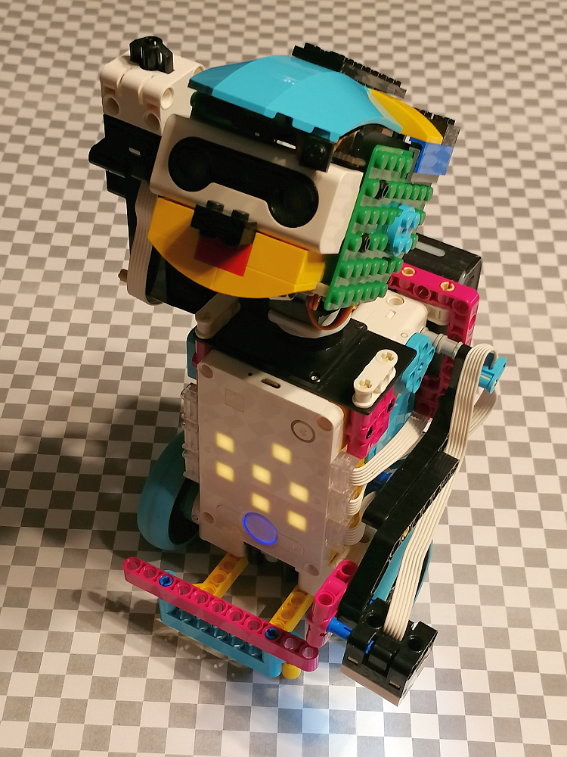
How Many Points?
This game supports early counting and number recognition by guiding children to follow along as the robot counts points.
Co-funded by the European Union. Views and opinions expressed are however those of the author(s) only and do not necessarily reflect those of the European Union or Fundacja Rozwoju Systemu Edukacji. Neither the European Union nor the granting authority can be held responsible for them. Project no. 2022-1-PL01-KA220-HED-000086524

Slide 4
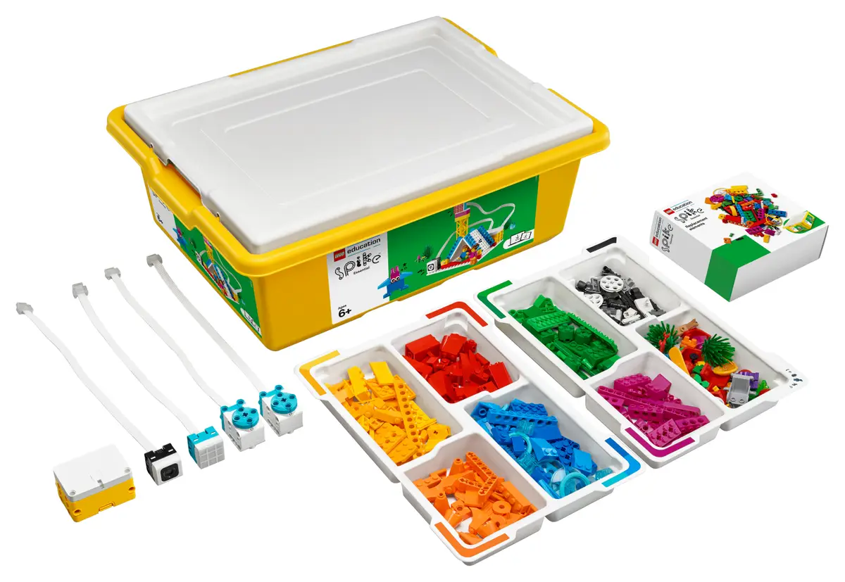
How Many Points?
System used - LEGO Spike Prime:
LEGO Spike Prime is a STEAM-focused robotics kit aimed at educational environments, combining programmable LEGO blocks with motors and sensors.
It features a powerful programmable hub, equipped with a 6-axis gyroscope, and various sensors, including a color sensor, force sensor, and distance sensor.
Co-funded by the European Union. Views and opinions expressed are however those of the author(s) only and do not necessarily reflect those of the European Union or Fundacja Rozwoju Systemu Edukacji. Neither the European Union nor the granting authority can be held responsible for them. Project no. 2022-1-PL01-KA220-HED-000086524

Slide 5
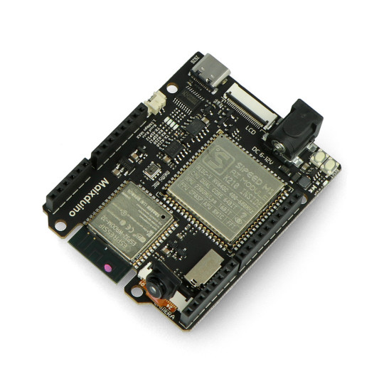
How Many Points?
Additional hardware - Maixduino Development Board:
Maixduino is a development board designed for AI and IoT applications, featuring the K210 AI chip with dual-core RISC-V processors. It includes onboard capabilities for machine vision, sound processing, and other edge AI applications.
Co-funded by the European Union. Views and opinions expressed are however those of the author(s) only and do not necessarily reflect those of the European Union or Fundacja Rozwoju Systemu Edukacji. Neither the European Union nor the granting authority can be held responsible for them. Project no. 2022-1-PL01-KA220-HED-000086524

Slide 6

How Many Points?
Scenario outline:
1. Explanation of the rules of the game
2. Example of a child playing with a robot
3. Summary
Co-funded by the European Union. Views and opinions expressed are however those of the author(s) only and do not necessarily reflect those of the European Union or Fundacja Rozwoju Systemu Edukacji. Neither the European Union nor the granting authority can be held responsible for them. Project no. 2022-1-PL01-KA220-HED-000086524

Slide 7
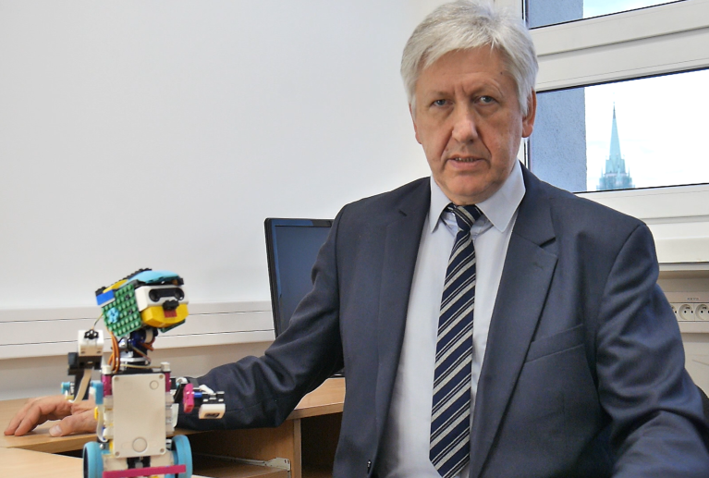
How Many Points?
Explanation of the rules of the game
The teacher introduces himself and announces the presentation of the game.
Co-funded by the European Union. Views and opinions expressed are however those of the author(s) only and do not necessarily reflect those of the European Union or Fundacja Rozwoju Systemu Edukacji. Neither the European Union nor the granting authority can be held responsible for them. Project no. 2022-1-PL01-KA220-HED-000086524

Slide 8
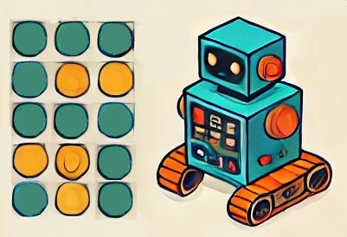
How Many Points?
Explanation of the rules of the game
The teacher explains what the game looks like, what is necessary to run it and how the game works step by step.
Co-funded by the European Union. Views and opinions expressed are however those of the author(s) only and do not necessarily reflect those of the European Union or Fundacja Rozwoju Systemu Edukacji. Neither the European Union nor the granting authority can be held responsible for them. Project no. 2022-1-PL01-KA220-HED-000086524

Slide 9
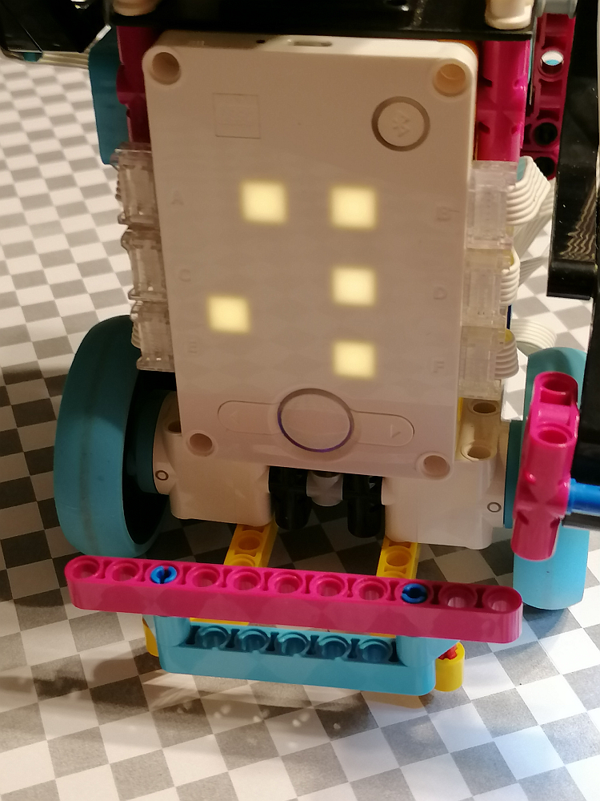
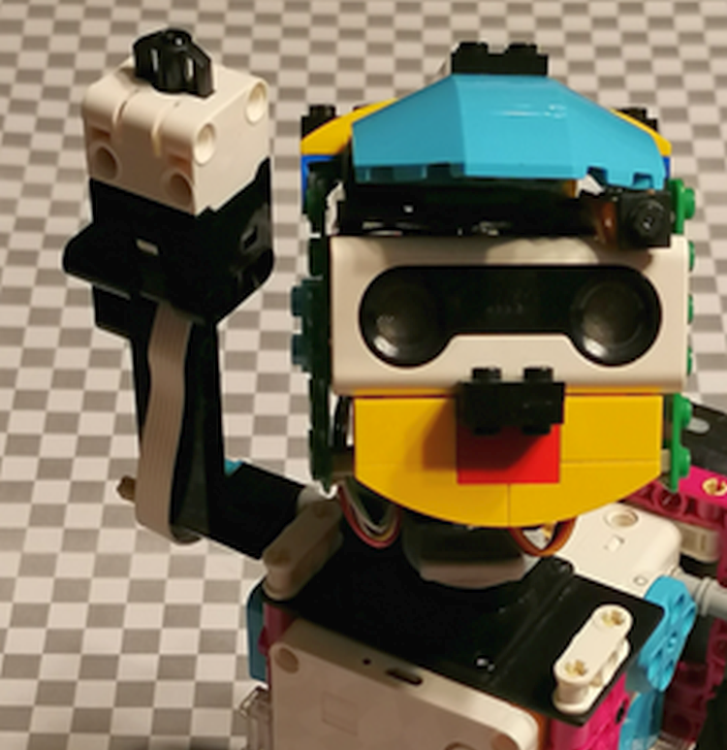
How Many Points?
Explanation of the rules of the game
The teacher focuses on the role
of the robot’s matrix display
and touch sensor.
Co-funded by the European Union. Views and opinions expressed are however those of the author(s) only and do not necessarily reflect those of the European Union or Fundacja Rozwoju Systemu Edukacji. Neither the European Union nor the granting authority can be held responsible for them. Project no. 2022-1-PL01-KA220-HED-000086524

Slide 10
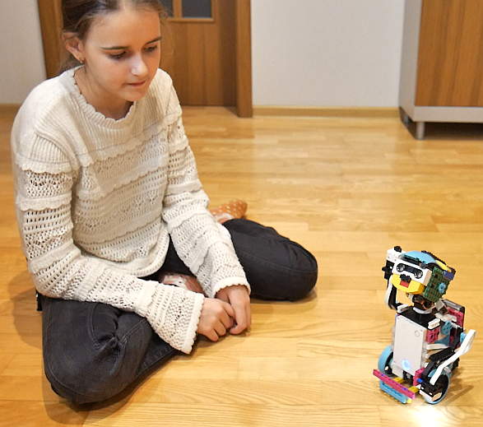
How Many Points?
Example of a child playing with a robot
A child is instructed on the meaning of the display and the symbols shown. The robot will display a number of dots for the child to count.
Co-funded by the European Union. Views and opinions expressed are however those of the author(s) only and do not necessarily reflect those of the European Union or Fundacja Rozwoju Systemu Edukacji. Neither the European Union nor the granting authority can be held responsible for them. Project no. 2022-1-PL01-KA220-HED-000086524

Slide 11
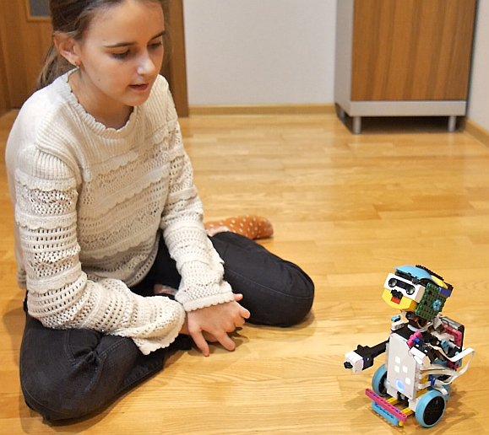
How Many Points?
Example of a child playing with a robot
The robot prompts the child to press its 'finger' the same number of times as the number of dots displayed.
Co-funded by the European Union. Views and opinions expressed are however those of the author(s) only and do not necessarily reflect those of the European Union or Fundacja Rozwoju Systemu Edukacji. Neither the European Union nor the granting authority can be held responsible for them. Project no. 2022-1-PL01-KA220-HED-000086524

Slide 12
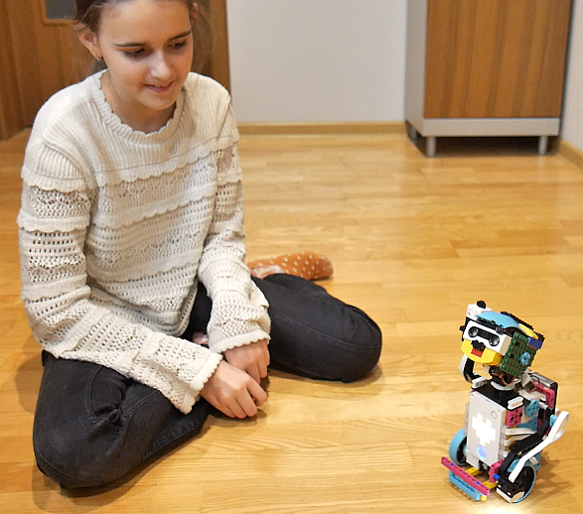
How Many Points?
Example of a child playing with a robot
The robot rewards the girl for a correct answer with a voice message of praise and by displaying a heart icon.
Co-funded by the European Union. Views and opinions expressed are however those of the author(s) only and do not necessarily reflect those of the European Union or Fundacja Rozwoju Systemu Edukacji. Neither the European Union nor the granting authority can be held responsible for them. Project no. 2022-1-PL01-KA220-HED-000086524

Slide 13
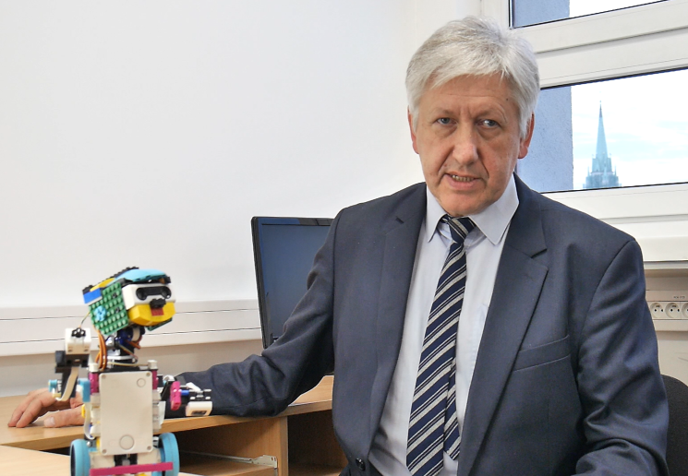
How Many Points?
Summary
The teacher summarizes that counting points on the robot’s LED display strengthens number recognition and counting. The robot’s interactive feedback reinforces counting accuracy and builds confidence in number comprehension.
Co-funded by the European Union. Views and opinions expressed are however those of the author(s) only and do not necessarily reflect those of the European Union or Fundacja Rozwoju Systemu Edukacji. Neither the European Union nor the granting authority can be held responsible for them. Project no. 2022-1-PL01-KA220-HED-000086524

Slide 14
Conclusion
This counting activity strengthens number recognition and counting accuracy as students follow the robot’s LED display. The robot’s interactive counting aloud supports memory and sequential counting, making abstract numbers more relatable and understandable. This game provides a solid base for numerical comprehension through direct, hands-on practice.
Co-funded by the European Union. Views and opinions expressed are however those of the author(s) only and do not necessarily reflect those of the European Union or Fundacja Rozwoju Systemu Edukacji. Neither the European Union nor the granting authority can be held responsible for them. Project no. 2022-1-PL01-KA220-HED-000086524

Slide 15
Thank you for your attention!
Co-funded by the European Union. Views and opinions expressed are however those of the author(s) only and do not necessarily reflect those of the European Union or Fundacja Rozwoju Systemu Edukacji. Neither the European Union nor the granting authority can be held responsible for them. Project no. 2022-1-PL01-KA220-HED-000086524

Slide 16

This document may be copied, reproduced or modified according to the above rules.
In addition, an acknowledgement of the authors of the document and
all applicable portions of the copyright notice must be clearly referenced.
All rights reserved. © Copyright 2023 RbtsInMath

