Slide 1
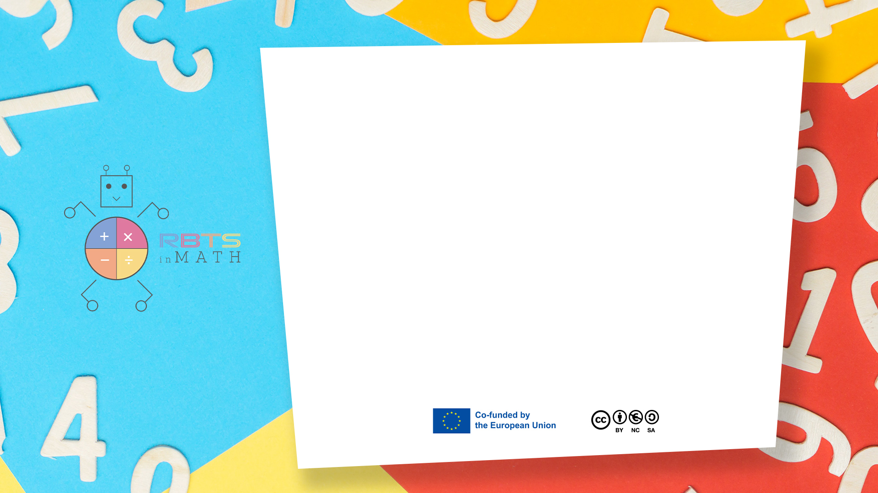
RbtsInMath: Developing Mathematics Achievement through Using Robotics Applications in Flipped Learning
2022-1-PL01-KA220-HED-000089820
MODULE 5: THE USE OF ROBOTICS IN MATHEMATICS EDUCATION IN PRIMARY SCHOOLS
Lesson 5.4: What’s the Result?
Co-funded by the European Union. Views and opinions expressed are however those of the author(s) only and do not necessarily reflect those of the European Union or Fundacja Rozwoju Systemu Edukacji. Neither the European Union nor the granting authority can be held responsible for them.

Slide 2


MODULE 5: THE USE OF ROBOTICS IN MATHEMATICS EDUCATION IN PRIMARY SCHOOLS
Lesson 5.4: What’s the Result?
Prepared by:
All the pictures and photographs used in this publication are royalty-free, chosen from open sources.

Slide 3
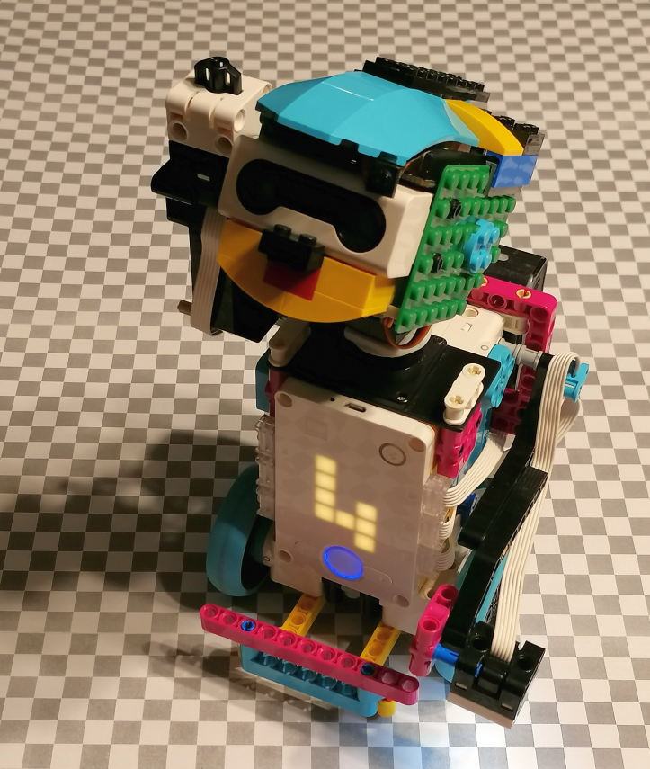
What’s the Result?
This game introduces basic addition and subtraction, allowing children to observe arithmetic operations in action.
Co-funded by the European Union. Views and opinions expressed are however those of the author(s) only and do not necessarily reflect those of the European Union or Fundacja Rozwoju Systemu Edukacji. Neither the European Union nor the granting authority can be held responsible for them. Project no. 2022-1-PL01-KA220-HED-000086524

Slide 4
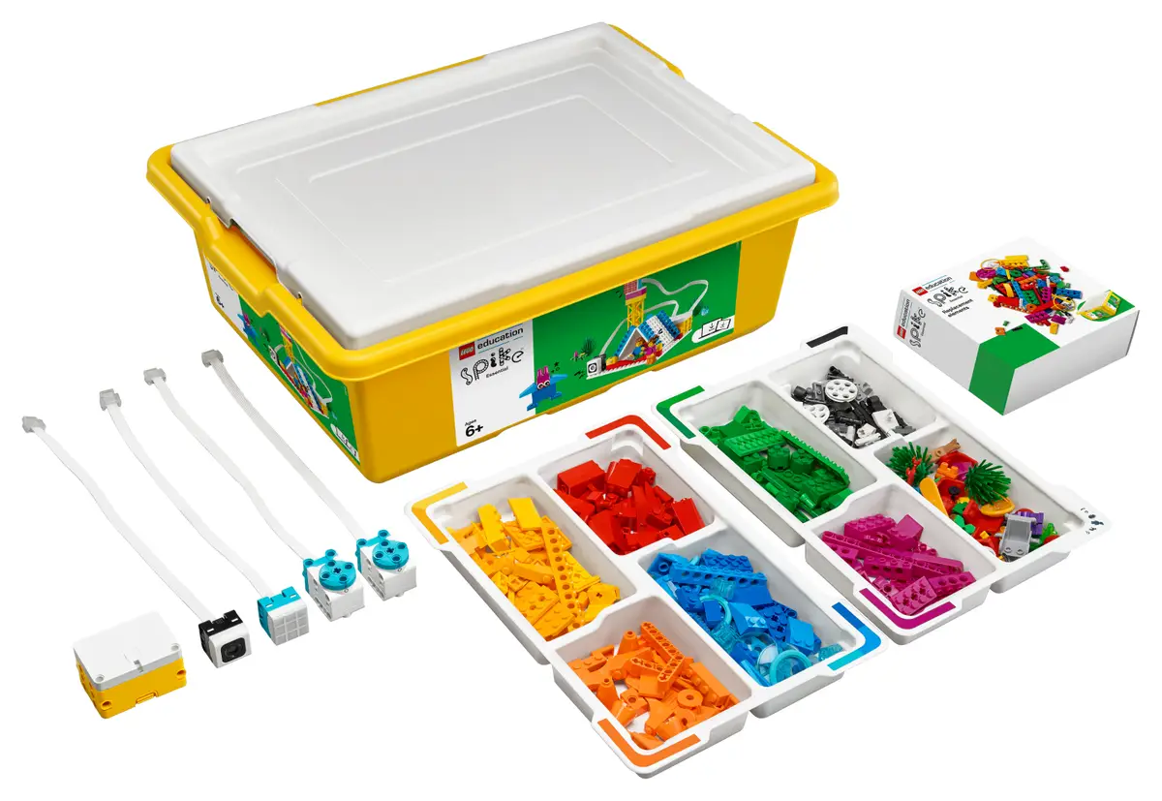
What’s the Result?
System used - LEGO Spike Prime:
LEGO Spike Prime is a STEAM-focused robotics kit aimed at educational environments, combining programmable LEGO blocks with motors and sensors. It features a powerful programmable hub, equipped with a 6-axis gyroscope, and various sensors, including a color sensor, force sensor, and distance sensor.
Co-funded by the European Union. Views and opinions expressed are however those of the author(s) only and do not necessarily reflect those of the European Union or Fundacja Rozwoju Systemu Edukacji. Neither the European Union nor the granting authority can be held responsible for them. Project no. 2022-1-PL01-KA220-HED-000086524

Slide 5
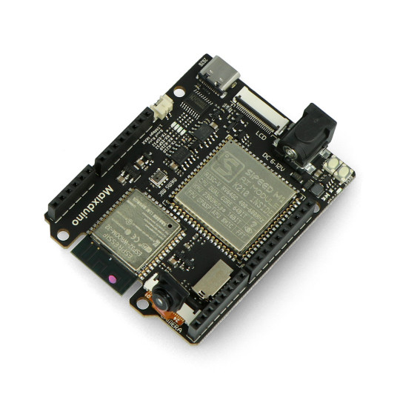
What’s the Result?
Additional hardware - Maixduino Development Board:
Maixduino is a development board designed for AI and IoT applications, featuring the K210 AI chip with dual-core RISC-V processors. It includes onboard capabilities for machine vision, sound processing, and other edge AI applications.
Co-funded by the European Union. Views and opinions expressed are however those of the author(s) only and do not necessarily reflect those of the European Union or Fundacja Rozwoju Systemu Edukacji. Neither the European Union nor the granting authority can be held responsible for them. Project no. 2022-1-PL01-KA220-HED-000086524

Slide 6

What’s the Result?
Scenario outline:
1. Explanation of the rules of the game
2. Example of a child playing with a robot
3. Summary
Co-funded by the European Union. Views and opinions expressed are however those of the author(s) only and do not necessarily reflect those of the European Union or Fundacja Rozwoju Systemu Edukacji. Neither the European Union nor the granting authority can be held responsible for them. Project no. 2022-1-PL01-KA220-HED-000086524

Slide 7
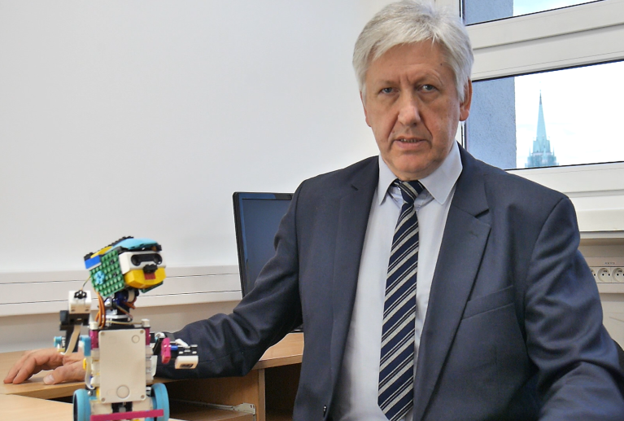
What’s the Result?
Explanation of the rules of the game
The teacher introduces himself and announces the presentation of the game
Co-funded by the European Union. Views and opinions expressed are however those of the author(s) only and do not necessarily reflect those of the European Union or Fundacja Rozwoju Systemu Edukacji. Neither the European Union nor the granting authority can be held responsible for them. Project no. 2022-1-PL01-KA220-HED-000086524

Slide 8
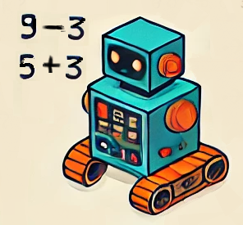
What’s the Result?
Explanation of the rules of the game
The teacher explains what the game looks like, what is necessary to run it and how the game works step by step.
Co-funded by the European Union. Views and opinions expressed are however those of the author(s) only and do not necessarily reflect those of the European Union or Fundacja Rozwoju Systemu Edukacji. Neither the European Union nor the granting authority can be held responsible for them. Project no. 2022-1-PL01-KA220-HED-000086524

Slide 9
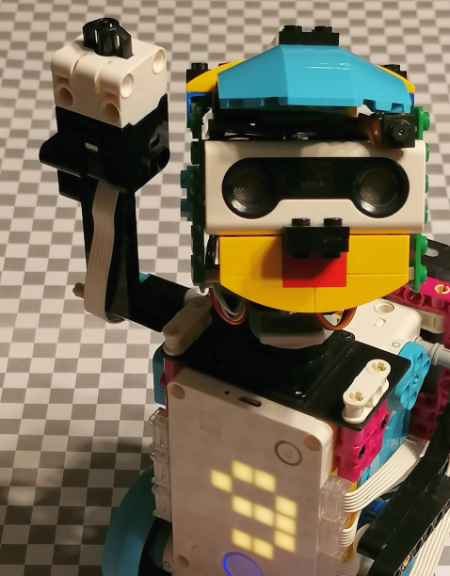
What’s the Result?
Explanation of the rules of the game
The teacher focuses on the role of the robot’s matrix display and touch sensor.
Co-funded by the European Union. Views and opinions expressed are however those of the author(s) only and do not necessarily reflect those of the European Union or Fundacja Rozwoju Systemu Edukacji. Neither the European Union nor the granting authority can be held responsible for them. Project no. 2022-1-PL01-KA220-HED-000086524

Slide 10
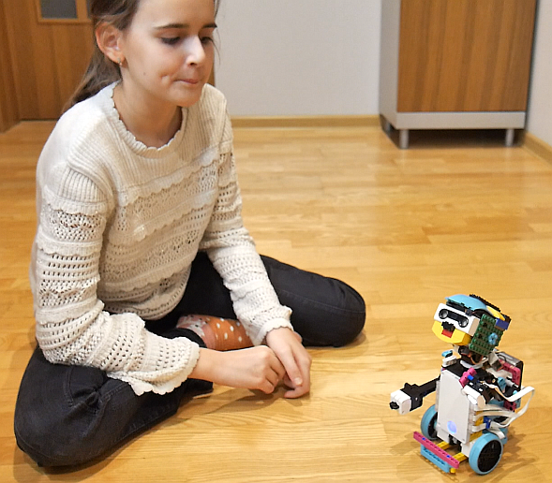
What’s the Result?
Example of a child playing with a robot
The child interacts with the robot by pressing a button. The robot tells the child what operation it will perform.
Co-funded by the European Union. Views and opinions expressed are however those of the author(s) only and do not necessarily reflect those of the European Union or Fundacja Rozwoju Systemu Edukacji. Neither the European Union nor the granting authority can be held responsible for them. Project no. 2022-1-PL01-KA220-HED-000086524

Slide 11
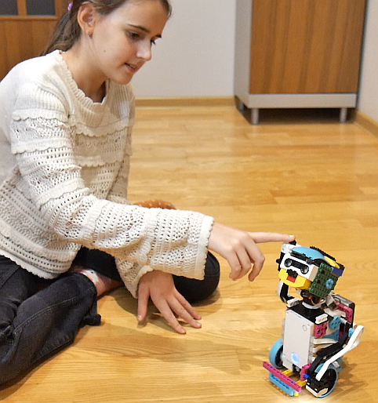
What’s the Result?
Example of a child playing with a robot
As the child presses the button, the robot calculates the result of the operation.
Co-funded by the European Union. Views and opinions expressed are however those of the author(s) only and do not necessarily reflect those of the European Union or Fundacja Rozwoju Systemu Edukacji. Neither the European Union nor the granting authority can be held responsible for them. Project no. 2022-1-PL01-KA220-HED-000086524

Slide 12
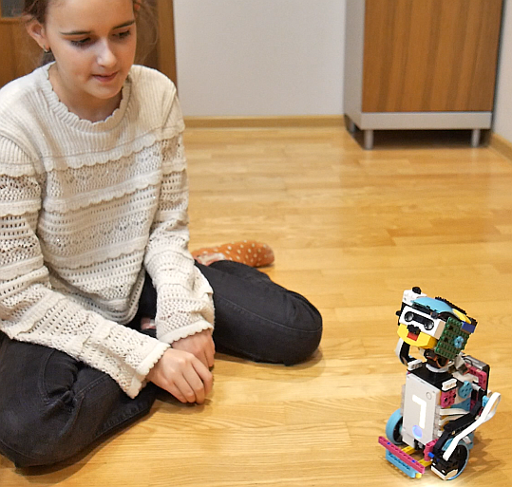
What’s the Result?
Example of a child playing with a robot
Then, the robot sets a starting value and asks the girl to perform a specified math operation and provide the resulting number.
Co-funded by the European Union. Views and opinions expressed are however those of the author(s) only and do not necessarily reflect those of the European Union or Fundacja Rozwoju Systemu Edukacji. Neither the European Union nor the granting authority can be held responsible for them. Project no. 2022-1-PL01-KA220-HED-000086524

Slide 13
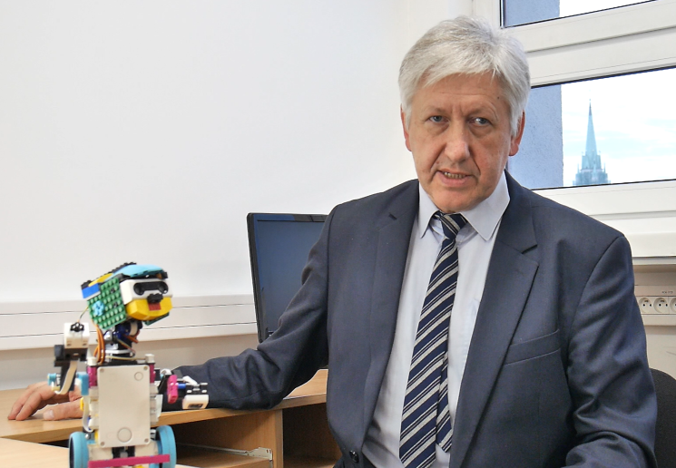
What’s the Result?
Summary
The teacher explains that this game introduces addition and subtraction as the robot guides students through simple operations. Visual and verbal feedback helps students gain confidence in understanding sums and differences.
Co-funded by the European Union. Views and opinions expressed are however those of the author(s) only and do not necessarily reflect those of the European Union or Fundacja Rozwoju Systemu Edukacji. Neither the European Union nor the granting authority can be held responsible for them. Project no. 2022-1-PL01-KA220-HED-000086524

Slide 14
Conclusion
This game introduces basic addition and subtraction by guiding students through operations with immediate feedback from the robot. By visualizing numbers on the LED display and listening to the robot's prompts, students develop a stronger understanding of basic arithmetic. This interactive approach reinforces math operations and builds confidence in handling small sums and differences.
Co-funded by the European Union. Views and opinions expressed are however those of the author(s) only and do not necessarily reflect those of the European Union or Fundacja Rozwoju Systemu Edukacji. Neither the European Union nor the granting authority can be held responsible for them. Project no. 2022-1-PL01-KA220-HED-000086524

Slide 15
Thank you for your attention!
Co-funded by the European Union. Views and opinions expressed are however those of the author(s) only and do not necessarily reflect those of the European Union or Fundacja Rozwoju Systemu Edukacji. Neither the European Union nor the granting authority can be held responsible for them. Project no. 2022-1-PL01-KA220-HED-000086524

Slide 16

This document may be copied, reproduced or modified according to the above rules. In addition, an acknowledgement of the authors of the document and all applicable portions of the copyright notice must be clearly referenced.
All rights reserved. © Copyright 2023 RbtsInMath

