Slide 1

RbtsInMath: Developing Mathematics Achievement
through Using Robotics Applications in Flipped Learning
2022-1-PL01-KA220-HED-000089820
MODULE 6: FLIPPED LEARNING AND ITS PRACTICES IN PRIMARY SCHOOLS
Lesson 6.1: Traditional Learning Environment
Co-funded by the European Union. Views and opinions expressed are however those of the author(s) only and do not necessarily reflect those of the European Union or Fundacja Rozwoju Systemu Edukacji. Neither the European Union nor the granting authority can be held responsible for them.

Slide 2


MODULE 6:
FLIPPED LEARNING AND ITS PRACTICES IN PRIMARY SCHOOLS
Lesson 6.1: Traditional Learning Environment
Prepared by:
All the pictures and photographs used in this publication are royalty-free, chosen from open sources.

Slide 3
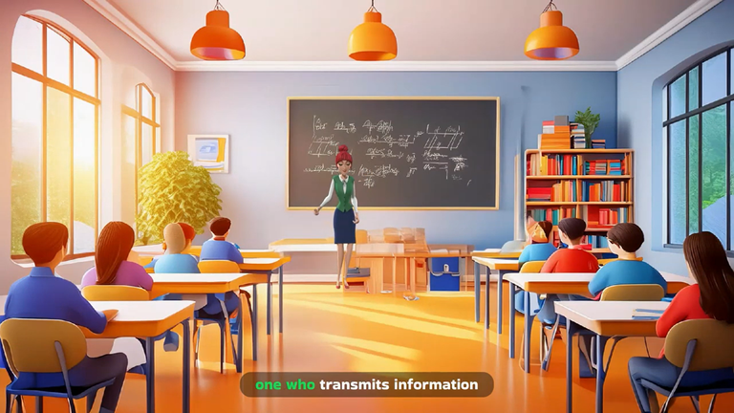
Lesson 1: Traditional Learning Environment
In traditional learning environments, the teacher is the one who transmits information, while the students are in a passive role of receiving it.
This situation restricts students' opportunities for active participation and developing critical thinking skills.
Co-funded by the European Union. Views and opinions expressed are however those of the author(s) only and do not necessarily reflect those of the European Union or Fundacja Rozwoju Systemu Edukacji. Neither the European Union nor the granting authority can be held responsible for them. Project no. 2022-1-PL01-KA220-HED-000086524

Slide 4
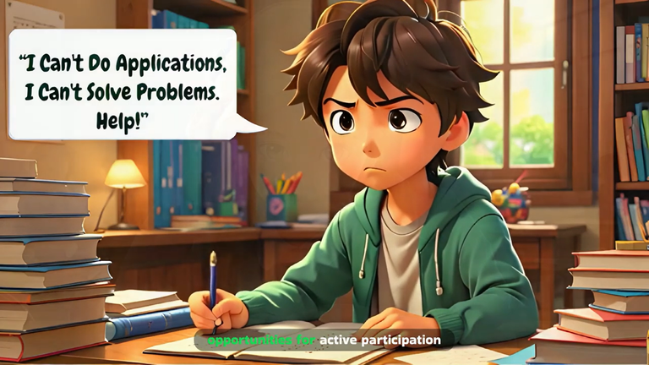
Lesson 1: Traditional Learning Environment
Memorization of information and its repetition in exams is encouraged.
This can hinder students from internalizing the information meaningfully and can make lasting learning more difficult.
Co-funded by the European Union. Views and opinions expressed are however those of the author(s) only and do not necessarily reflect those of the European Union or Fundacja Rozwoju Systemu Edukacji. Neither the European Union nor the granting authority can be held responsible for them. Project no. 2022-1-PL01-KA220-HED-000086524

Slide 5
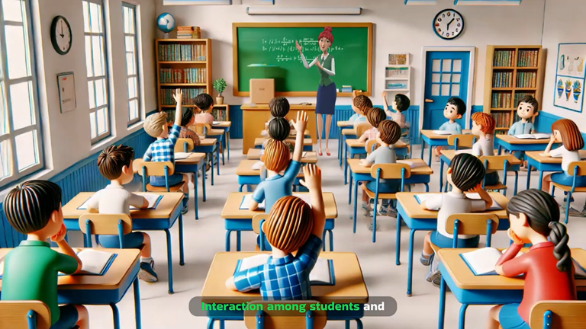
Lesson 1: Traditional Learning Environment
Interaction among students and with the teacher is limited.
This means fewer opportunities for collaborative learning and the development of social skills.
Co-funded by the European Union. Views and opinions expressed are however those of the author(s) only and do not necessarily reflect those of the European Union or Fundacja Rozwoju Systemu Edukacji. Neither the European Union nor the granting authority can be held responsible for them. Project no. 2022-1-PL01-KA220-HED-000086524

Slide 6
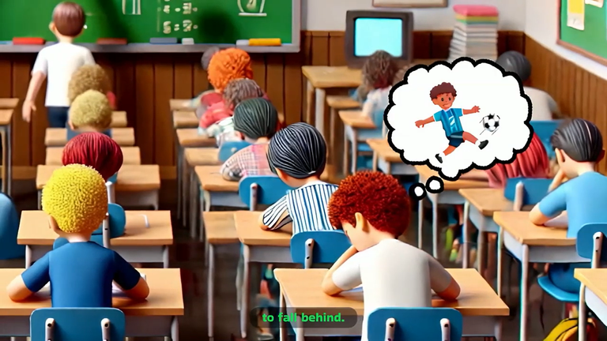
Lesson 1: Traditional Learning Environment
All students are taught with the same methods and at the same pace.
Individual differences and learning needs are ignored, which can cause some students to fall behind.
Co-funded by the European Union. Views and opinions expressed are however those of the author(s) only and do not necessarily reflect those of the European Union or Fundacja Rozwoju Systemu Edukacji. Neither the European Union nor the granting authority can be held responsible for them. Project no. 2022-1-PL01-KA220-HED-000086524

Slide 7
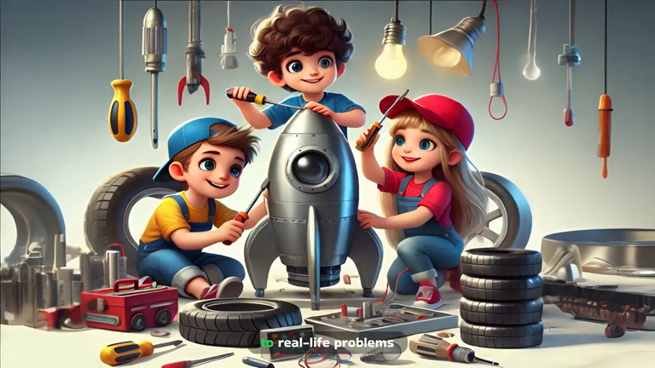
Lesson 1: Traditional Learning Environment
Opportunities for making connections to real-life problems and for hands-on learning are limited.
Co-funded by the European Union. Views and opinions expressed are however those of the author(s) only and do not necessarily reflect those of the European Union or Fundacja Rozwoju Systemu Edukacji. Neither the European Union nor the granting authority can be held responsible for them. Project no. 2022-1-PL01-KA220-HED-000086524

Slide 8
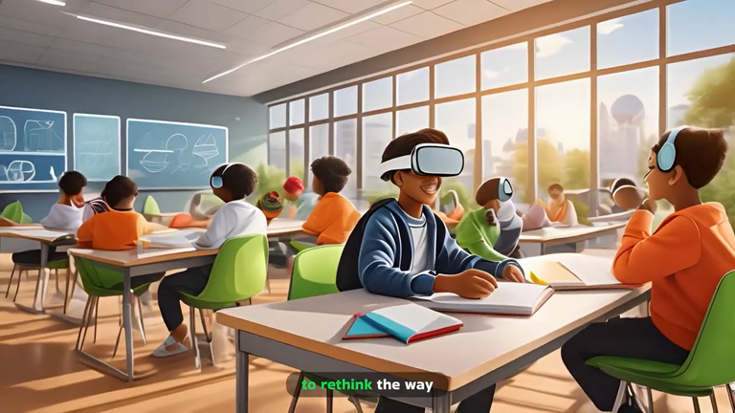
Lesson 1: Traditional Learning Environment
That's why we need to rethink the way we approach education and provide more productive learning environments for future students.
Co-funded by the European Union. Views and opinions expressed are however those of the author(s) only and do not necessarily reflect those of the European Union or Fundacja Rozwoju Systemu Edukacji. Neither the European Union nor the granting authority can be held responsible for them. Project no. 2022-1-PL01-KA220-HED-000086524

Slide 9
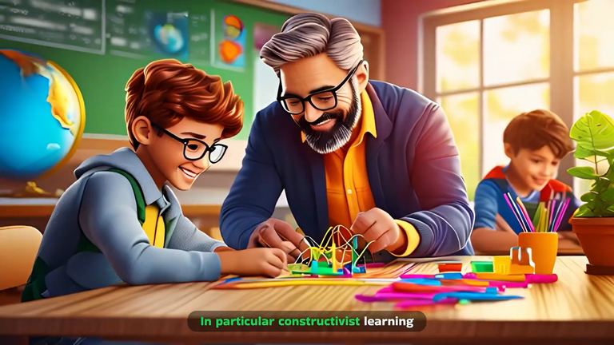
Lesson 1: Traditional Learning Environment
In particular, constructivist learning environments can provide a more effective educational experience by offering a learning process that is student-centered, meaningful, collaborative, sensitive to individual differences and oriented to real life.
Co-funded by the European Union. Views and opinions expressed are however those of the author(s) only and do not necessarily reflect those of the European Union or Fundacja Rozwoju Systemu Edukacji. Neither the European Union nor the granting authority can be held responsible for them. Project no. 2022-1-PL01-KA220-HED-000086524

Slide 10
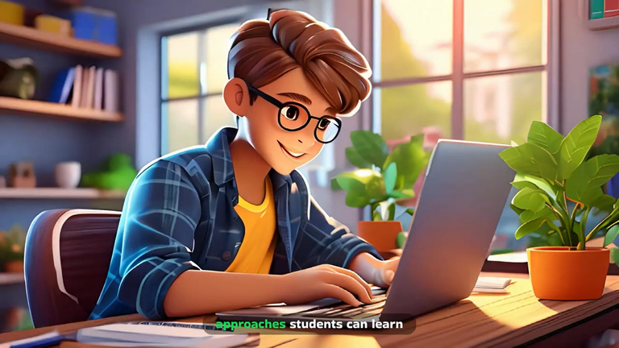
Lesson 1: Traditional Learning Environment
In one of these approaches, students can learn theoretical subjects at home on a computer.
In the classroom environment, they can devote a lot of time to practices and activities related to the subjects they have learned.
Co-funded by the European Union. Views and opinions expressed are however those of the author(s) only and do not necessarily reflect those of the European Union or Fundacja Rozwoju Systemu Edukacji. Neither the European Union nor the granting authority can be held responsible for them. Project no. 2022-1-PL01-KA220-HED-000086524

Slide 11
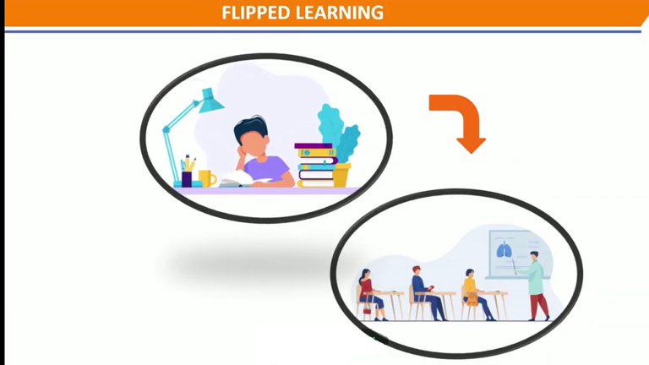
Lesson 1: Traditional Learning Environment
This approach is called Flipped Learning.
Co-funded by the European Union. Views and opinions expressed are however those of the author(s) only and do not necessarily reflect those of the European Union or Fundacja Rozwoju Systemu Edukacji. Neither the European Union nor the granting authority can be held responsible for them. Project no. 2022-1-PL01-KA220-HED-000086524

Slide 12
Conclusion
To foster lasting learning, we must shift from traditional methods that stifle active participation and critical thinking.
Emphasizing interaction, personalized pacing, and real-life connections will create more dynamic and inclusive educational environments for future students.
Co-funded by the European Union. Views and opinions expressed are however those of the author(s) only and do not necessarily reflect those of the European Union or Fundacja Rozwoju Systemu Edukacji. Neither the European Union nor the granting authority can be held responsible for them. Project no. 2022-1-PL01-KA220-HED-000086524

Slide 13
Thank you for your attention!
Co-funded by the European Union. Views and opinions expressed are however those of the author(s) only and do not necessarily reflect those of the European Union or Fundacja Rozwoju Systemu Edukacji. Neither the European Union nor the granting authority can be held responsible for them. Project no. 2022-1-PL01-KA220-HED-000086524

Slide 14

This document may be copied, reproduced or modified according to the above rules.
In addition, an acknowledgement of the authors of the document and
all applicable portions of the copyright notice must be clearly referenced.
All rights reserved. © Copyright 2023 RbtsInMath

