Slide 1
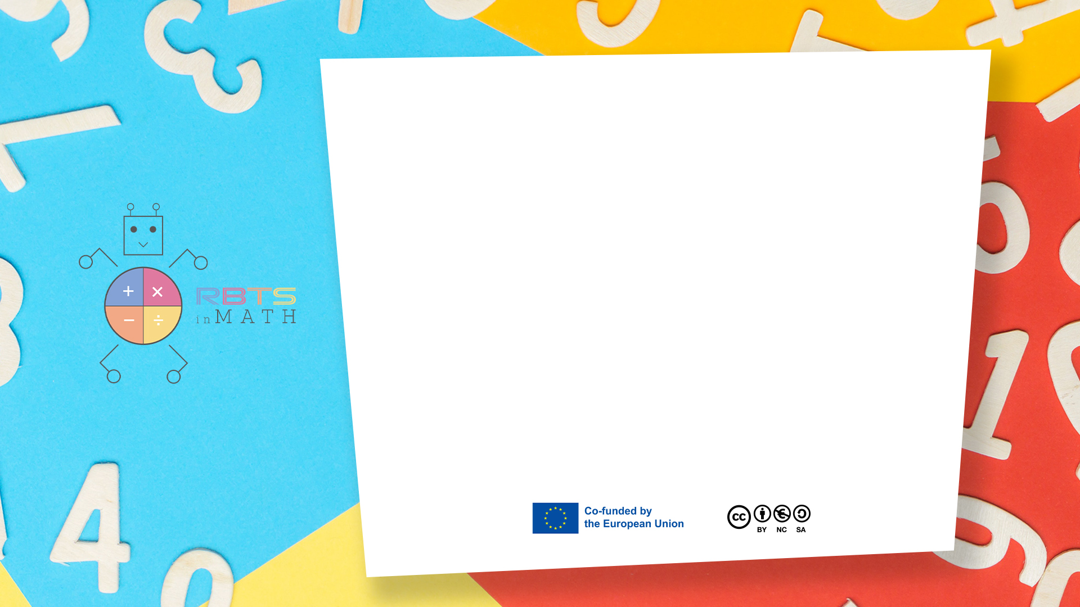
RbtsInMath: Developing Mathematics Achievement through Using Robotics Applications in Flipped Learning
2022-1-PL01-KA220-HED-000089820
MODULE 6: FLIPPED LEARNING AND ITS PRACTICES IN PRIMARY SCHOOLS
Lesson 6.2: What is the Flipped Learning?
Co-funded by the European Union. Views and opinions expressed are however those of the author(s) only and do not necessarily reflect those of the European Union or Fundacja Rozwoju Systemu Edukacji. Neither the European Union nor the granting authority can be held responsible for them.

Slide 2


MODULE 6: FLIPPED LEARNING AND ITS PRACTICES IN PRIMARY SCHOOLS
Lesson 6.2: What is the Flipped Learning?
Prepared by:
All the pictures and photographs used in this publication are royalty-free, chosen from open sources.

Slide 3

Lesson 2: What is the Flipped Learning?
Flipped Learning is a learning model in which lessons are taught with a student-centered approach, unlike the traditional education model.
Co-funded by the European Union. Views and opinions expressed are however those of the author(s) only and do not necessarily reflect those of the European Union or Fundacja Rozwoju Systemu Edukacji. Neither the European Union nor the granting authority can be held responsible for them. Project no. 2022-1-PL01-KA220-HED-000086524

Slide 4

Lesson 2: What is the Flipped Learning?
In this model, students learn course content outside the classroom, often through video or online materials, and use in-class time to reinforce this knowledge, discuss, and do hands-on activities.
Co-funded by the European Union. Views and opinions expressed are however those of the author(s) only and do not necessarily reflect those of the European Union or Fundacja Rozwoju Systemu Edukacji. Neither the European Union nor the granting authority can be held responsible for them. Project no. 2022-1-PL01-KA220-HED-000086524

Slide 5
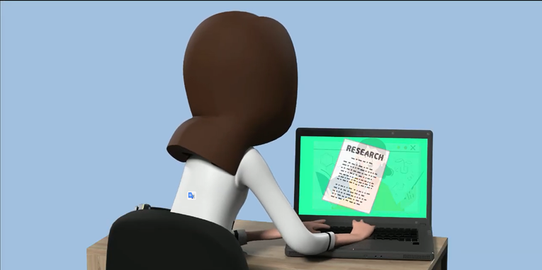
Lesson 2: What is the Flipped Learning?
Students use teacher-prepared videos, articles, or other digital resources to learn the course topic in advance.
Co-funded by the European Union. Views and opinions expressed are however those of the author(s) only and do not necessarily reflect those of the European Union or Fundacja Rozwoju Systemu Edukacji. Neither the European Union nor the granting authority can be held responsible for them. Project no. 2022-1-PL01-KA220-HED-000086524

Slide 6
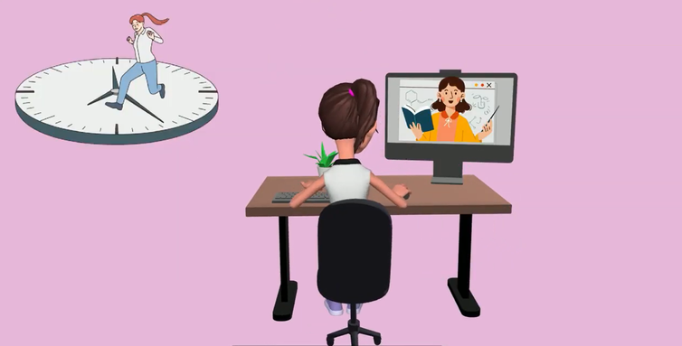
Lesson 2: What is the Flipped Learning?
This process allows students to learn the subject at their own pace and in their own time.
Co-funded by the European Union. Views and opinions expressed are however those of the author(s) only and do not necessarily reflect those of the European Union or Fundacja Rozwoju Systemu Edukacji. Neither the European Union nor the granting authority can be held responsible for them. Project no. 2022-1-PL01-KA220-HED-000086524

Slide 7

Lesson 2: What is the Flipped Learning?
Classroom time is used to deepen students' learning process.
Discussions, group work, projects and applied activities have an important place in this process.
Co-funded by the European Union. Views and opinions expressed are however those of the author(s) only and do not necessarily reflect those of the European Union or Fundacja Rozwoju Systemu Edukacji. Neither the European Union nor the granting authority can be held responsible for them. Project no. 2022-1-PL01-KA220-HED-000086524

Slide 8
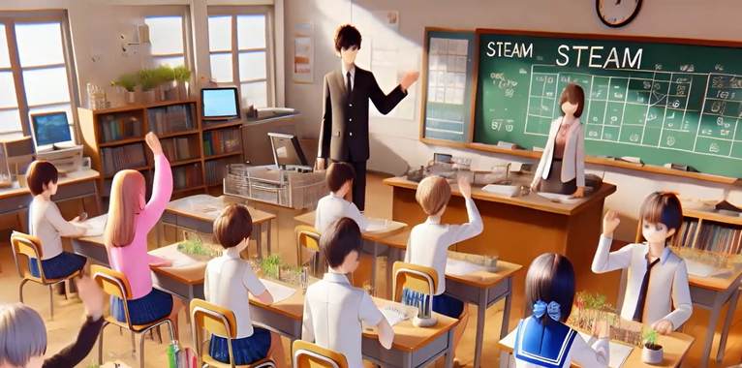
Lesson 2: What is the Flipped Learning?
Students actively engage with course materials.
Asks questions, solves problems and develops critical thinking skills.
Co-funded by the European Union. Views and opinions expressed are however those of the author(s) only and do not necessarily reflect those of the European Union or Fundacja Rozwoju Systemu Edukacji. Neither the European Union nor the granting authority can be held responsible for them. Project no. 2022-1-PL01-KA220-HED-000086524

Slide 9
Conclusion
Flipped Learning shifts the focus from traditional teaching to a student-centered approach.
Students learn course material outside class through videos or articles and use in-class time for discussions, projects, and hands-on activities, enhancing engagement and critical thinking skills.
Co-funded by the European Union. Views and opinions expressed are however those of the author(s) only and do not necessarily reflect those of the European Union or Fundacja Rozwoju Systemu Edukacji. Neither the European Union nor the granting authority can be held responsible for them. Project no. 2022-1-PL01-KA220-HED-000086524

Slide 10
Thank you for your attention!
Co-funded by the European Union. Views and opinions expressed are however those of the author(s) only and do not necessarily reflect those of the European Union or Fundacja Rozwoju Systemu Edukacji. Neither the European Union nor the granting authority can be held responsible for them. Project no. 2022-1-PL01-KA220-HED-000086524

Slide 11

This document may be copied, reproduced or modified according to the above rules. In addition, an acknowledgement of the authors of the document and all applicable portions of the copyright notice must be clearly referenced.
All rights reserved. © Copyright 2023 RbtsInMath

