Slide 1

RbtsInMath: Developing Mathematics Achievement
through Using Robotics Applications in Flipped Learning
2022-1-PL01-KA220-HED-000089820
MODULE 6: FLIPPED LEARNING AND ITS PRACTICES IN PRIMARY SCHOOLS
Lesson 6.3: Advantages of Flipped Learning
Co-funded by the European Union. Views and opinions expressed are however those of the author(s) only and do not necessarily reflect those of the European Union or Fundacja Rozwoju Systemu Edukacji. Neither the European Union nor the granting authority can be held responsible for them.

Slide 2


MODULE 6:
FLIPPED LEARNING AND ITS PRACTICES IN PRIMARY SCHOOLS
Lesson 6.3: Advantages of Flipped Learning
Prepared by:
All the pictures and photographs used in this publication are royalty-free, chosen from open sources.

Slide 3
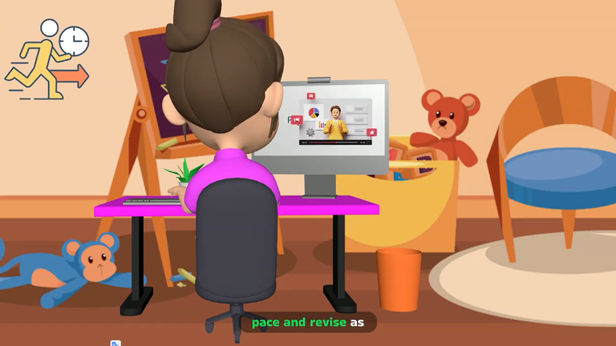
Lesson 3: Advantages of Flipped Learning
In the Flipped Learning approach, students can learn topics at their own pace and revise as many times as they need.
Co-funded by the European Union. Views and opinions expressed are however those of the author(s) only and do not necessarily reflect those of the European Union or Fundacja Rozwoju Systemu Edukacji. Neither the European Union nor the granting authority can be held responsible for them. Project no. 2022-1-PL01-KA220-HED-000086524

Slide 4
Lesson 3: Advantages of Flipped Learning
In-class time allows students to interact more with the teacher and classmates.

Slide 5

Lesson 3: Advantages of Flipped Learning
This model encourages students to take a more active role in the learning process and enables them to take responsibility.

Slide 6

Lesson 3: Advantages of Flipped Learning
This model enables students to participate more in the learning process and gain in-depth understanding through technology-supported learning materials and active classroom activities.

Slide 7
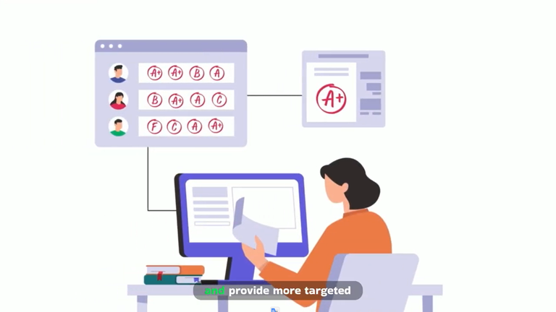
Lesson 3: Advantages of Flipped Learning
Teachers can monitor students' progress in online activities and provide more targeted support where they need it.

Slide 8

Lesson 3: Advantages of Flipped Learning
This model increases students' greater participation and motivation in the learning process.

Slide 9
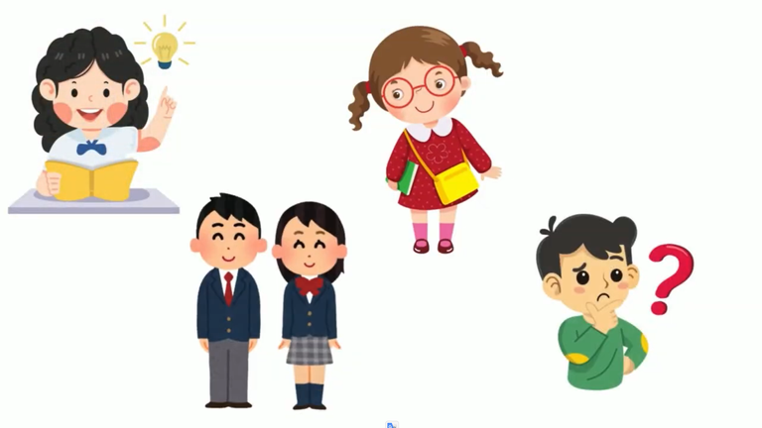
Lesson 3: Advantages of Flipped Learning
Flipped Learning can better respond to each student's individual learning needs and appeals to students with different learning styles.

Slide 10
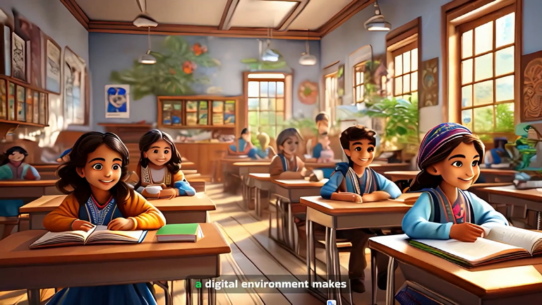
Lesson 3: Advantages of Flipped Learning
Presenting course materials in a digital environment makes it easier for students from different socio-economic backgrounds to access educational resources.

Slide 11
Conclusion
The Flipped Learning model promotes active student participation and responsibility by allowing self-paced learning and in-depth understanding through digital resources.
It facilitates teacher-student interaction, supports diverse learning styles, and ensures equitable access to educational materials, enhancing motivation and personalized support.

Slide 12
Thank you for your attention!
Co-funded by the European Union. Views and opinions expressed are however those of the author(s) only and do not necessarily reflect those of the European Union or Fundacja Rozwoju Systemu Edukacji. Neither the European Union nor the granting authority can be held responsible for them. Project no. 2022-1-PL01-KA220-HED-000086524

Slide 13

This document may be copied, reproduced or modified according to the above rules.
In addition, an acknowledgement of the authors of the document and
all applicable portions of the copyright notice must be clearly referenced.
All rights reserved. © Copyright 2023 RbtsInMath

