Slide 1
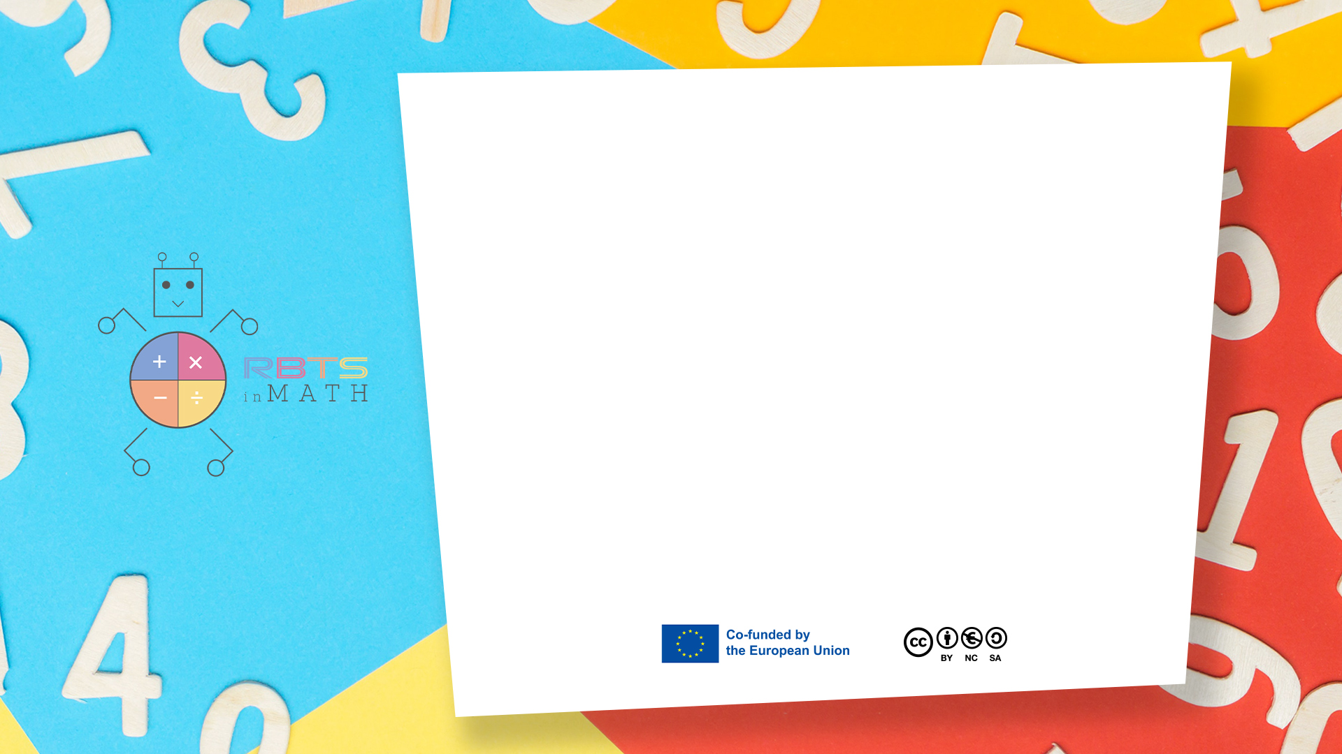
RbtsInMath: Developing Mathematics Achievement
through Using Robotics Applications in Flipped Learning
2022-1-PL01-KA220-HED-000089820
MODULE 6: FLIPPED LEARNING AND ITS PRACTICES IN PRIMARY SCHOOLS
Lesson 6.5: Flipped Learning Examples in Primary Education
Co-funded by the European Union. Views and opinions expressed are however those of the author(s) only and do not necessarily reflect those of the European Union or Fundacja Rozwoju Systemu Edukacji. Neither the European Union nor the granting authority can be held responsible for them.

Slide 2


MODULE 6:
FLIPPED LEARNING AND ITS PRACTICES IN PRIMARY SCHOOLS
Lesson 6.5: Flipped Learning Examples in Primary Education
Prepared by:
All the pictures and photographs used in this publication are royalty-free, chosen from open sources.

Slide 3
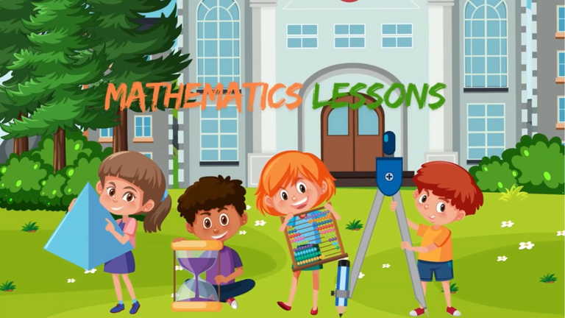
Lesson 5: Flipped Learning Examples in Primary Education

Slide 4
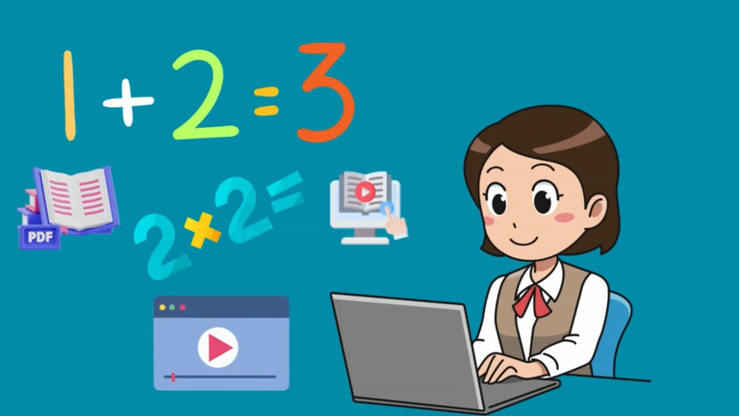
Lesson 5: Flipped Learning Examples in Primary Education
At home teachers create videos or interactive lessons on addition and subtraction.

Slide 5
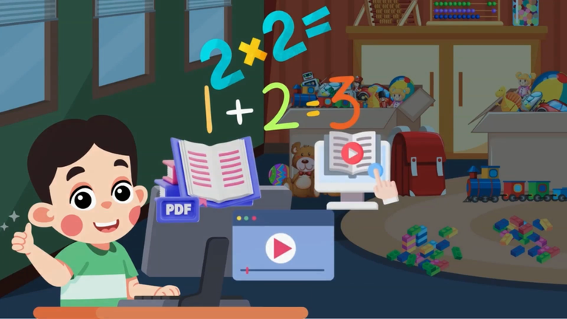
Lesson 5: Flipped Learning Examples in Primary Education
Students watch videos or interactive lessons prepared by their teachers on their computers or tablets at home.

Slide 6
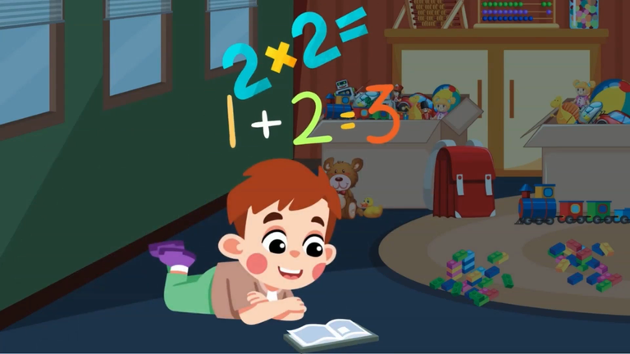
Lesson 5: Flipped Learning Examples in Primary Education
They read books on these subjects when necessary.

Slide 7
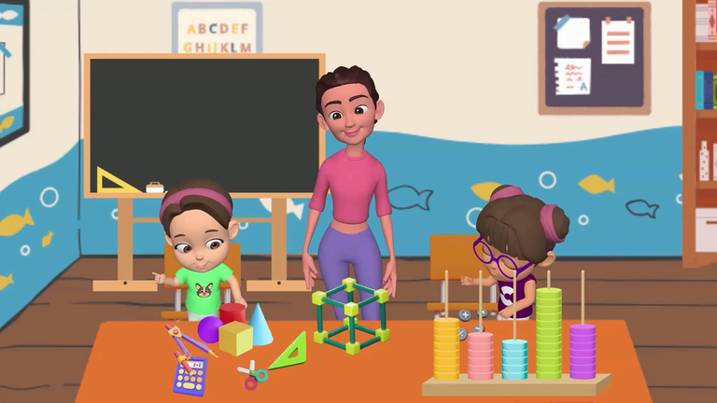
Lesson 5: Flipped Learning Examples in Primary Education
Students engage in group work games or problem-solving activities to apply these.

Slide 8

Lesson 5: Flipped Learning Examples in Primary Education
Working individually or in small groups the teacher explains points that students do not understand.

Slide 9
Lesson 5: Flipped Learning Examples in Primary Education
Working individually or in small groups the teacher explains points that students do not understand.

Slide 10
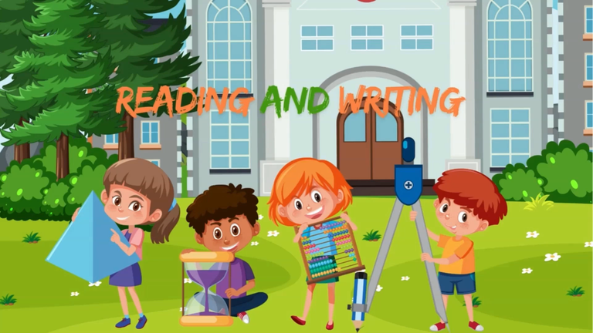
Lesson 5: Flipped Learning Examples in Primary Education

Slide 11

Lesson 5: Flipped Learning Examples in Primary Education
The teacher prepares a story about reading and writing and questions and discussion topics related to this story.

Slide 12
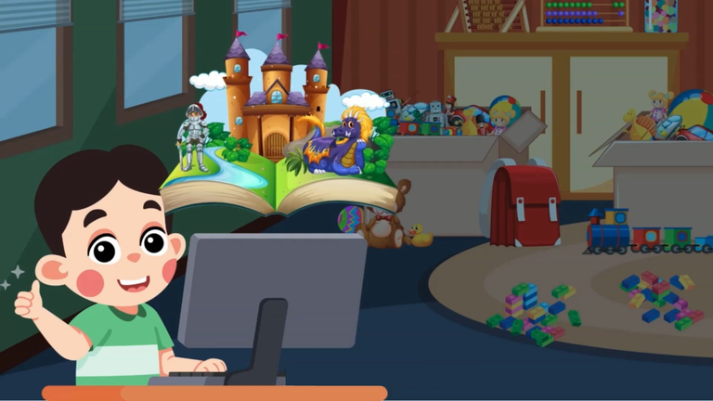
Lesson 5: Flipped Learning Examples in Primary Education
Students watch the story prepared by their teacher at home or read a book about this story.

Slide 13
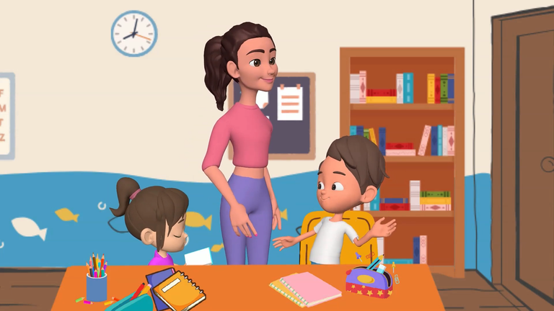
Lesson 5: Flipped Learning Examples in Primary Education
In class students discuss the story they read conduct character analysis and perform creative writing activities.
They may also dramatize the story or retell it in comic form.

Slide 14
Conclusion
Flipped Learning in primary education fosters active, student-centered learning by having students review instructional content at home and engage in hands-on activities in class.
This approach enhances understanding, promotes collaboration, and develops critical thinking skills, making learning more engaging and effective for young students.

Slide 15
Thank you for your attention!
Co-funded by the European Union. Views and opinions expressed are however those of the author(s) only and do not necessarily reflect those of the European Union or Fundacja Rozwoju Systemu Edukacji. Neither the European Union nor the granting authority can be held responsible for them. Project no. 2022-1-PL01-KA220-HED-000086524

Slide 16
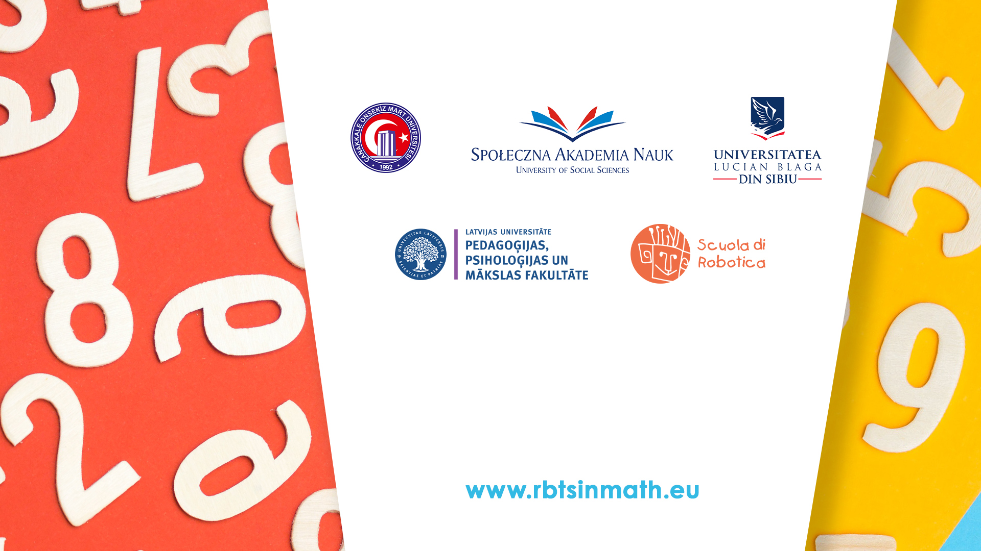
This document may be copied, reproduced or modified according to the above rules.
In addition, an acknowledgement of the authors of the document and
all applicable portions of the copyright notice must be clearly referenced.
All rights reserved. © Copyright 2023 RbtsInMath

