Slide 1

RbtsInMath: Developing Mathematics Achievement
through Using Robotics Applications in Flipped Learning
2022-1-PL01-KA220-HED-000089820
MODULE 7:
TEACHING FLIPPED LEARNING AND ITS PRACTICES IN HIGHER EDUCATION INSTITUTIONS
Lesson 7.1: Engagement, collaboration
and successful lessons through
Flipped Learning
Co-funded by the European Union. Views and opinions expressed are however those of the author(s) only and do not necessarily reflect those of the European Union or Fundacja Rozwoju Systemu Edukacji. Neither the European Union nor the granting authority can be held responsible for them.

Slide 2


MODULE 7:
TEACHING FLIPPED LEARNING AND ITS PRACTICES IN HIGHER EDUCATION INSTITUTIONS
Lesson 7.1: Engagement, collaboration
and successful lessons through Flipped Learning
Prepared by:
All the pictures and photographs used in this publication are royalty-free, chosen from open sources.

Slide 3
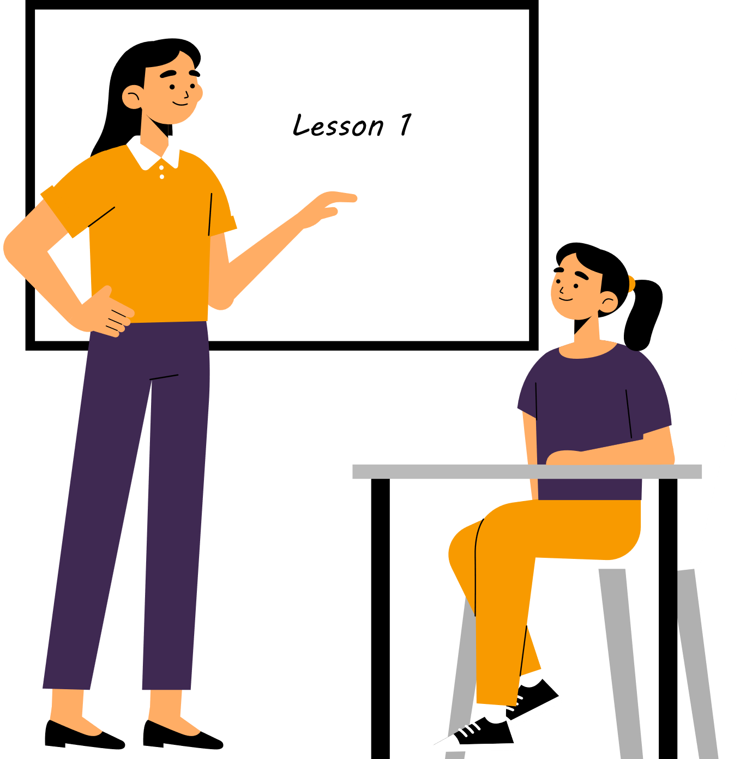
Engagement, collaboration and successful lessons through Flipped Learning
The teacher in the classroom explains to the students what flipped learning is.
Co-funded by the European Union. Views and opinions expressed are however those of the author(s) only and do not necessarily reflect those of the European Union or Fundacja Rozwoju Systemu Edukacji. Neither the European Union nor the granting authority can be held responsible for them. Project no. 2022-1-PL01-KA220-HED-000086524

Slide 4

Engagement, collaboration
and successful lessons through Flipped Learning
Students study according to the teacher's information
Co-funded by the European Union. Views and opinions expressed are however those of the author(s) only and do not necessarily reflect those of the European Union or Fundacja Rozwoju Systemu Edukacji. Neither the European Union nor the granting authority can be held responsible for them. Project no. 2022-1-PL01-KA220-HED-000086524

Slide 5

Engagement, collaboration
and successful lessons through Flipped Learning
The next lesson follows in which the teacher meets with the initially prepared students to fix the knowledge gained at home.
Co-funded by the European Union. Views and opinions expressed are however those of the author(s) only and do not necessarily reflect those of the European Union or Fundacja Rozwoju Systemu Edukacji. Neither the European Union nor the granting authority can be held responsible for them. Project no. 2022-1-PL01-KA220-HED-000086524

Slide 6


Engagement, collaboration
and successful lessons through Flipped Learning
Students make a description of the concept of Flipped Learning, make a representation through a scheme created by them through.
Co-funded by the European Union. Views and opinions expressed are however those of the author(s) only and do not necessarily reflect those of the European Union or Fundacja Rozwoju Systemu Edukacji. Neither the European Union nor the granting authority can be held responsible for them. Project no. 2022-1-PL01-KA220-HED-000086524

Slide 7

Engagement, collaboration
and successful lessons through Flipped Learning
The teacher marks the key elements of the given representation.
Co-funded by the European Union. Views and opinions expressed are however those of the author(s) only and do not necessarily reflect those of the European Union or Fundacja Rozwoju Systemu Edukacji. Neither the European Union nor the granting authority can be held responsible for them. Project no. 2022-1-PL01-KA220-HED-000086524

Slide 8


Engagement, collaboration
and successful lessons through Flipped Learning
Students are excited about the information received and involvement in the development of learning through Flipped Learning.
Co-funded by the European Union. Views and opinions expressed are however those of the author(s) only and do not necessarily reflect those of the European Union or Fundacja Rozwoju Systemu Edukacji. Neither the European Union nor the granting authority can be held responsible for them. Project no. 2022-1-PL01-KA220-HED-000086524

Slide 9
Conclusion
Flipped learning is an innovative educational approach that fundamentally changes the way students interact with academic content and the learning process.
The benefits and impact of this method: development of critical and collaborative skills, flexibility, autonomy, personalization and differentiation of training.
Co-funded by the European Union. Views and opinions expressed are however those of the author(s) only and do not necessarily reflect those of the European Union or Fundacja Rozwoju Systemu Edukacji. Neither the European Union nor the granting authority can be held responsible for them. Project no. 2022-1-PL01-KA220-HED-000086524

Slide 10
Thank you for your attention!
Co-funded by the European Union. Views and opinions expressed are however those of the author(s) only and do not necessarily reflect those of the European Union or Fundacja Rozwoju Systemu Edukacji. Neither the European Union nor the granting authority can be held responsible for them. Project no. 2022-1-PL01-KA220-HED-000086524

Slide 11

This document may be copied, reproduced or modified according to the above rules.
In addition, an acknowledgement of the authors of the document and
all applicable portions of the copyright notice must be clearly referenced.
All rights reserved. © Copyright 2023 RbtsInMath

