Slide 1
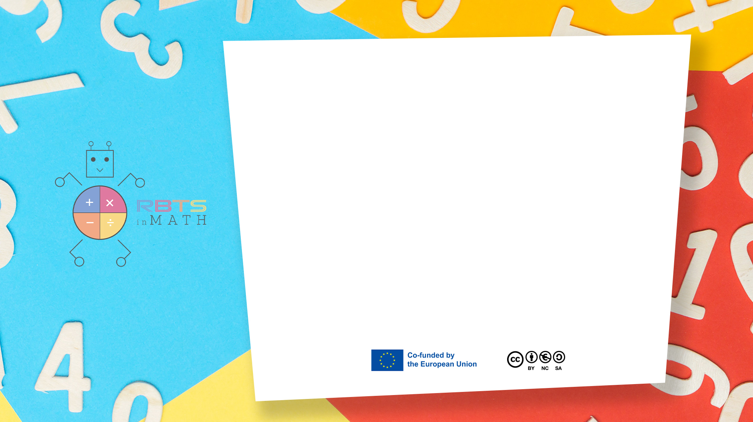
RbtsInMath: Developing Mathematics Achievement through Using Robotics Applications in Flipped Learning
2022-1-PL01-KA220-HED-000089820
MODULE 7: TEACHING FLIPPED LEARNING AND ITS PRACTICES IN HIGHER EDUCATION INSTITUTIONS
Lesson 7.5: Flipped Learning vs Traditional Learning
in Higher Education
Co-funded by the European Union. Views and opinions expressed are however those of the author(s) only and do not necessarily reflect those of the European Union or Fundacja Rozwoju Systemu Edukacji. Neither the European Union nor the granting authority can be held responsible for them.

Slide 2


MODULE 7: TEACHING FLIPPED LEARNING AND ITS PRACTICES IN HIGHER EDUCATION INSTITUTIONS
Lesson 7.5: Flipped Learning vs Traditional Learning in Higher Education
Prepared by:
All the pictures and photographs used in this publication are royalty-free, chosen from open sources.

Slide 3
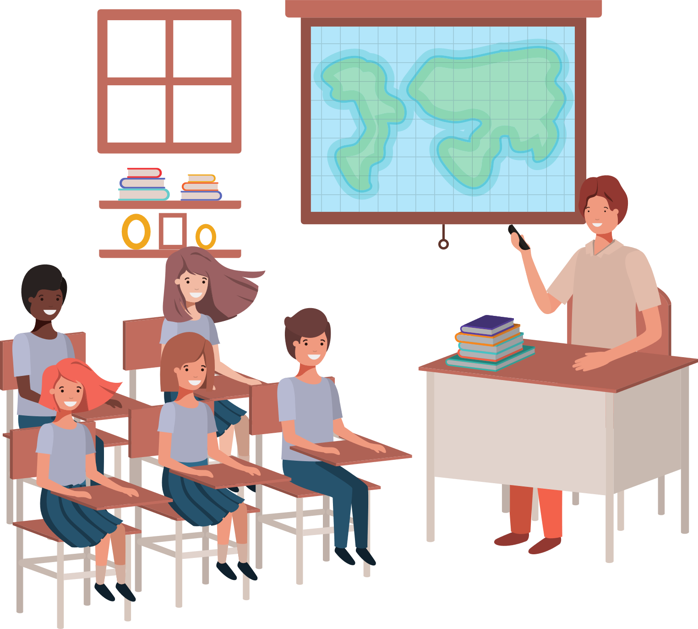
Flipped Learning vs Traditional Learning in Higher Education
Traditional classroom scene with a lecturer at the front and students sitting in rows.T
Co-funded by the European Union. Views and opinions expressed are however those of the author(s) only and do not necessarily reflect those of the European Union or Fundacja Rozwoju Systemu Edukacji. Neither the European Union nor the granting authority can be held responsible for them. Project no. 2022-1-PL01-KA220-HED-000086524

Slide 4
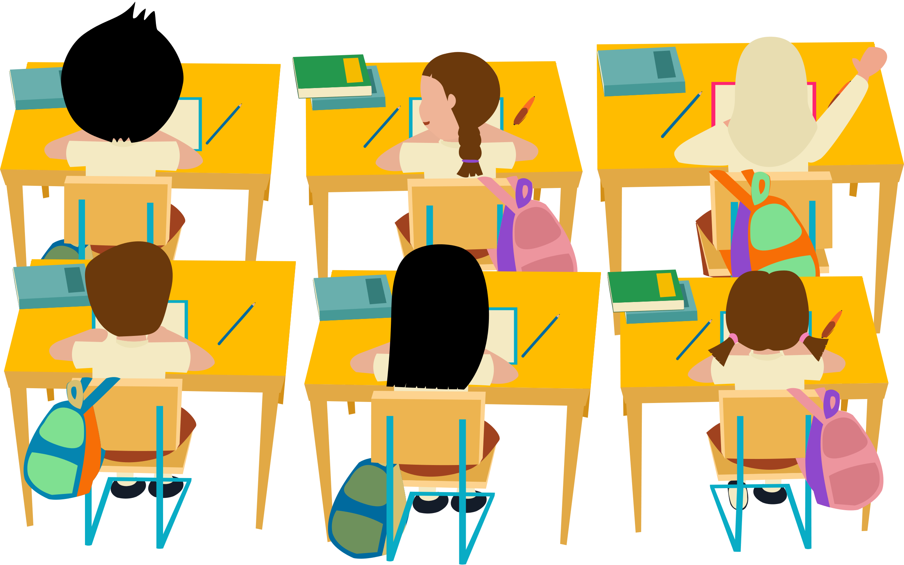
Flipped Learning vs Traditional Learning in Higher Education
Traditional classroom scene showing students taking notes while the instructor lectures.
Co-funded by the European Union. Views and opinions expressed are however those of the author(s) only and do not necessarily reflect those of the European Union or Fundacja Rozwoju Systemu Edukacji. Neither the European Union nor the granting authority can be held responsible for them. Project no. 2022-1-PL01-KA220-HED-000086524

Slide 5
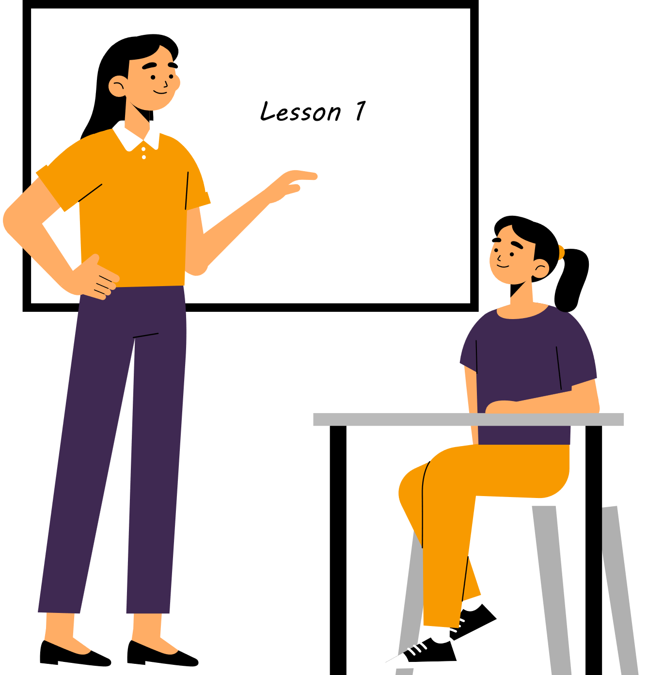
Flipped Learning vs Traditional Learning in Higher Education
Traditional learning provides a structured environment and direct interaction with the instructor.
Co-funded by the European Union. Views and opinions expressed are however those of the author(s) only and do not necessarily reflect those of the European Union or Fundacja Rozwoju Systemu Edukacji. Neither the European Union nor the granting authority can be held responsible for them. Project no. 2022-1-PL01-KA220-HED-000086524

Slide 6

Flipped Learning vs Traditional Learning in Higher Education
Flipped classroom setup showing students engaging with pre-recorded lectures or materials on their devices.
Co-funded by the European Union. Views and opinions expressed are however those of the author(s) only and do not necessarily reflect those of the European Union or Fundacja Rozwoju Systemu Edukacji. Neither the European Union nor the granting authority can be held responsible for them. Project no. 2022-1-PL01-KA220-HED-000086524

Slide 7

Flipped Learning vs Traditional Learning in Higher Education
Flipped classroom scene showing students engaged in discussions, group work, or hands-on activities.
Co-funded by the European Union. Views and opinions expressed are however those of the author(s) only and do not necessarily reflect those of the European Union or Fundacja Rozwoju Systemu Edukacji. Neither the European Union nor the granting authority can be held responsible for them. Project no. 2022-1-PL01-KA220-HED-000086524

Slide 8


Flipped Learning vs Traditional Learning in Higher Education
Flipped Learning offers self-paced learning, deeper engagement, and personalized instruction tailored to individual student needs
Co-funded by the European Union. Views and opinions expressed are however those of the author(s) only and do not necessarily reflect those of the European Union or Fundacja Rozwoju Systemu Edukacji. Neither the European Union nor the granting authority can be held responsible for them. Project no. 2022-1-PL01-KA220-HED-000086524

Slide 9
Conclusion
Split screen showing traditional and flipped classrooms again.
Both approaches have their merits, but Flipped Learning offers a more student-centered and engaging educational experience.
Co-funded by the European Union. Views and opinions expressed are however those of the author(s) only and do not necessarily reflect those of the European Union or Fundacja Rozwoju Systemu Edukacji. Neither the European Union nor the granting authority can be held responsible for them. Project no. 2022-1-PL01-KA220-HED-000086524

Slide 10
Thank you for your attention!
Co-funded by the European Union. Views and opinions expressed are however those of the author(s) only and do not necessarily reflect those of the European Union or Fundacja Rozwoju Systemu Edukacji. Neither the European Union nor the granting authority can be held responsible for them. Project no. 2022-1-PL01-KA220-HED-000086524

Slide 11

This document may be copied, reproduced or modified according to the above rules. In addition, an acknowledgement of the authors of the document and all applicable portions of the copyright notice must be clearly referenced.
All rights reserved. © Copyright 2023 RbtsInMath

