Slide 1
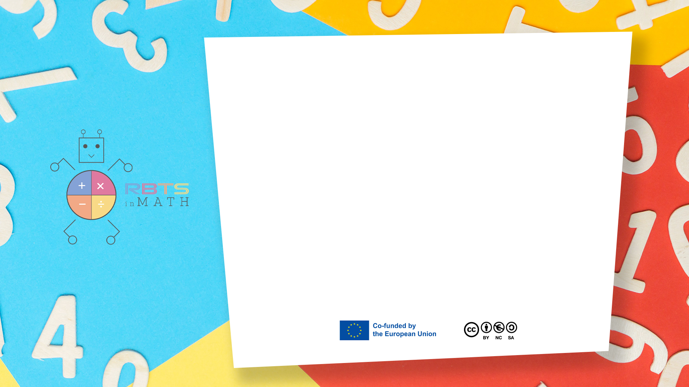
RbtsInMath: Developing Mathematics Achievement through Using Robotics Applications in Flipped Learning
2022-1-PL01-KA220-HED-000089820
MODULE 8: HOW TO USE ROBOTICS TO TEACH MATHEMATICS IN PRIMARY SCHOOLS
Lesson 8.3: Musical Walk
Co-funded by the European Union. Views and opinions expressed are however those of the author(s) only and do not necessarily reflect those of the European Union or Fundacja Rozwoju Systemu Edukacji. Neither the European Union nor the granting authority can be held responsible for them.

Slide 2


MODULE 8: HOW TO USE ROBOTICS TO TEACH MATHEMATICS IN PRIMARY SCHOOLS
Lesson 8.3: Musical Walk
Prepared by:
All the pictures and photographs used in this publication are royalty-free, chosen from open sources.

Slide 3
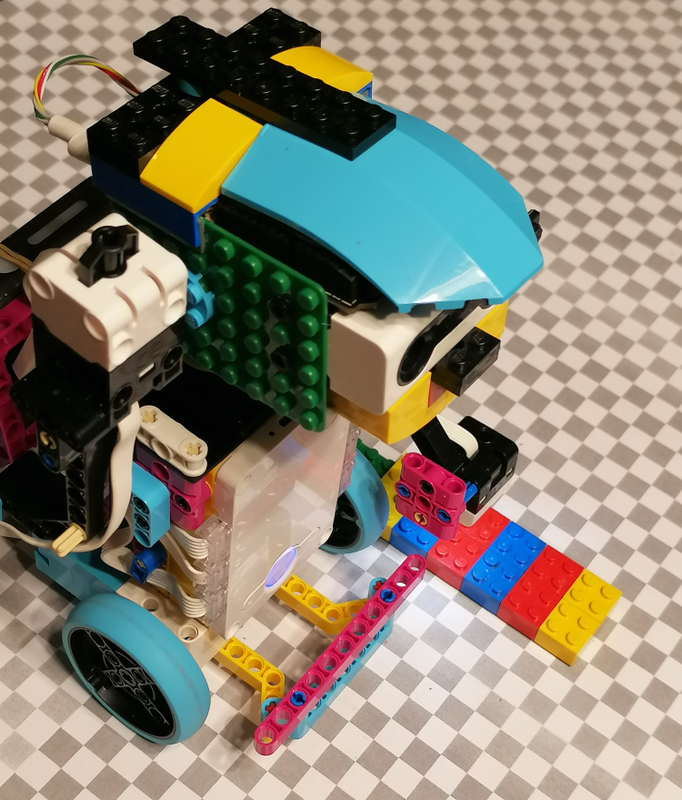
Musical Walk
This game reinforces pattern recognition and sequencing by linking colors to musical notes as the robot follows a path.

Slide 4
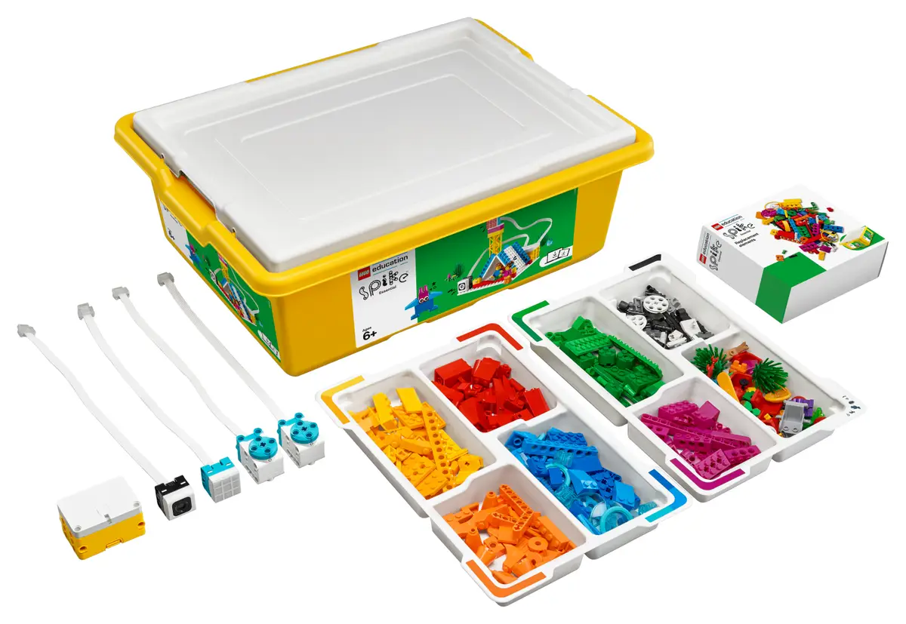
Musical Walk
System used - LEGO Spike Prime:
LEGO Spike Prime is a STEAM-focused robotics kit aimed at educational environments, combining programmable LEGO blocks with motors and sensors. It features a powerful programmable hub, equipped with a 6-axis gyroscope, and various sensors, including a color sensor, force sensor, and distance sensor.

Slide 5
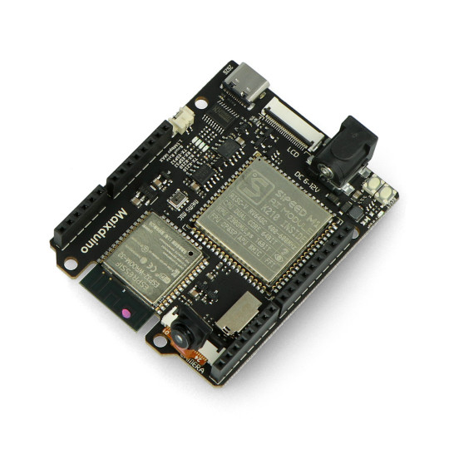
Musical Walk
Additional hardware - Maixduino Development Board:
Maixduino is a development board designed for AI and IoT applications, featuring the K210 AI chip with dual-core RISC-V processors. It includes onboard capabilities for machine vision, sound processing, and other edge AI applications.

Slide 6

Musical Walk
Scenario outline:
1. Explanation of the rules of the game
2. Example of a child playing with a robot
3. Summary

Slide 7

Musical Walk
Explanation of the rules of the game
The teacher introduces himself and announces the presentation of the game

Slide 8

Musical Walk
Explanation of the rules of the game
The teacher explains what the game looks like, what is necessary to run it and how the game works step by step

Slide 9
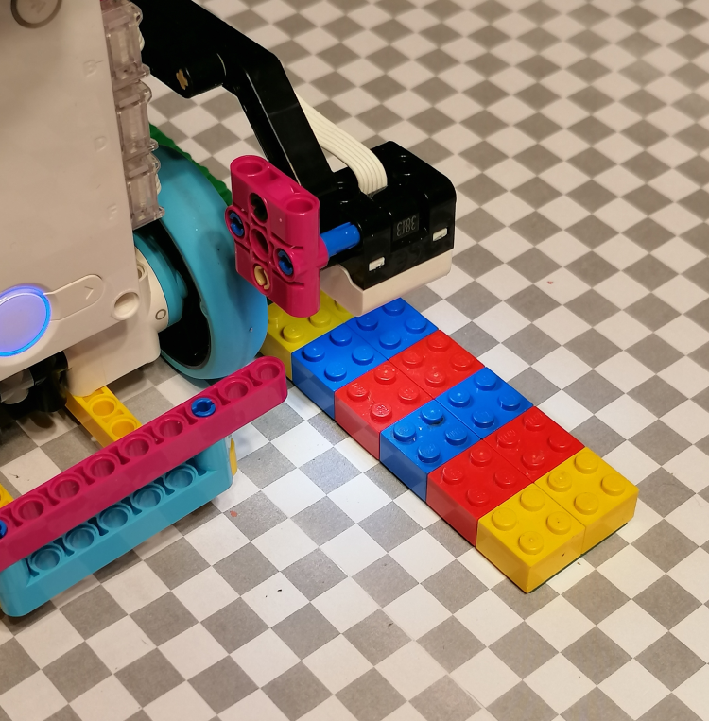
Musical Walk
Explanation of the rules of the game
The teacher focuses on the role of the robot’s colour sensor and motors.

Slide 10
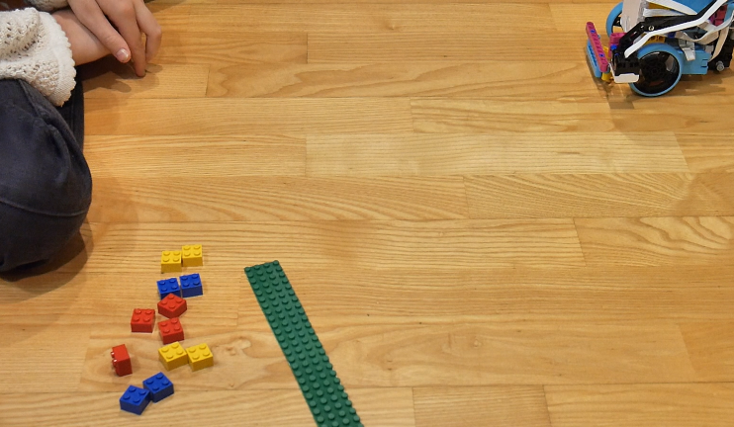
Musical Walk
Example of a child playing with a robot
The child creates a sequence of colored blocks coding a short melody for the robot.

Slide 11
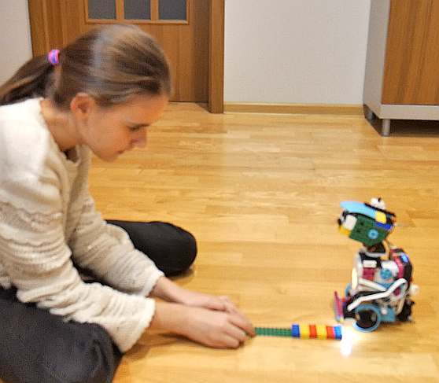
Musical Walk
Example of a child playing with a robot
The child places them on the floor at the colour sensor of the robot.

Slide 12
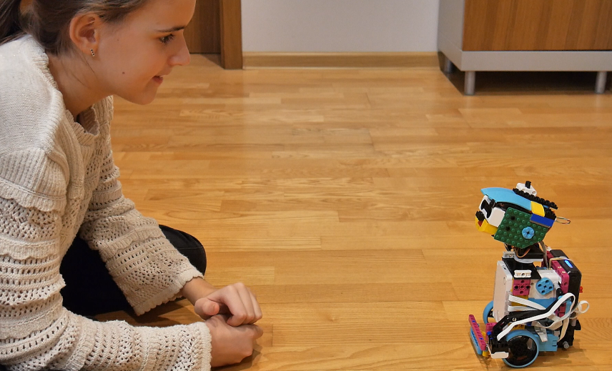
Musical Walk
Example of a child playing with a robot
The child listens as the robot plays composed sequence of note sounds.

Slide 13

Musical Walk
Summary
The teacher explains that this game reinforces pattern recognition and sequencing by connecting colors to musical notes. Students develop a basic understanding of rhythm and order as they follow their color-coded paths to create a melody.

Slide 14
Conclusion
This game reinforces pattern recognition by connecting colors to musical notes, helping students understand sequencing and auditory patterns. By creating and following their own color-coded paths, students learn the basics of rhythm, order, and sound association. The combination of music and movement in this game promotes a multisensory approach to learning patterns.

Slide 15
Thank you for your attention!
Co-funded by the European Union. Views and opinions expressed are however those of the author(s) only and do not necessarily reflect those of the European Union or Fundacja Rozwoju Systemu Edukacji. Neither the European Union nor the granting authority can be held responsible for them. Project no. 2022-1-PL01-KA220-HED-000086524

Slide 16
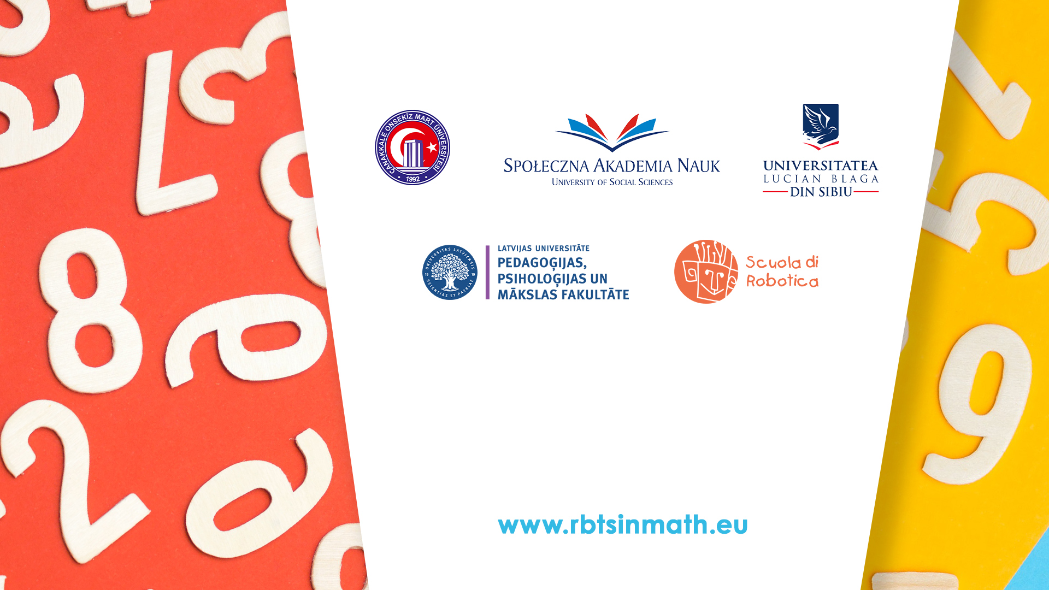
This document may be copied, reproduced or modified according to the above rules. In addition, an acknowledgement of the authors of the document and all applicable portions of the copyright notice must be clearly referenced.
All rights reserved. © Copyright 2023 RbtsInMath

