Slide 1

RbtsInMath: Developing Mathematics Achievement through Using Robotics Applications in Flipped Learning
2022-1-PL01-KA220-HED-000089820
MODULE 9: DEVELOPMENT OF COMPUTATIONAL THINKING
Lesson 9.1.2: Main principles of analytical-algorithmic thinking
Co-funded by the European Union. Views and opinions expressed are however those of the author(s) only and do not necessarily reflect those of the European Union or Fundacja Rozwoju Systemu Edukacji. Neither the European Union nor the granting authority can be held responsible for them.

Slide 2


MODULE 9: DEVELOPMENT OF COMPUTATIONAL THINKING
Lesson 9.1.2: Main principles of analytical-algorithmic thinking
Prepared by:
All the pictures and photographs used in this publication are royalty-free, chosen from open sources.

Slide 3

MAIN PRINCIPLES OF ANALYTICAL-ALGORITHMIC THINKING
Understanding the relationship between the computer and the human being
It involves recognizing the interplay between technology and human cognition, enabling individuals to leverage computational tools effectively in problem-solving processes

Slide 4

MAIN PRINCIPLES OF ANALYTICAL-ALGORITHMIC THINKING
The ability to design algorithms for problem solving
Analytical-algorithmic thinking emphasizes the development of systematic procedures or algorithms to address complex challenges, promoting structured problem-solving approaches

Slide 5

MAIN PRINCIPLES OF ANALYTICAL-ALGORITHMIC THINKING
Abstraction and the ability to find and use information through the modelling of information
This principle underscores the importance of abstraction in simplifying complex information and leveraging it effectively to inform decision-making and problem-solving processes

Slide 6

MAIN PRINCIPLES OF ANALYTICAL-ALGORITHMIC THINKING
Analysing problems: possible solutions and anticipating other problems
It involves analyzing problems thoroughly, exploring potential solutions, and anticipating future challenges or consequences to develop robust and proactive problem-solving strategies

Slide 7

MAIN PRINCIPLES OF ANALYTICAL-ALGORITHMIC THINKING
Communication: being able to explain problems and possible solutions to them
Effective communication skills are essential in analytical-algorithmic thinking, enabling individuals to articulate problems, propose solutions, and collaborate effectively with others to achieve common goals

Slide 8

MAIN PRINCIPLES OF ANALYTICAL-ALGORITHMIC THINKING
Teamwork - actively working with others to solve problems and achieve results
Active collaboration with others fosters synergy and collective intelligence, enabling teams to tackle complex problems more effectively through shared insights, expertise, and resources

Slide 9
Conclusion
By embracing these principles, individuals can cultivate a holistic problem-solving mindset that is grounded in analytical thinking, algorithmic design, effective communication, and collaborative teamwork. This approach provides individuals and teams with the tools to navigate complex challenges, innovate, and achieve sustainable solutions that drive positive outcomes in various domains and industries.

Slide 10
Thank you for your attention!
Co-funded by the European Union. Views and opinions expressed are however those of the author(s) only and do not necessarily reflect those of the European Union or Fundacja Rozwoju Systemu Edukacji. Neither the European Union nor the granting authority can be held responsible for them. Project no. 2022-1-PL01-KA220-HED-000086524

Slide 11
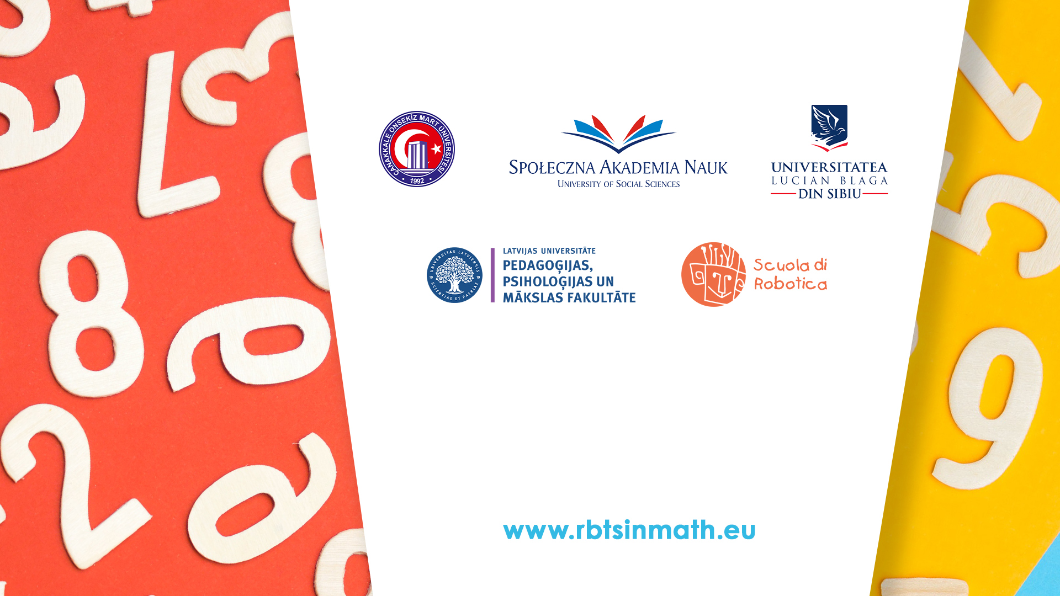
This document may be copied, reproduced or modified according to the above rules. In addition, an acknowledgement of the authors of the document and all applicable portions of the copyright notice must be clearly referenced.
All rights reserved. © Copyright 2023 RbtsInMath

