Slide 1

RbtsInMath: Developing Mathematics Achievement
through Using Robotics Applications in Flipped Learning
2022-1-PL01-KA220-HED-000089820
MODULE 9:
DEVELOPMENT OF COMPUTATIONAL THINKING
Lesson 9.1.3: Characteristics of Computational Thinking
Co-funded by the European Union. Views and opinions expressed are however those of the author(s) only and do not necessarily reflect those of the European Union or Fundacja Rozwoju Systemu Edukacji. Neither the European Union nor the granting authority can be held responsible for them.

Slide 2


MODULE 9:
DEVELOPMENT OF COMPUTATIONAL THINKING
Lesson 9.1.3: Characteristics of Computational Thinking
Prepared by:
All the pictures and photographs used in this publication are royalty-free, chosen from open sources.

Slide 3

CHARACTERISTICS OF COMPUTATIONAL THINKING
Formulation of the problem, including the use of computers or other technological solutions for its solution
It involves defining the problem statement and leveraging technological solutions to develop effective problem-solving strategies

Slide 4

CHARACTERISTICS OF COMPUTATIONAL THINKING
Logical data organisation and analysis
Computational thinking emphasizes logical organization and analysis of data to derive meaningful insights and inform decision-making

Slide 5

CHARACTERISTICS OF COMPUTATIONAL THINKING
Transformation of data with the help of abstractions, away from irrelevant data to relevant data
By abstracting away irrelevant details, computational thinking focuses on extracting relevant information from data to facilitate problem-solving

Slide 6

CHARACTERISTICS OF COMPUTATIONAL THINKING
Automatic solutions through the use of algorithmic thinking (step-by-step solution of a problem)
It entails breaking down problems into step-by-step procedures and applying algorithmic thinking to develop automated solutions

Slide 7

CHARACTERISTICS OF COMPUTATIONAL THINKING
Identification, analysis and implementation of possible solutions, with the aim of achieving the most efficient solution using the most cost-effective resources

Slide 8
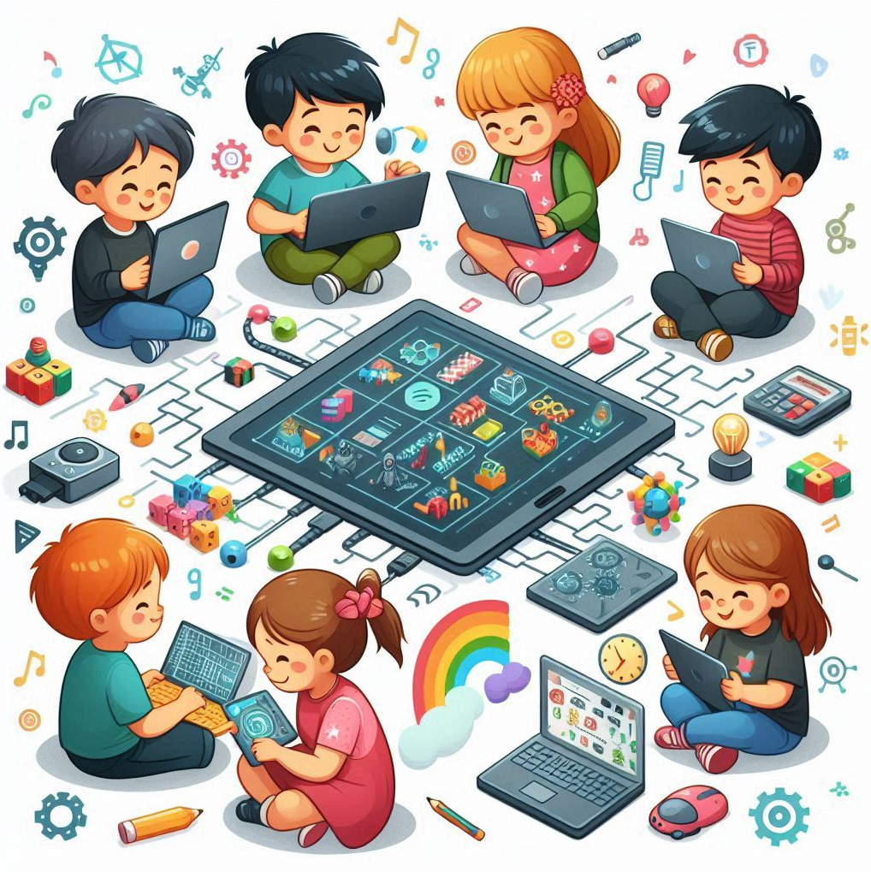
CHARACTERISTICS OF COMPUTATIONAL THINKING
Generalisation of the problem to other problems
Computational thinking promotes the generalization of problem-solving approaches, allowing insights gained from solving one problem to be applied to similar problems in different contexts

Slide 9
Conclusion
The application of computational thinking enables individuals to utilise technology in a more effective manner, facilitating the resolution of complex problems, the stimulation of innovation and the achievement of desired outcomes with optimal resource utilisation. This comprehensive approach to problem-solving is vital for navigating the complexities of the digital age and harnessing technology to create positive impacts across a range of domains and industries.

Slide 10
Thank you for your attention!
Co-funded by the European Union. Views and opinions expressed are however those of the author(s) only and do not necessarily reflect those of the European Union or Fundacja Rozwoju Systemu Edukacji. Neither the European Union nor the granting authority can be held responsible for them. Project no. 2022-1-PL01-KA220-HED-000086524

Slide 11

This document may be copied, reproduced or modified according to the above rules.
In addition, an acknowledgement of the authors of the document and
all applicable portions of the copyright notice must be clearly referenced.
All rights reserved. © Copyright 2023 RbtsInMath

