Slide 1

RbtsInMath: Developing Mathematics Achievement through Using Robotics Applications in Flipped Learning
2022-1-PL01-KA220-HED-000089820
MODULE 9: DEVELOPMENT OF COMPUTATIONAL THINKING
Lesson 9.2.1: Teaching strategies and tools for Computational Thinking
Co-funded by the European Union. Views and opinions expressed are however those of the author(s) only and do not necessarily reflect those of the European Union or Fundacja Rozwoju Systemu Edukacji. Neither the European Union nor the granting authority can be held responsible for them.

Slide 2


MODULE 9: DEVELOPMENT OF COMPUTATIONAL THINKING
Lesson 9.2.1: Teaching strategies and tools for Computational Thinking
Prepared by:
All the pictures and photographs used in this publication are royalty-free, chosen from open sources.

Slide 3

LEARNING-TEACHING ACTIVITIES FOR COMPUTATIONAL THINKING
Algorithmic Puzzles
Present students with algorithmic puzzles or challenges that require logical thinking and step-by-step problem solving. Encourage them to break down the problem, identify patterns and devise algorithms to solve it. This activity develops their algorithmic thinking skills

Slide 4

LEARNING-TEACHING ACTIVITIES FOR COMPUTATIONAL THINKING
Coding Projects
Set coding projects using block-based programming languages such as Scratch or visual programming tools such as Blockly. Students can practice computational thinking concepts while developing their coding skills by creating interactive stories, games or simulations

Slide 5

LEARNING-TEACHING ACTIVITIES FOR COMPUTATIONAL THINKING
Pattern Recognition
Presenting patterns or sequences to students, asking them to identify the rules that underlie them. This activity fosters the development of pattern recognition skills, which is an essential component of computational thinking. In order to challenge their peers, students can also create their own pattern sequences

Slide 6

LEARNING-TEACHING ACTIVITIES FOR COMPUTATIONAL THINKING
Decomposition Exercises
Present students with a complex problem and guide them to break it down into smaller, more manageable pieces. Encourage them to see how the sub-problems relate to one another and to develop strategies for solving each. This activity will enhance their ability to break down problems and to think in a modular way

Slide 7

LEARNING-TEACHING ACTIVITIES FOR COMPUTATIONAL THINKING
Robotics or Physical Computing
Use robotics kits or physical computing platforms such as Arduino to engage students in hands-on activities. As they program and control physical devices, they can apply computational thinking concepts. They can design algorithms for maze navigation, interactive sensors or task automation

Slide 8

LEARNING-TEACHING ACTIVITIES FOR COMPUTATIONAL THINKING
Data Analysis and Visualization
Introduce students to data analysis tools and guide them in the analysis and interpretation of data sets. Encourage them to use graphs and charts to visualize their findings and to identify patterns, trends and relationships within the data. This activity will enhance their ability to extract meaningful insights from data

Slide 9

LEARNING-TEACHING ACTIVITIES FOR COMPUTATIONAL THINKING
Computational Thinking Games
Incorporate computational thinking focused educational games or online platforms. These platforms often provide interactive challenges that reinforce concepts like sequence, conditional, looping and decomposing

Slide 10
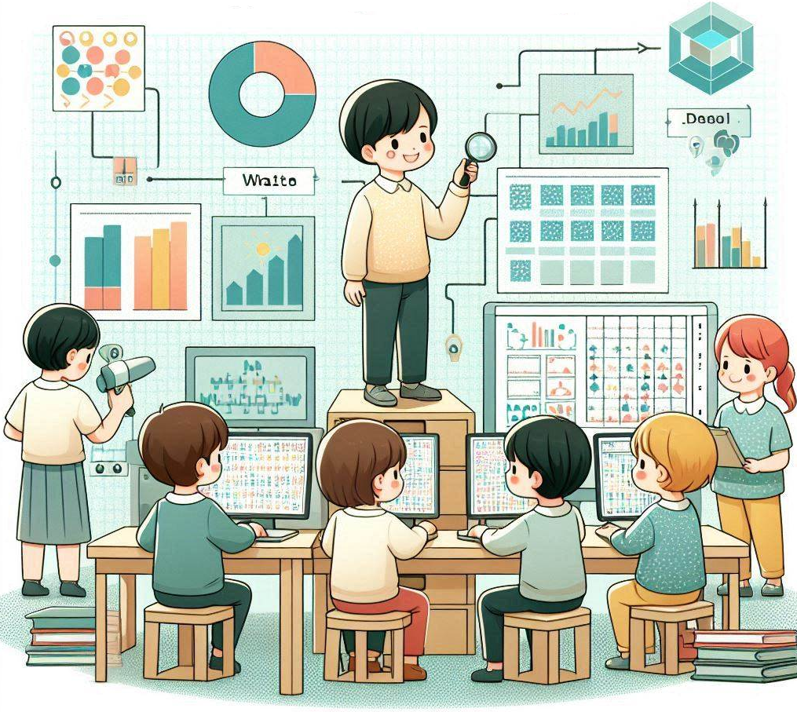
LEARNING-TEACHING ACTIVITIES FOR COMPUTATIONAL THINKING
Collaborative Problem Solving
Assign group projects or problem solving activities that require collaborating and teaming up. Students will be able to work together to solve complex problems, exchange ideas and work together to develop strategies for computational thinking. This activity promotes communication and cooperative problem solving skills

Slide 11
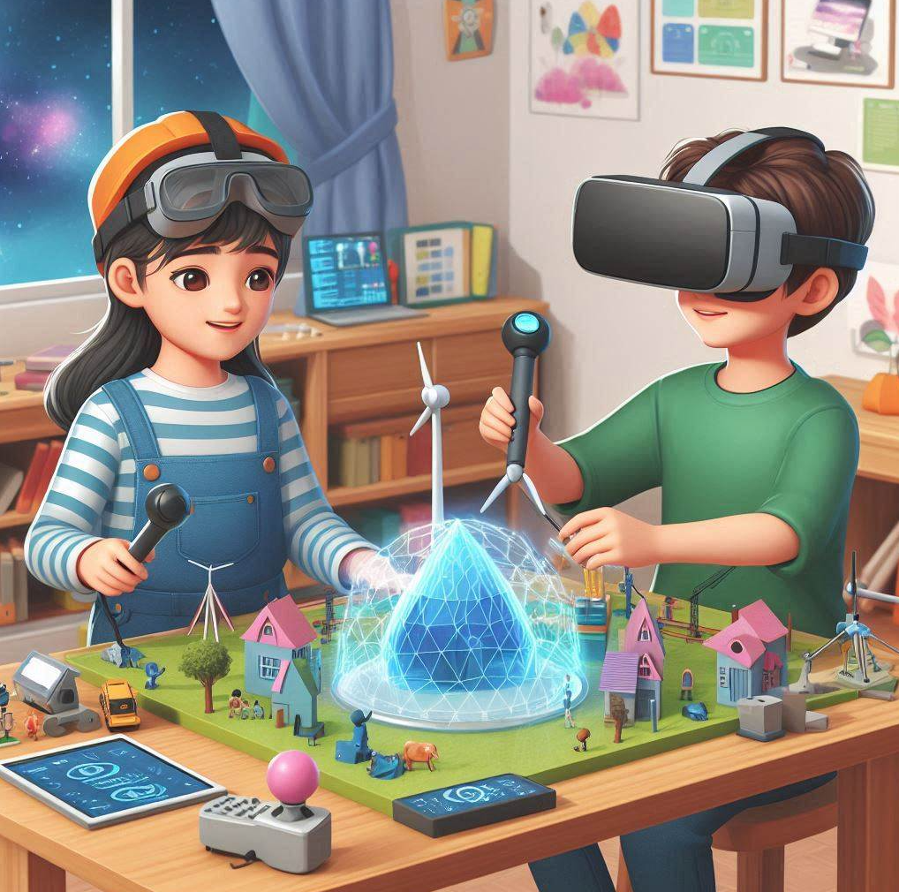
LEARNING-TEACHING ACTIVITIES FOR COMPUTATIONAL THINKING
Simulation or Modeling
Encourage students to use software tools such as NetLogo or virtual reality platforms to create simulations or models of real-world scenarios. This will enable them to use computational thinking to simulate and analyse complex systems, to predict outcomes and to understand the relationships between cause and effect

Slide 12
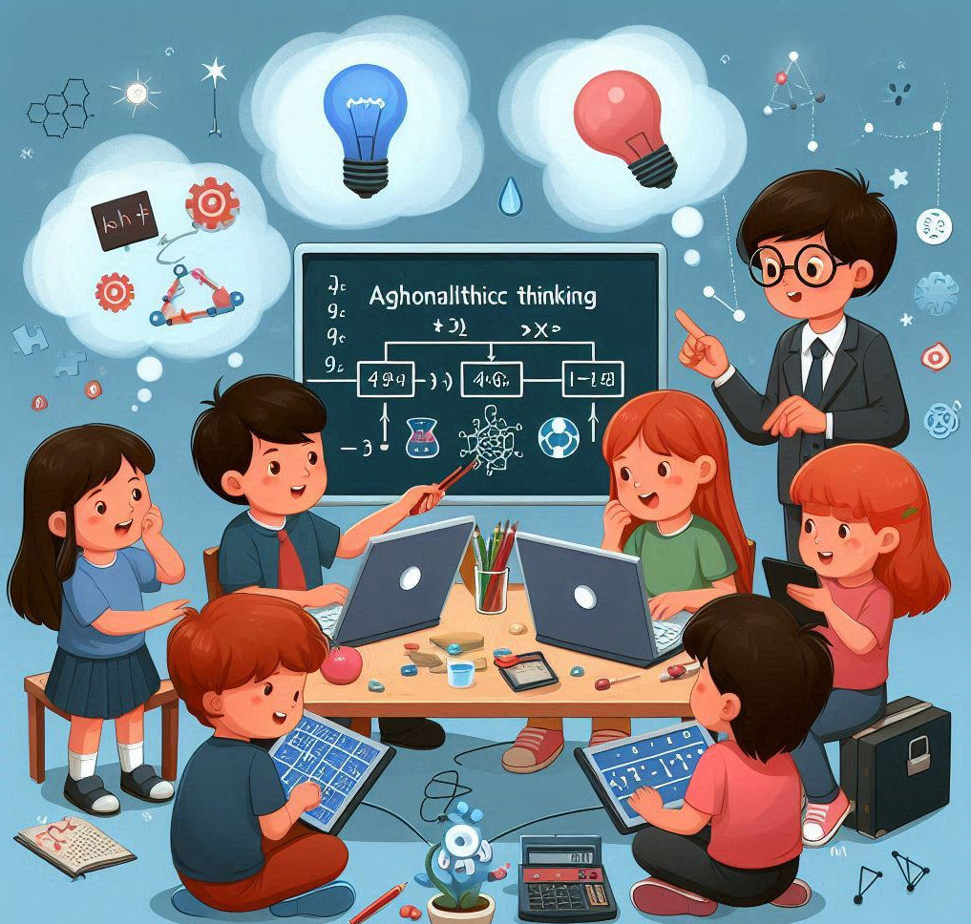
LEARNING-TEACHING ACTIVITIES FOR COMPUTATIONAL THINKING
Case Studies and Real-World Examples
Provide students with case studies or real-life examples in which computational thinking was used to solve a problem. Facilitate discussions about how computational thinking principles can be applied in different domains by discussing the strategies and tools used in these scenarios

Slide 13
Conclusion
Learning and teaching activities can be used to teach the strategies and tools of computational thinking to students.

Slide 14
Thank you for your attention!
Co-funded by the European Union. Views and opinions expressed are however those of the author(s) only and do not necessarily reflect those of the European Union or Fundacja Rozwoju Systemu Edukacji. Neither the European Union nor the granting authority can be held responsible for them. Project no. 2022-1-PL01-KA220-HED-000086524

Slide 15

This document may be copied, reproduced or modified according to the above rules. In addition, an acknowledgement of the authors of the document and all applicable portions of the copyright notice must be clearly referenced.
All rights reserved. © Copyright 2023 RbtsInMath

