Slide 1

RbtsInMath: Developing Mathematics Achievement
through Using Robotics Applications in Flipped Learning
2022-1-PL01-KA220-HED-000089820
MODULE 9:
DEVELOPMENT OF COMPUTATIONAL THINKING
Lesson 9.2.2: Components of Computational Thinking
Co-funded by the European Union. Views and opinions expressed are however those of the author(s) only and do not necessarily reflect those of the European Union or Fundacja Rozwoju Systemu Edukacji. Neither the European Union nor the granting authority can be held responsible for them.

Slide 2


MODULE 9:
DEVELOPMENT OF COMPUTATIONAL THINKING
Lesson 9.2.2: Components of Computational Thinking
Prepared by:
All the pictures and photographs used in this publication are royalty-free, chosen from open sources.

Slide 3

COMPONENTS OF COMPUTATIONAL THINKING
Abstraction
Abstraction is the process of simplifying an artefact by removing unnecessary details, making it understandable. The skill lies in simplifying the problem without losing important information, and in choosing the right details to hide

Slide 4

COMPONENTS OF COMPUTATIONAL THINKING
Algorithmic thinking
Algorithmic thinking is the process of finding a solution through a clearly defined set of steps

Slide 5

COMPONENTS OF COMPUTATIONAL THINKING
Automation
Automation is a labour-saving process that instructs a computer to perform repetitive tasks quickly and efficiently, exceeding human processing capabilities

Slide 6
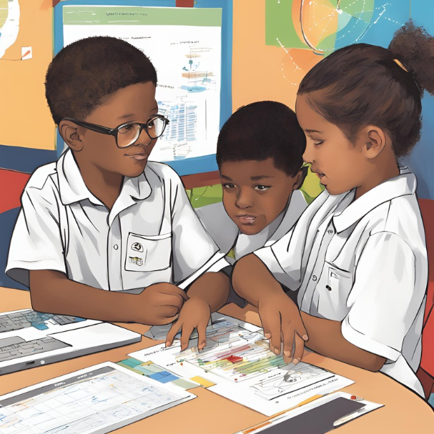
COMPONENTS OF COMPUTATIONAL THINKING
Decomposition
Decomposition is a cognitive approach in which artefacts are broken down into their component parts. It becomes easier to solve complex problems, gain better insight into new situations and design large systems by understanding, solving, developing and evaluating these parts separately

Slide 7

COMPONENTS OF COMPUTATIONAL THINKING
Debugging
Debugging is a systematic process of analysis and evaluation. It uses techniques such as testing, tracing and reasoning to predict and verify

Slide 8
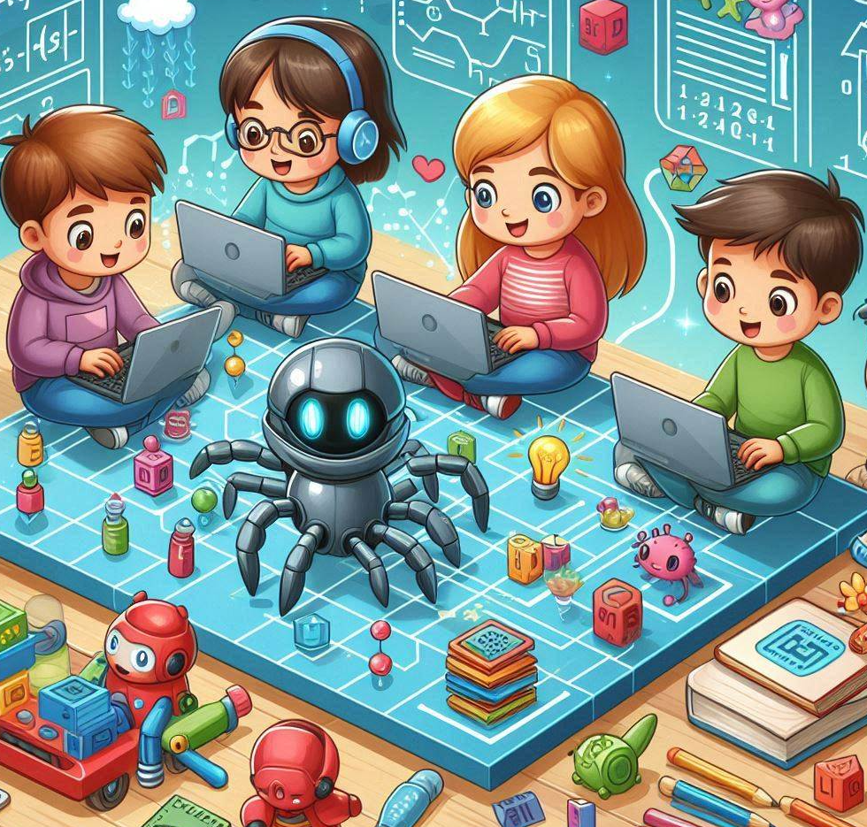
COMPONENTS OF COMPUTATIONAL THINKING
Generalization
Generalisation involves recognizing patterns, similarities and connections and using them to solve new problems based on previous solutions. It makes use of previous experience so that algorithms designed for specific problems can be adapted for the solution of a whole class of similar problems

Slide 9
Conclusion
These components constitute the basis of computational thinking, endowing individuals with the capacity to address intricate problems, innovate, and adapt to the rapidly evolving technological landscape. By acquiring proficiency in these abilities, individuals can effectively navigate the intricacies of the digital age and fully leverage the transformative potential of computing to drive positive societal change.

Slide 10
Thank you for your attention!
Co-funded by the European Union. Views and opinions expressed are however those of the author(s) only and do not necessarily reflect those of the European Union or Fundacja Rozwoju Systemu Edukacji. Neither the European Union nor the granting authority can be held responsible for them. Project no. 2022-1-PL01-KA220-HED-000086524

Slide 11

This document may be copied, reproduced or modified according to the above rules.
In addition, an acknowledgement of the authors of the document and
all applicable portions of the copyright notice must be clearly referenced.
All rights reserved. © Copyright 2023 RbtsInMath

